Slide 1
Wednesday February 18, 2015 Mr. Goblirsch – U.S. History
OBJECTIVE – Students Will Be Able To – SWBAT:
Determine how people qualify for Social Security compensation.
AGENDA:
WARM-UP: Relevance Questions
PRIOR KNOWLEDGE: Relief, Recovery, Reform
CONCEPT: Social Security
SKILL: Analyzing Quotes
CLOSURE: Social Security Scenarios
Relevance Questions WARM-UP: (Follow the directions below)
***2 Minutes***
Think about the questions below and write your answers in your notebook.
Do you have a grandparent over 65 years old?
Do you know somebody who has been unemployed in the last year or two?
Do you know somebody who has been injured and no longer able to work?

Slide 2
Objective: SWBAT - Students Will Be Able To:
Determine how people qualify for Social Security compensation.
What will we be doing today? Today we will_______.
Notes:
Grade-level standard
Measurable objective from grade-level standard
T reads objective
Chorally read objective
T asks what is our objective?
Tell your partner (A tell B, B tell A)
What is our objective?
Choral response or TPS followed by RS

Slide 3
Prior Knowledge
OBJECTIVE – SWBAT:
Determine how people qualify for Social Security compensation.
NEW DEAL
Relief - Provide support for those impacted by the Great Depression
Recovery - Rebuild the economy and regain the idea of the American Dream
Reform - Establish policies that will prevent another economic disaster
STRUCTURED ACADEMIC DISCUSSION:
One area FDR’s New Deal addressed to provide Relief, Recovery, or Reform was …

Slide 4
Concept
OBJECTIVE – SWBAT:
Determine how people qualify for Social Security compensation.
Social Security
Central Question: What are the components of the Social Security Act of 1935 and what purpose do they serve?
Watch FDRs Social Security Act speech- delivered on August 14, 1935
Use the handout to follow along with FDRs speech establishing the Social Security Act of 1935
Notes:
Teacher reads definition or rule first
Then chorally read definition or rule together
Teacher shows an example and uses the sentence frame to explain why
Teacher shows another example then asks students to use the sentence frame with partners to explain why it’s an example
***If non-examples should be included they should be in concept
Be sure to provide a visual that will help them u

Slide 5
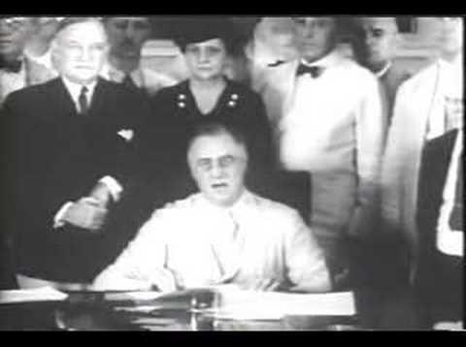
Concept
OBJECTIVE – SWBAT:
Determine how people qualify for Social Security compensation.
STRUCTURED ACADEMIC DISCUSSION:
What’s the purpose of the Social Security Act?

Slide 6
Concept
OBJECTIVE – SWBAT:
Determine how people qualify for Social Security compensation.
The four components of the Social Security Act:
Disability
Old Age
Dependent Children/Survivor
Unemployment
Notes:
Teacher reads definition or rule first
Then chorally read definition or rule together
Teacher shows an example and uses the sentence frame to explain why
Teacher shows another example then asks students to use the sentence frame with partners to explain why it’s an example
***If non-examples should be included they should be in concept
Be sure to provide a visual that will help them u

Slide 7
Social Security Act of 1935
Policy Component
Purpose/Issue Being Addressed
Scenario
Disability
Old Age
Dependent Children/Survivor
Unemployment
Write your notes in the “Purpose” column

Slide 8
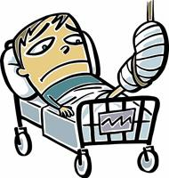
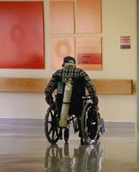
Concept
OBJECTIVE – SWBAT:
Determine how people qualify for Social Security compensation.
Disability - Unable to work based on physical or mental condition
Notes:
Teacher reads definition or rule first
Then chorally read definition or rule together
Teacher shows an example and uses the sentence frame to explain why
Teacher shows another example then asks students to use the sentence frame with partners to explain why it’s an example
***If non-examples should be included they should be in concept
Be sure to provide a visual that will help them u

Slide 9
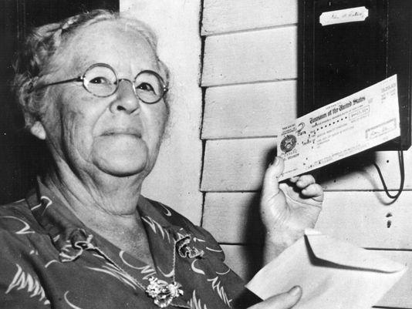
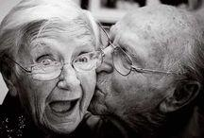
Concept
OBJECTIVE – SWBAT:
Determine how people qualify for Social Security compensation.
Old Age - Unable to work based on age of worker
Notes:
Teacher reads definition or rule first
Then chorally read definition or rule together
Teacher shows an example and uses the sentence frame to explain why
Teacher shows another example then asks students to use the sentence frame with partners to explain why it’s an example
***If non-examples should be included they should be in concept
Be sure to provide a visual that will help them u

Slide 10
Structured Academic Discussion
OBJECTIVE – SWBAT:
Determine how people qualify for Social Security compensation.
The Disability component of the Social Security Act is . . .
The Old Age component of the Social Security Act is . . .

Slide 11
Concept
OBJECTIVE – SWBAT:
Determine how people qualify for Social Security compensation.
Dependent Children/Survivor - Financial aid to families who have lost a wage earner
Notes:
Teacher reads definition or rule first
Then chorally read definition or rule together
Teacher shows an example and uses the sentence frame to explain why
Teacher shows another example then asks students to use the sentence frame with partners to explain why it’s an example
***If non-examples should be included they should be in concept
Be sure to provide a visual that will help them u

Slide 12
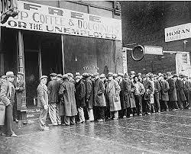
Concept
OBJECTIVE – SWBAT:
Determine how people qualify for Social Security compensation.
Unemployment - Unable to gain employment
Notes:
Teacher reads definition or rule first
Then chorally read definition or rule together
Teacher shows an example and uses the sentence frame to explain why
Teacher shows another example then asks students to use the sentence frame with partners to explain why it’s an example
***If non-examples should be included they should be in concept
Be sure to provide a visual that will help them u

Slide 13
Structured Academic Discussion
OBJECTIVE – SWBAT:
Determine how people qualify for Social Security compensation.
The Dependent children/survivor component of the Social Security Act is . . .
The Unemployment component of the Social Security Act is . . .

Slide 14
Social Security Act of 1935
Policy Component
Purpose/Issue Being Addressed
Scenario
Disability
Unable to work based on physical or mental condition
Old Age
Unable to work based on age of worker
Dependent Children/Survivor
Financial aid to families who have lost a wage earner
Unemployment
Unable to gain employment
Your chart should have this information

Slide 15
Why is this relevant to ME?
OBJECTIVE – SWBAT:
Determine how people qualify for Social Security compensation.
Raise your hand if you have a grandparent over 65 years old.
Tell your partner if you know somebody who is out of work/unemployed, or has been in the last year.
Hold up a fist (0), 1 finger (1 below), or 2 fingers (both below):
if you know someone who has been injured and unable to work or
know someone who has lost a loved one who was a primary wage earner.
S.A.D. - The Social Security Act is relevant to me because ...

Slide 16
Skill Modeling
OBJECTIVE – SWBAT:
Determine how people qualify for Social Security compensation.
“I am a boy of 12 years … My father hasn’t worked for 5 months. He went plenty times to relief, he filled out application. They won’t give us anything. I don’t know why … My father he staying home. All the time he’s crying because he can’t find work. I told him why are you crying daddy, and daddy said why shouldn’t I cry when there is nothing in the house. I feel sorry for him. That night I couldn’t sleep.”
STEPS:
Read the quote.
Identify the characteristics of the person.
Determine which component of Social Security they qualify for. (Refer to your chart).
Write a statement explaining your decision.

Slide 17
Skill Modeling
OBJECTIVE – SWBAT:
Determine how people qualify for Social Security compensation.
“I am a boy of 12 years … My father hasn’t worked for 5 months. He went plenty times to relief, he filled out application. They won’t give us anything. I don’t know why … My father he staying home. All the time he’s crying because he can’t find work. I told him why are you crying daddy, and daddy said why shouldn’t I cry when there is nothing in the house. I feel sorry for him. That night I couldn’t sleep.”
STEPS:
Read the quote.
Identify the characteristics of the person.
Determine which component of Social Security they qualify for. (Refer to your chart).
Write a statement explaining your decision.

Slide 18
Skill Modeling
OBJECTIVE – SWBAT:
Determine how people qualify for Social Security compensation.
“I am a boy of 12 years … My father hasn’t worked for 5 months. He went plenty times to relief, he filled out application. They won’t give us anything. I don’t know why … My father he staying home. All the time he’s crying because he can’t find work. I told him why are you crying daddy, and daddy said why shouldn’t I cry when there is nothing in the house. I feel sorry for him. That night I couldn’t sleep.”
STATEMENT:
This boy’s father would qualify for unemployment compensation under the Social Security Act because he is out of work and not able to find a job even though he’s been actively looking for one.

Slide 19
Skill: Guided Practice
OBJECTIVE – SWBAT:
Determine how people qualify for Social Security compensation.
“I am a widow with a son fourteen years of age and am trying to support him and myself and keep him in school on a very small sum which I make. I feel worthy of asking you about this: I am greatly in need of a coat. If you have one which you have laid aside from last season would appreciate it so much if you would send it to me.”
STEPS:
Read the quote.
Identify the characteristics of the person and discuss it with your partner.
Refer to your chart, and determine which component of Social Security they qualify for and discuss it with your partner.
Write a statement explaining your decision.

Slide 20
Skill Guided Practice
OBJECTIVE – SWBAT:
Determine how people qualify for Social Security compensation.
“I am a widow with a son fourteen years of age and am trying to support him and myself and keep him in school on a very small sum which I make. I feel worthy of asking you about this: I am greatly in need of a coat. If you have one which you have laid aside from last season would appreciate it so much if you would send it to me.”
STATEMENT:
This woman and her son would qualify for ______________ under the Social Security Act because ________________________________.

Slide 21
Skill Independent Practice
OBJECTIVE – SWBAT:
Determine how people qualify for Social Security compensation.
DIRECTIONS: Read the rest of the quotes and complete the remainder of the worksheet on your own.
STEPS:
Read the quote
Identify the characteristics of the person and discuss it with your partner
Determine which component of Social Security they qualify for and discuss it with your partner
Write a statement explaining your decision.

Slide 22
Social Security Act of 1935
Policy Component
Purpose/Issue Being Addressed
Scenario
Disability
Unable to work based on physical or mental condition
Old Age
Unable to work based on age of worker
Dependent Children/Survivor
Financial aid to families who have lost a wage earner
Unemployment
Unable to gain employment

Slide 23
Closure
OBJECTIVE – SWBAT:
Determine how people qualify for Social Security compensation.
Create scenarios for each of the four components of the Social Security Act. If you need to, refer back to the quote examples we analyzed today. Write the scenarios in the 3rd column of your Social Security chart.

Slide 24
Social Security Act of 1935
Policy Component
Purpose/Issue Being Addressed
Scenario
Disability
Old Age
Dependent Children/Survivor
Unemployment

