Slide 1
Friday March 6, 2015 Mr. Goblirsch – U.S. History
OBJECTIVE – Students Will Be Able To – SWBAT:
Analyze the purpose and evaluate the effectiveness of American propaganda during WWII.
AGENDA:
WARM-UP: Propaganda
CONCEPT: Propaganda
TASK: Analyzing Propaganda
VIDEO: Donald Duck Propaganda
***Tora Tora Tora Movie Assignment
DUE TUESDAY***
Propaganda WARM-UP: (Follow the directions below)
***5 Minutes***
Look at the poster to the right.
What do you see in this poster?
What is the purpose/goal of this poster?
Is this poster’s purpose primarily visual or verbal?
Do you think this poster’s message is effective?

Slide 2
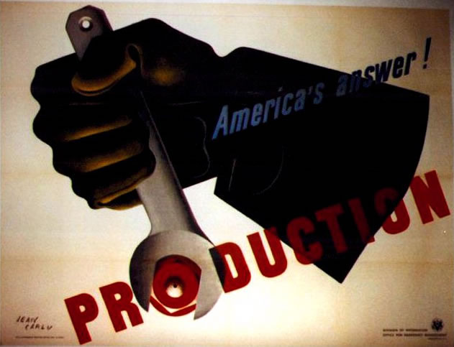
Propaganda wwii

Slide 3
Propaganda…what is it??
Information, ideas, or rumors persuasively spread to help or harm a person, group, movement, institution, or nation.

Slide 4
Why was it used?
When World War II was approaching, Americans did not want to go to war. Having sustained losses in World War I and just coming out of a depression, most Americans thought that energies should be spent at home, improving America, instead of becoming involved in war overseas. However, the government recognized that American participation was necessary, and quickly stepped up pro-war propaganda.

Slide 5
Common Themes
Production and Labor
Conservation
Buying War Bonds
Joining Military
Espionage
Fear of the Enemy

Slide 6
Propaganda Poster Questions
1. Are the messages in the poster primarily visual, verbal, or both?
2. What does the Government hope the audience will do?
3. The most effective posters use symbols that are unusual, simple, and direct. Is this an effective poster?
DIRECTIONS: The class will be divided in half. The right side will analyze the cartoon on the right, and the left side will analyze the cartoon on the left. Work with your partner to discuss these three questions about each poster.

Slide 9
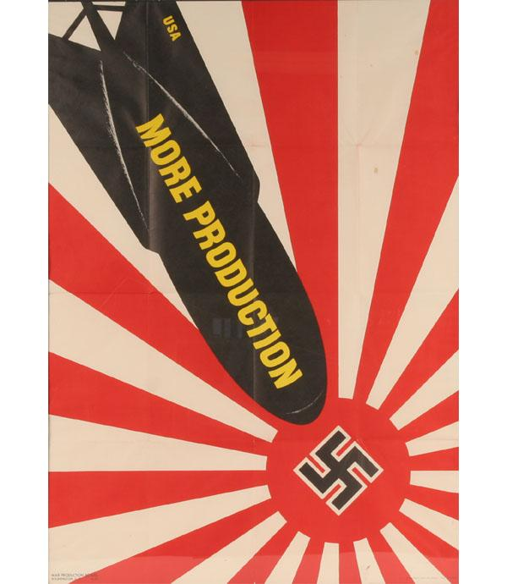

Slide 10
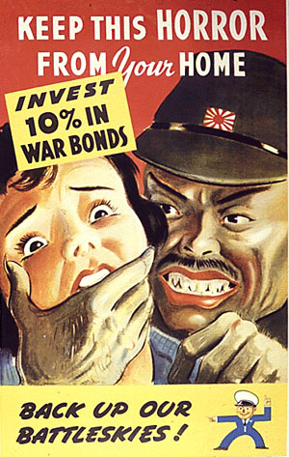

Slide 11
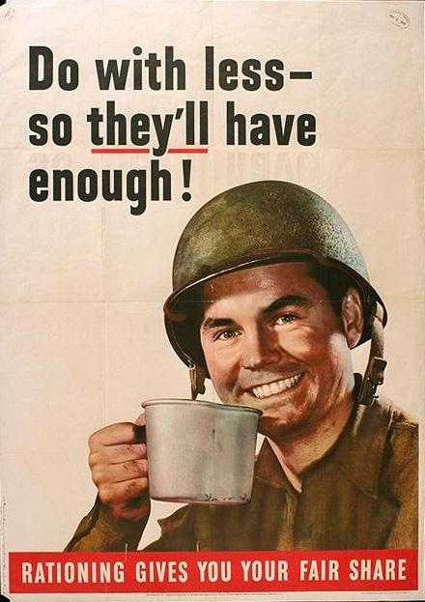

Slide 12
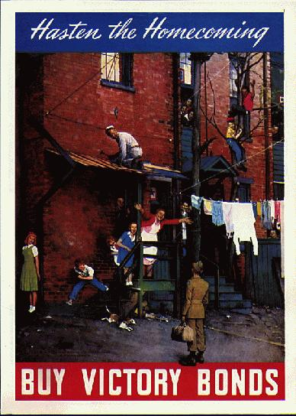

Slide 13
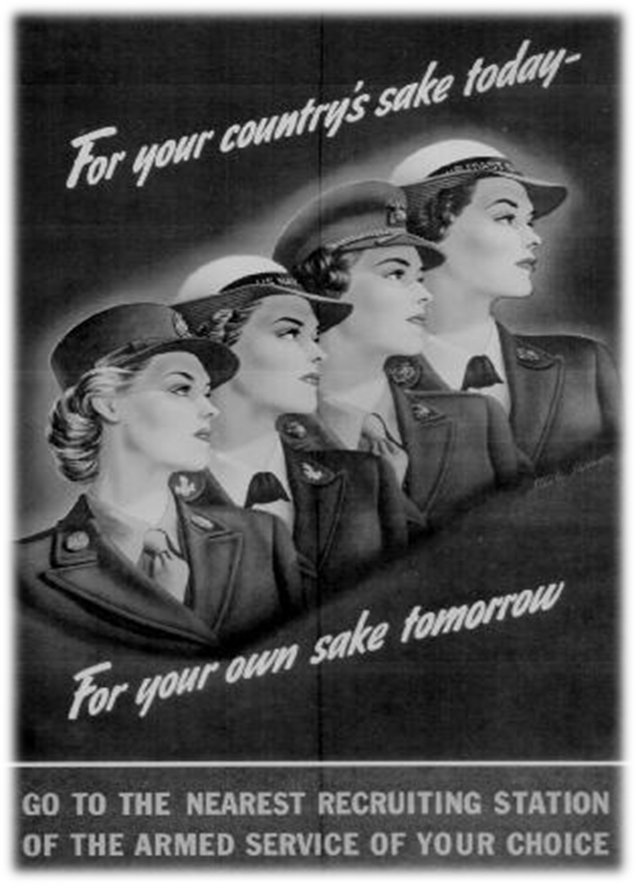

Slide 15
EXIT TICKET: Donald Duck Propaganda
DIRECTIONS: Write a paragraph exit ticket answering the questions below based on the propaganda cartoon.
Was the message in this video primarily visual, verbal or both?
What was the purpose of the video?
Is this an effective piece of propaganda?
Yes/No? Why?

Slide 16
Propaganda Poster Questions
1. What are the main colors used in the poster?
2. What symbols (if any) are used in the poster?
3. If a symbol is used, is it
clear (easy to interpret)?
memorable?
dramatic?
4. Are the messages in the poster primarily visual, verbal, or both?
5. Who do you think is the intended audience for the poster?
6. What does the Government hope the audience will do?
7. The most effective posters use symbols that are unusual, simple, and direct. Is this an effective poster?

