Slide 1
Monday March 16, 2015 Mr. Goblirsch – U.S. History
OBJECTIVE – Students Will Be Able To – SWBAT:
Describe the early battles in the Pacific that stopped the Japanese expansion.
AGENDA:
WARM-UP: War in the Pacific Vocab
HANDOUT: Allies stem the Japanese Tide
CONCEPT: War in the Pacific
TASK: WWII: War in the Pacific Timeline
CLOSURE: Early Battles Wrap-Up
*****3rd Quarter Ends FRIDAY*****
War in the Pacific Vocab WARM-UP: (Follow the directions below)
***5 Minutes***
Define the terms below using the glossary of your textbook.
Battle of Midway 2. Kamikaze

Slide 2
PRIOR KNOWLEDGE
U.S. and Japan’s relationship was strained over Japan’s invasions of China and expansion to other Southeast Asian countries = U.S. oil embargo.
U.S. entered WWII because the Japanese launched a surprise attack on Pearl Harbor December 7, 1941. Most of the American Pacific Naval fleet either destroyed or damaged. Air craft carriers were NOT present during attack.
Allied war strategy:
#1 – Defeat Hitler in Europe
#2 – Defeat Japan in the Pacific
STRUCTURED ACADEMIC DISCUSSION:
What type of reaction was Japan hoping to get from the U.S.? How did the U.S. really react?
Do you agree with the Allied war strategy? Why/Why not?

Slide 3
OVERVIEW
Read the front page of the handout, The Allies Stem the Japanese Tide. Discuss the questions below with your partner.
STRUCTURED ACADEMIC DISCUSSION:
What American colonial territory did Japan acquire in 1942?
Why do you think it took the U.S. until the spring of 1942 to fight back against Japan after the attack on Pearl Harbor in December 1941?
Why was the Battle of Midway important?

Slide 4
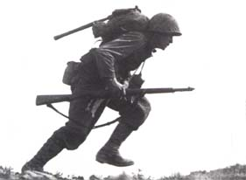
THE UNITED STATES IN WORLD WAR II
War
In the
Pacific

Slide 5
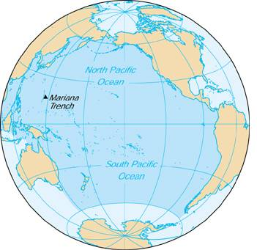
SECTION 3: THE WAR IN THE PACIFIC
The Americans did not celebrate long, as Japan was busy conquering an empire that dwarfed Hitler’s Third Reich
Japan had conquered much of southeast Asia including the Dutch East Indies, Guam, and most of China

Slide 6
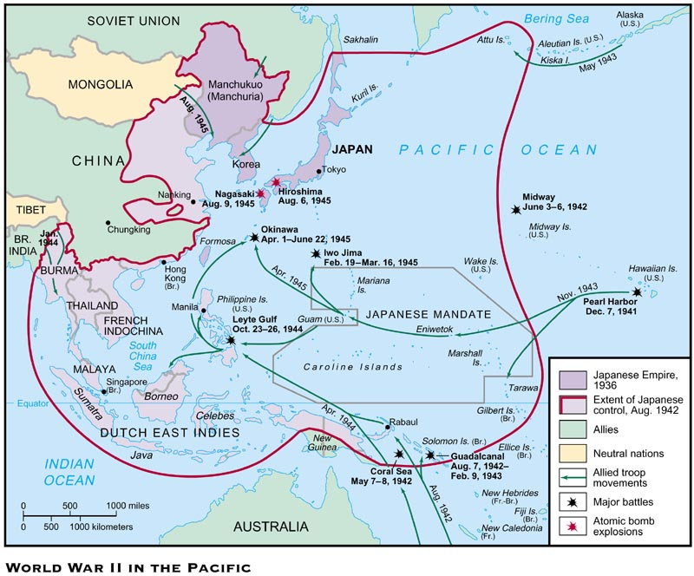

Slide 7
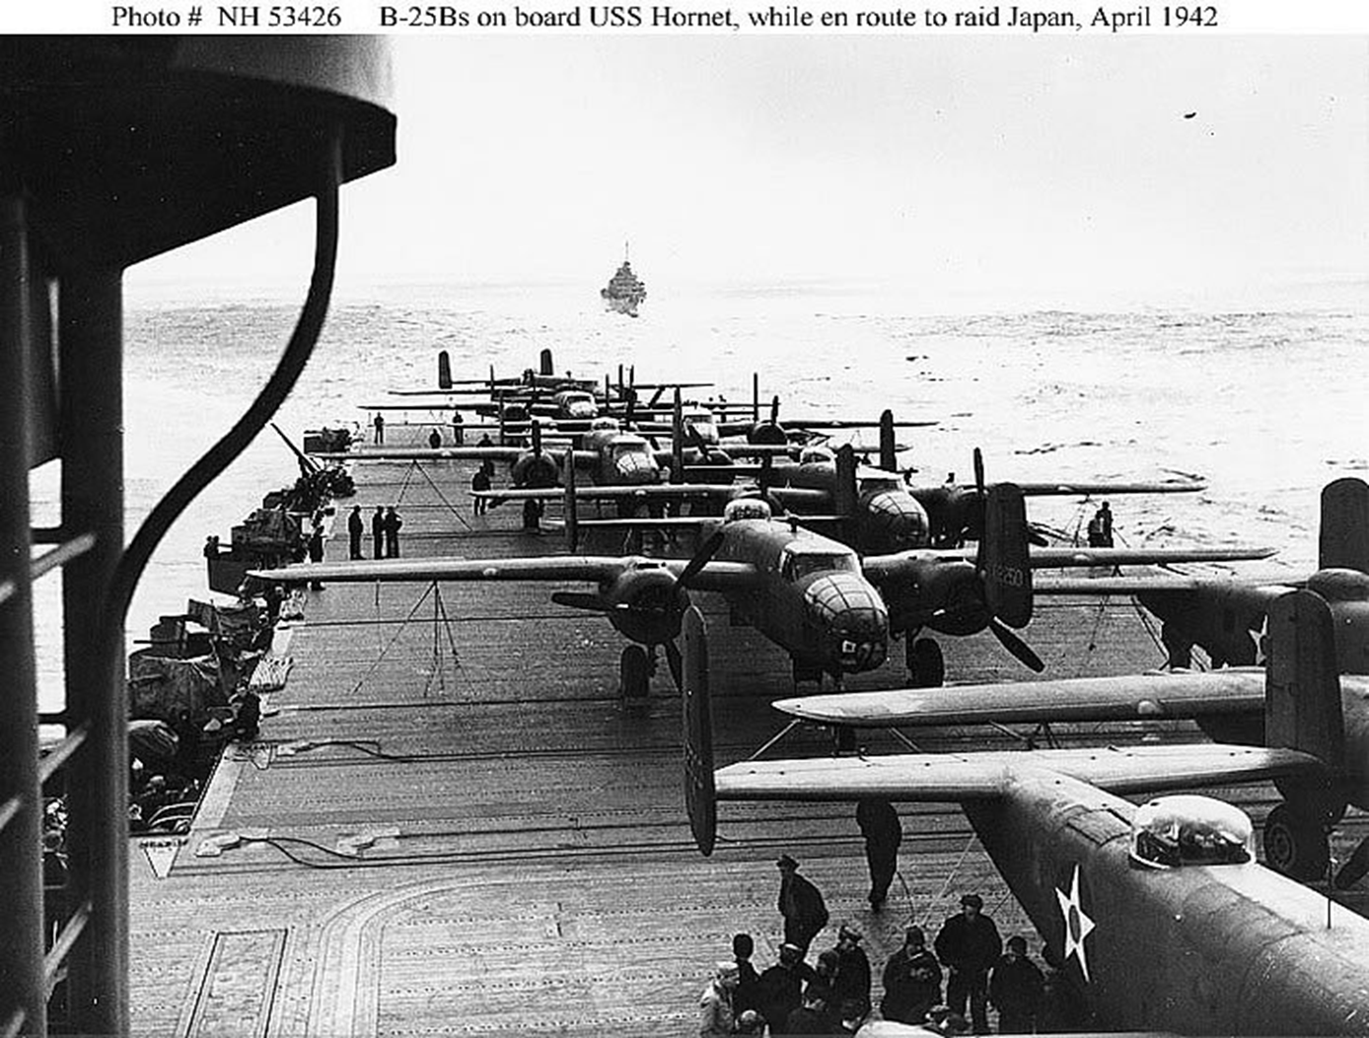
War in the Pacific
I. 6 Months after Pearl Harbor
A. After Pearl Harbor, No defeats for 6 months
B. Created Pacific Empire (Asia mainland & Pacific Islands)
C. Hong Kong, French Indochina, Malaya, Burma, part of China, the Dutch East Indies, Guam, Wake Island, Solomon Islands, and other Pacific Islands
II. April 1942 – Doolittle’s Raid
A. Surprise air raid on Tokyo
16 Bombers attacked Tokyo & other cities
B. Raised American Spirits
Doolittle's Raiders

Slide 8
Structured Academic Discussion
In the first 6 months after Pearl Harbor …
Doolittle’s raid was important to the U.S. because …

Slide 9
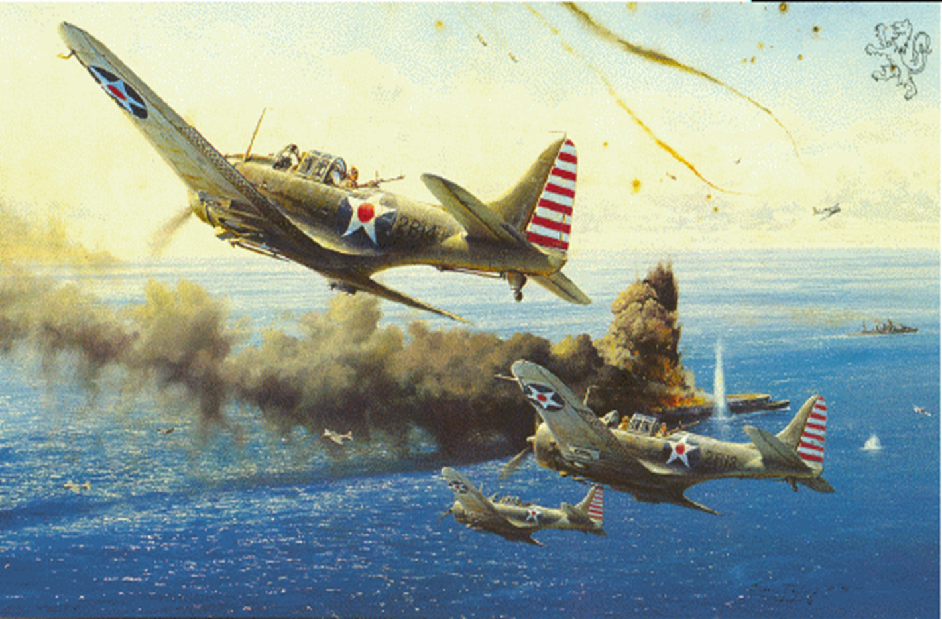
War in the Pacific – Turning the Tide
May 1942 - Battle of Coral Sea
1. Japans First Setback
(all carrier planes, not a single shot from a ship)
2. Saved Australia
3. 1st turning point
Battle of Coral Sea

Slide 10
THE BATTLE OF MIDWAY
Japan’s next thrust was toward Midway Island – a strategic Island northwest of Hawaii
U.S. had advanced knowledge of Japan’s plans
The Americans won a decisive victory as their planes destroyed 4 Japanese aircraft carriers and 250 planes

Slide 11
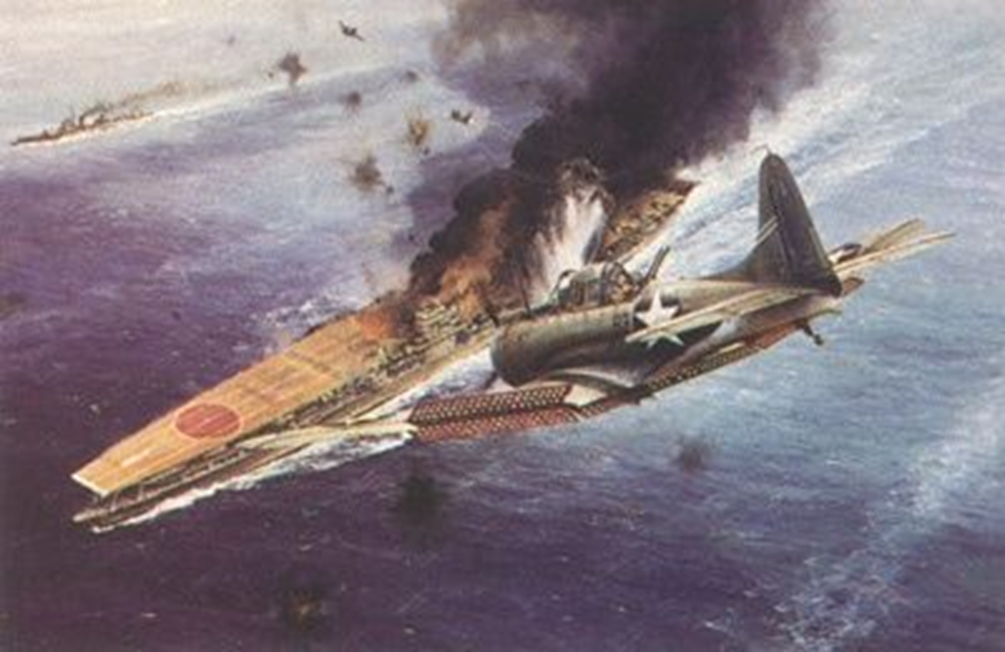
War in the Pacific – Turning the Tide
June 1942 - Battle of Midway
Had broken Japanese code, knew where going to attack
Attacked Naval fleet while planes were refueling/rearming
1. Japans 2nd Defeat – major turning point
2. Saved Hawaii & the west coast
3. Japan lost 4 carriers & 250 planes
Battle of Midway

Slide 12
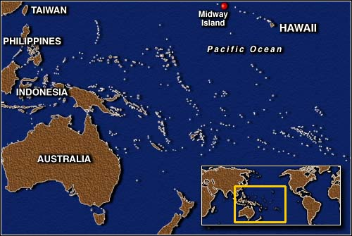
The Battle of Midway was a turning point in the war – soon the Allies were island hopping toward Japan

Slide 13
Structured Academic Discussion
The Battle of Coral Sea was important because …
The Battle of Midway was important because …

Slide 14
War in the Pacific
“Island Hopping Campaign”
U.S. goes on the offensive after Coral Sea and Midway
US Strategy to defeat Japan
C. Use islands as stepping stones to launch attack on Japan’s mainland

Slide 15
War in the Pacific Timeline
DIRECTIONS: Read P. 578 – 583 in your text book, then fill in the timeline of events in the boxes below.
6 Months after Pearl Harbor
Event: Japan creates Asian empire
Description/Impact: Japan takes Hong Kong, French Indochina, Malaya, Burma, part of China, & Dutch East Indies, Guam, Wake Island, Solomon Islands, & other islands in the Pacific
May 1942
Event:
Description/Impact:
Aug 1942 – Feb 1943
Event:
Description/Impact:
Navajo Code Talkers
Read the “Historical Spotlight” on P. 579.
Impact:
Feb – Mar 1945
Event:
Description/Impact:
1942
1943
1944
1945
April 1942
Event:
Description/ Impact:
June 1942
Event:
Description/Impact:
Late 1942, 1943, & Early 1944
Event: “Island Hopping Campaign”
Use the Map on P. 580 to list 5 island battles won & the Date.
1.
2.
3.
4.
5.
October 1944
Event:
Description/Impact:
April – June 1945
Event:
Description/Impact:

