Slide 1
Monday April 13, 2015 Mr. Goblirsch – U.S. History
OBJECTIVE – Students Will Be Able To – SWBAT:
Describe how the Cold War impacted the American homefront.
AGENDA:
WARM-UP: 2nd Red Scare Vocab
CHART: Cold War Review
CONCEPT: Cold War @ Home
ASSIGNMENT: Workbook Pg. 73
2nd Red Scare Vocab WARM-UP: (Follow the directions below)
***5 Minutes***
Define the terms below.
HUAC 3) blacklist
Hollywood ten 4) McCarthyism

Slide 2
Cold War Review
Communist Spread vs. Containment
Nuclear Arms Race
Fear of Communism
Cause -
Effect -
Cause -
Effect -
Cause -
Effect -
Cause -
Effect -
CAUSES
1.
2.
3.
4.
EFFECTS
1.
2.
3.
4.

Slide 3
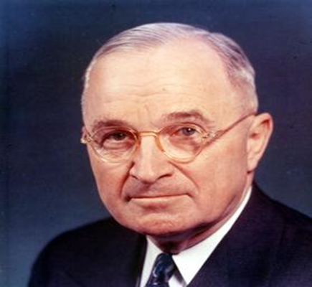
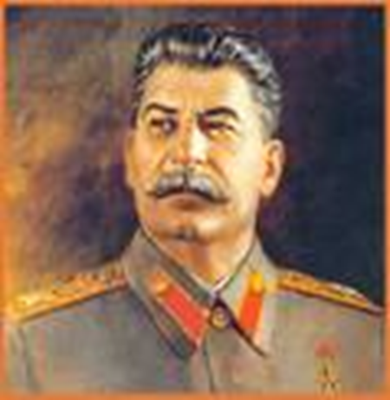
COLD WAR ON THE HOMEFRONT
2nd Red Scare

Slide 4
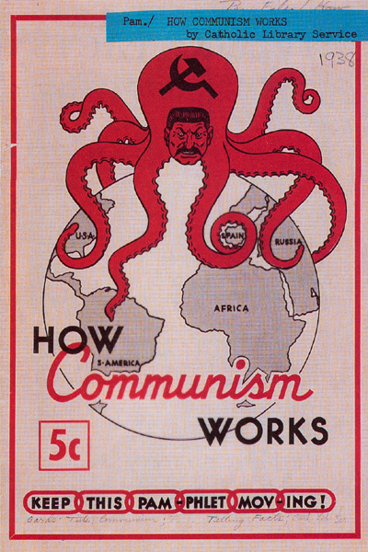
1
Describe the picture.
Who does the octopus represent? What is it trying to do?
What main idea about the Cold War is best represented by this picture? Why?

Slide 5
SECTION 3: THE COLD WAR AT HOME
At the height of WWII, about 80,000 Americans claimed membership in the Communist Party
Some feared that the first loyalty of these American Communists was to the Soviet Union
Americans feared communist ideology, a world revolution and Soviet expansion
Anti-Soviet cartoon

Slide 6
U.S. GOVERNMENT TAKES ACTION
In March of 1947, President Truman set up the Loyalty Review Board
The board was created to investigate federal employees and dismiss those disloyal to the U.S. government
The U.S. Attorney General also drew up a list of 91 “subversive” organizations – membership in any of these was ground for suspicion

Slide 7
THE HOUSE UN-AMERICAN ACTIVITIES COMMITTEE
The HUAC was a government body which first made headlines in 1947 when it began investigating communist influence in the movie industry
The committee believed that Communists were sneaking propaganda into films
The HUAC subpoenaed witnesses from Hollywood to discuss their involvement

Slide 8
THE BLACKLIST TEN
Ten witnesses refused to cooperate because they believed the proceedings were unconstitutional – they were jailed
Subsequently, the committee blacklisted 500 actors, directors, writers and producers whom they believed had communist connections
The “Blacklist Ten” (And two lawyers)

Slide 9
Structured Academic Discussion
HUAC ______
A blacklist is _______

Slide 10
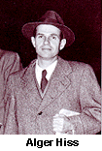
SPY CASES STUN THE NATION
Two spy cases added to the fear gripping the nation
Alger Hiss was accused of being a spy for the Soviets
A young Republican congressman named Richard Nixon gained fame by tirelessly prosecuting Hiss
Hiss was found guilty and jailed – less than four years later Nixon was VP
Nixon examines microfilm in Hiss case

Slide 11
THE ROSENBERGS
Another high profile trial was the Rosenberg spy case
The Rosenbergs were accused of providing information to Soviets which enabled them to produce an atomic bomb in 1949
Ethel and Julius Rosenberg were found guilty and executed
The Rosenbergs were the first U.S. citizens executed for espionage

Slide 12
Structured Academic Discussion
The Alger Hiss spy case ______
Julius and Ethel Rosenberg ______

Slide 13
ASSIGNMENT
Read Pgs. 616 - 621
Complete Workbook Pg. 73 (Part A ONLY)
Turn it into the basket
DUE THURSDAY

Slide 14
MCCARTHY LAUNCHES “WITCH HUNT”
The most famous anti-Communist activist was Senator Joseph McCarthy, a Republican from Wisconsin
McCarthy took advantage of people’s concern about Communism by making unsupported claims that 205 state department members were Communists

Slide 15
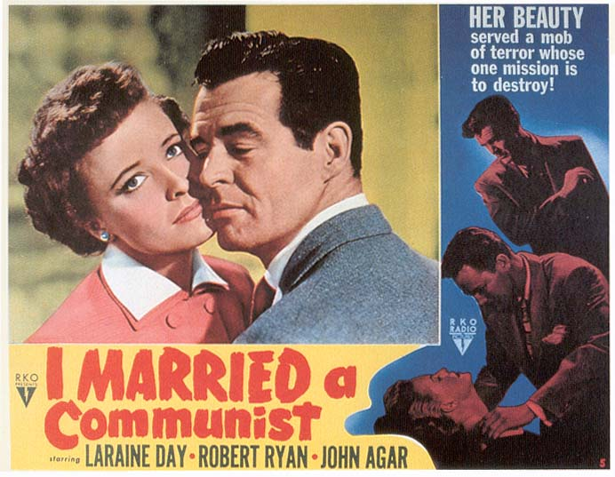
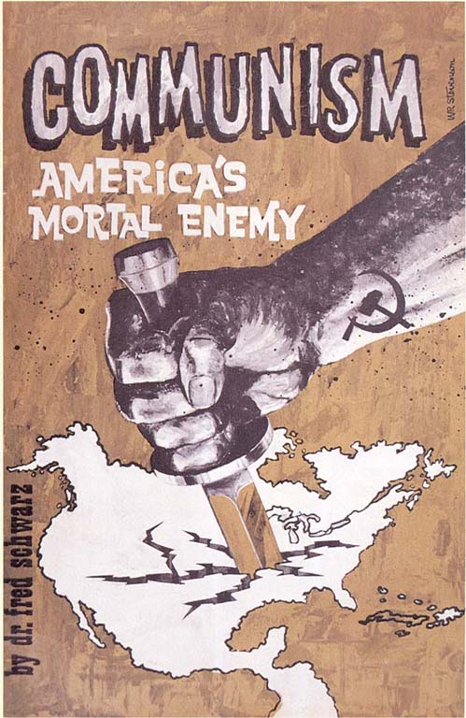
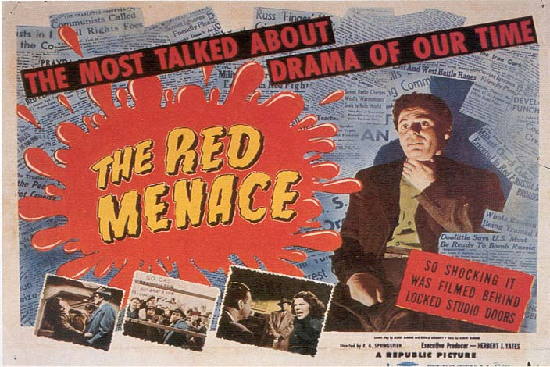
Anti-Communist propaganda during McCarthy era

Slide 16
MCCARTHY’S DOWNFALL
Finally, in 1954 McCarthy went too far
He accused high ranking Army officers of being Communists
In the televised proceedings McCarthy’s bullying of witnesses alienated the national audience
Three years later he died of alcoholism at age 49
McCarthy’s attacking style and utter lack of evidence led to his downfall

Slide 17
THE AMERICAN SHAME
Today, those Congressional witch hunts and episodes of “red-baiting" are universally discredited as abuse of official power
The history of the blacklist era has come to stand for demagoguery, censorship, and political despotism; and the blacklisting, persecution, and jailing of American citizens for their political beliefs - or their perceived political beliefs - is regarded as a shameful chapter in modern American history

Slide 18
Review
The name of the person who was a red baiting senator, with “a list”…
The name of the congressional committee who investigated possible communists.
Blacklist means…
Name the two spy cases that caused anti communist feelings (McCarthyism) in the U.S.

Slide 19
Fear of Communism Questions
Directions: Read Ch 18 Sec 3, answer these questions with your partner on the back of the Cold War Review worksheet.
Describe the activities of the HUAC against the Hollywood film industry.
What was the McCarron Act?
Why were Alger Hiss and Ethel & Julius Rosenberg convicted of being Communist spies?
How did Joseph McCarthy spark fear of Communism?
Use the chart on P. 621, what effects did McCarthyism have on Americans?
Analyze the Political Cartoon on P. 620. Answer the 2 questions about the cartoon.

