Slide 1
Tuesday April 14, 2015 Mr. Goblirsch – U.S. History
OBJECTIVE – Students Will Be Able To – SWBAT:
Describe how McCarthyism impacted the American homefront during the 2nd Red Scare.
AGENDA:
WARM-UP: 2nd Red Scare ?s
CONCEPT: Cold War @ Home
VIDEO: Cold War (37:10 → 50:50)
CHART: Cold War Review
ASSIGNMENT: Workbook Pg. 73
2nd Red Scare ?s WARM-UP: (Follow the directions below)
***5 Minutes***
Answer the questions below.
Read “The McCarron Act” on P. 618. What did the McCarron Act do?
Analyze the Political Cartoon on P. 620. Answer SkillBuilder question #1.
Analyze the Political Cartoon. Answer SkillBuilder question #2.

Slide 2
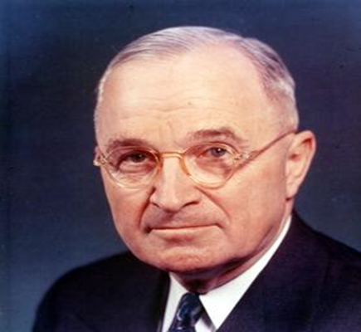
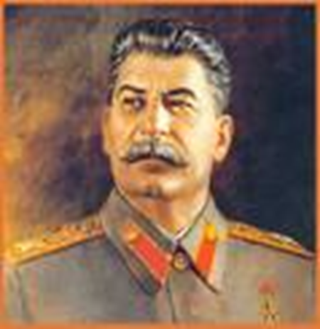
COLD WAR ON THE HOMEFRONT
2nd Red Scare

Slide 3
MCCARTHY LAUNCHES “WITCH HUNT”
The most famous anti-Communist activist was Senator Joseph McCarthy, a Republican from Wisconsin
McCarthy took advantage of people’s concern about Communism by making unsupported claims that 205 state department members were Communists

Slide 4
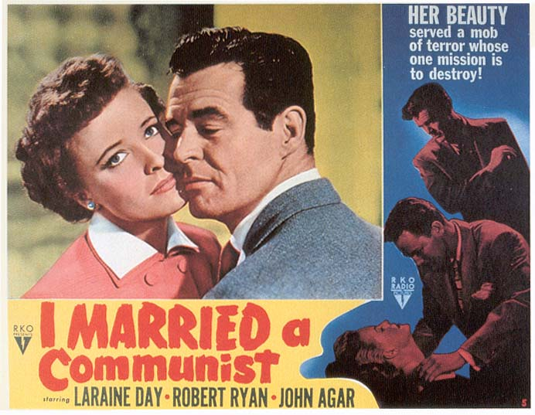
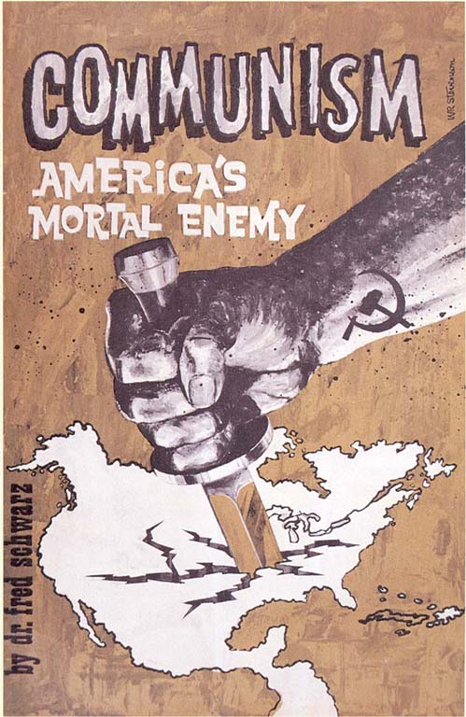
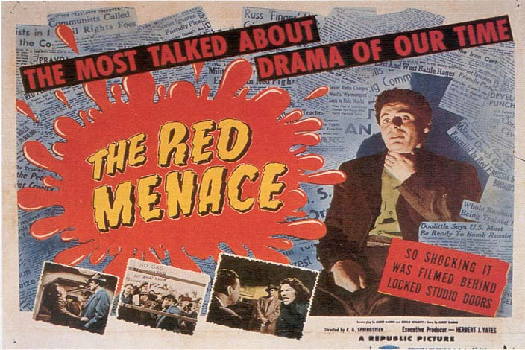
Anti-Communist propaganda during McCarthy era

Slide 5
MCCARTHY’S DOWNFALL
Finally, in 1954 McCarthy went too far
He accused high ranking Army officers of being Communists
In the televised proceedings McCarthy’s bullying of witnesses alienated the national audience
Three years later he died of alcoholism at age 49
McCarthy’s attacking style and utter lack of evidence led to his downfall

Slide 6
THE AMERICAN SHAME
Today, those Congressional witch hunts and episodes of “red-baiting" are universally discredited as abuse of official power
The history of the blacklist era has come to stand for demagoguery, censorship, and political despotism; and the blacklisting, persecution, and jailing of American citizens for their political beliefs - or their perceived political beliefs - is regarded as a shameful chapter in modern American history

Slide 7
MCCARTHYISM CHART&CARTOON
Turn to P. 621 in your textbook
Work with your partner
Analyze the chart on P. 621 & discuss the questions
Analyze the cartoon at the bottom of P. 621 & discuss the question

Slide 8
Cold War Review
Communist Spread vs. Containment
Nuclear Arms Race
Fear of Communism
Cause -
Effect -
Cause -
Effect -
Cause -
Effect -
Cause -
Effect -
CAUSES
1.
2.
3.
4.
EFFECTS
1.
2.
3.
4.

Slide 9
ASSIGNMENT
Read Pgs. 616 - 621
Complete Workbook Pg. 73 (Part A ONLY)
Turn it into the basket
DUE THURSDAY

