Slide 1
Thursday April 16, 2015 Mr. Goblirsch – U.S. History
OBJECTIVE – Students Will Be Able To – SWBAT:
Describe events that led to increasing hostility during the Cold War.
AGENDA:
WARM-UP: Budget Chart
DOCUMENTS: Cold War in Guatemala
CONCEPT: Cold War Heats Up Part II
HANDOUT: U-2 Incident
VIDEO: Cold War (50:55 → 1:05:00)
CLOSURE: Cold War Quiz Study Guide
***DUE TODAY - Workbook Pg. 73
*****Cold War Quiz TOMORROW
Budget Chart WARM-UP: (Follow the directions below)
***5 Minutes***
Analyze the chart on P. 626. Answer the questions below.
Answer SkillBuilder question #1
Answer SkillBuilder question #2

Slide 3
COLD WAR IN GUATEMALA
Why did the United States get involved in Guatemala?
What are some differences between Textbook A and Textbook B? What details appear in only one of the textbooks and not the other?
How do the details affect the overall story?
Why do you think one textbook found these details important to include but the other did not?

Slide 4
CIA DOCUMENT
What type of document is this?
What does it say about the U.S. involvement in Guatemala?
Does this document challenge the textbook accounts? Why or why not?

Slide 5
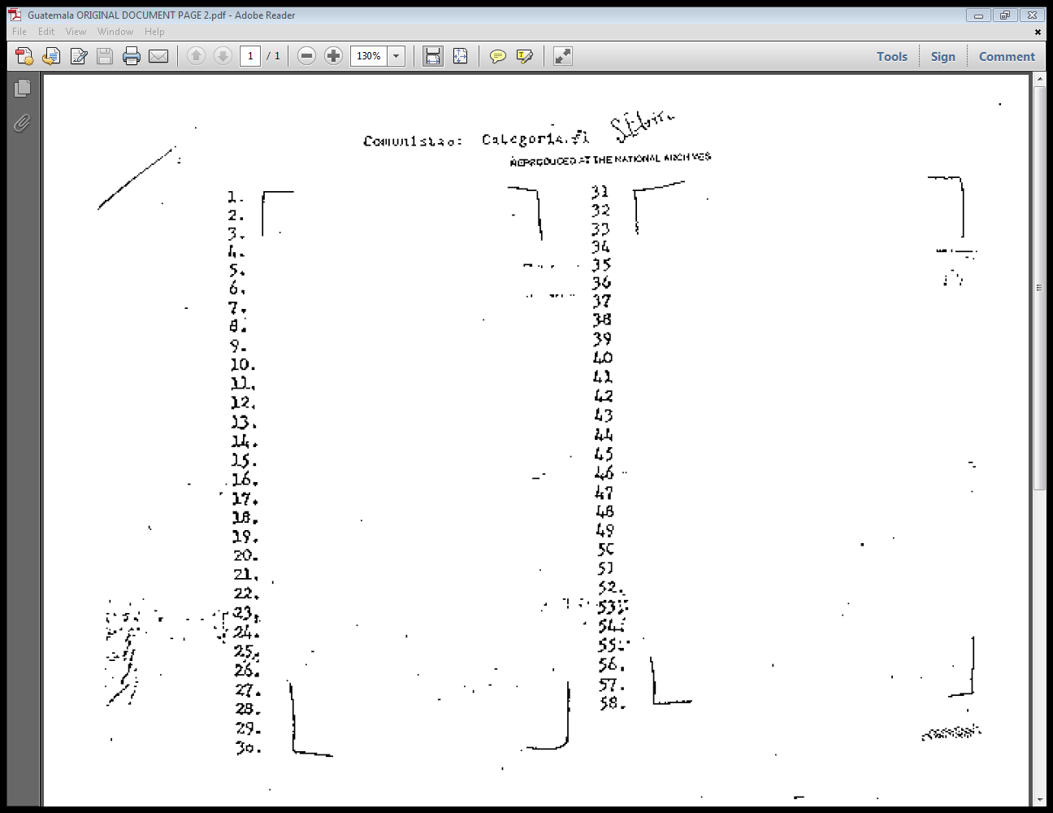

Slide 6
CLASS DISCUSSION
Why is this event in Guatemala considered part of the Cold War?
How does this event help you understand the United States’ behavior during the Cold War?
Are you surprised by this story? Why or why not?

Slide 7
COLD WAR HEATS UP PART II
Eisenhower

Slide 8
THE WARSAW PACT
To counter the U.S. defense alliance (NATO), in 1955 the Soviets formed their own mutual defense alliance known as the Warsaw Pact

Slide 9
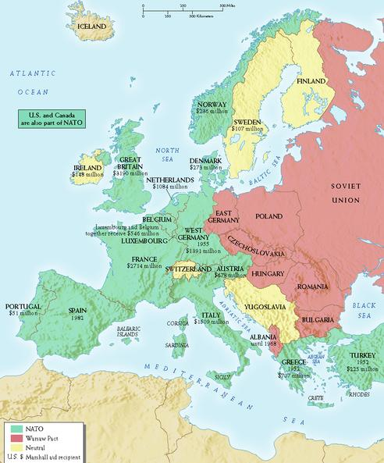
NATO
WARSAW
NEUTRAL

Slide 10
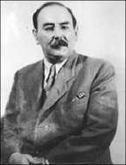
THE HUNGARIAN UPRISING
Dominated by the Soviet Union since the end of WWII, the Hungarian people rose up in revolt in 1956
Led by Imre Nagy, the liberal Communist leader of Hungary, the people demanded free elections and the end of Soviet domination
The Soviets’ response was swift and brutal – 30,000 Hungarians were killed (including Nagy) as the Soviets reasserted control
The Soviets responded to the Hungarian revolt with tanks

Slide 11
THE COLD WAR TAKES TO THE SKIES
The Space Race was initially dominated by the Soviets
On October 4, 1957, they launched Sputnik, the world’s first artificial satellite
Sputnik traveled around earth at 18,000 miles an hour, circling the globe every 96 minutes

Slide 12
U-2 PLANES SPY ON SOVIETS
In the late 1950s, the CIA began secret high-altitude spy missions over Soviet territory
The U-2’s infra-red cameras took detailed pictures of Soviet troop movements & missile sites

Slide 13
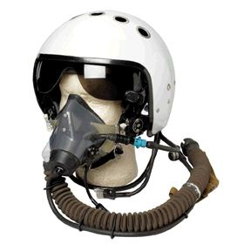
U-2 SPY PLANE SHOT DOWN OVER USSR
On May 1, 1960, Gary Power’s U-2 spy plane was shot down over Soviet territory
Powers parachuted into Soviet territory, was captured and sentenced to 10-years in prison
Because of this incident, the 1960s opened with tension between the two superpowers as great as ever
Powers was released in 1962 in exchange for convicted Soviet spy Rudolph Abel

Slide 14
Structured Academic Discussion
The Space Race …
The U-2 incident …

Slide 15
COLD WAR QUIZ STUDY GUIDE
Cold War
Containment
Truman Doctrine
Marshall Plan
Berlin Airlift
Chinese Civil War
Korean War
Eisenhower Doctrine
NATO & Warsaw Pact
CIA
CIA actions in Iran & Guatemala
Brinkmanship
2nd Red Scare
HUAC
McCarthyism

Slide 16
Cold War Review
Communist Spread vs. Containment
Nuclear Arms Race
Fear of Communism
Cause -
Effect -
Cause -
Effect -
Cause -
Effect -
Cause -
Effect -
CAUSES
1.
2.
3.
4.
EFFECTS
1.
2.
3.
4.

Slide 17
IV. Competition
Arms & Space Race
Arms: race to create 1st H-bomb
U.S. exploded 1st H-Bomb Nov 1 1952
Soviets exploded Aug 1953
Space: race for international prestige to launch first space satellite
A) Sputnik Oct 1957 - Soviets launched (orbited earth)
U.S. first launch disastrous, successfully launched Jan 1958
Brinkmanship under Eisenhower
Build up nuclear weapons w/ willingness to go to the edge of all-out war
Nuclear war becomes fear of Americans

