Slide 1
Tuesday April 21, 2015 Mr. Goblirsch – U.S. History
OBJECTIVE – Students Will Be Able To – SWBAT:
Describe the election of 1960 & the New Frontier programs JFK implemented during his presidency.
AGENDA:
WARM-UP: 1950s Summary
CONCEPT: JFK
VIDEO CLIPS: Debate & JFK Inauguration
READING: Ch 20 Sec 2 – Pgs. 679 - 683
ASSIGNMENT: Workbook Pg. 80
*****SBAC Math Testing ALL NEXT WEEK in this class
1950s Summary WARM-UP: (Follow the directions below)
***5 Minutes***
Read the handout. Answer the questions below.
#1 on handout
#2 on handout
#3 on handout
#4 on handout

Slide 2
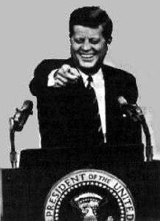
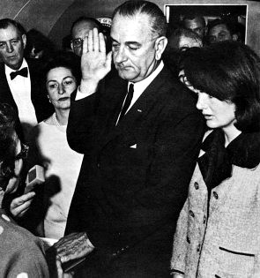
JFK & THE NEW FRONTIER
KENNEDY AND JOHNSON LEAD AMERICA IN THE 1960S

Slide 3
SECTION 1: KENNEDY AND THE COLD WAR
The Democratic nominee for president in 1960 was a young Massachusetts senator named John Kennedy
He promised to “get America moving again”
Kennedy had a well-organized campaign and was handsome and charismatic
Senator Kennedy, 1958

Slide 4
REPUBLICAN OPPONENT: RICHARD NIXON
The Republicans nominated Richard Nixon, Ike’s Vice-President
The candidates agreed on many domestic and foreign policy issues
Two factors helped put Kennedy over the top: T.V. and Civil Rights
Nixon hoped to ride the coattails of the popular President

Slide 5
TELEVISED DEBATE AFFECTS VOTE
On September 26, 1960, Kennedy and Nixon took part in the first televised debate between presidential candidates
Kennedy looked and spoke better than Nixon
Journalist Russell Baker said, “That night, image replaced the printed word as the national language of politics”

Slide 6
JFK: CONFIDENT, AT EASE DURING DEBATES
Television had become so central to people's lives that many observers blamed Nixon's loss to John F. Kennedy on his poor appearance in the televised presidential debates
JFK looked cool, collected, presidential
Nixon, according to one observer, resembled a "sinister chipmunk"
Click on photo for clip

Slide 7
Structured Academic Discussion
How do people get their information about political candidates today?
Can information be manipulated to mislead the public? How?

Slide 8
JFK’S OTHER EDGE: CIVIL RIGHTS
A second major event of the campaign took place in October, 1960
Police arrested Martin Luther King for conducting a “Sit-In” at a lunch counter in Georgia
King was sentenced to hard labor
Sit-Ins were non-violent protests over the policy of whites-only lunch counters in the South

Slide 9
JFK, NIXON REACT DIFFERENTLY TO KING ARREST
While the Eisenhower Administration refused to intervene, JFK phoned King’s wife and his brother, Robert Kennedy, worked for King’s release
The incident captured the attention of the African-American community, whose votes JFK would carry in key states
King
Kennedy

Slide 10
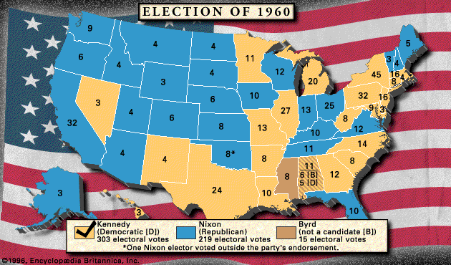
KENNEDY WINS CLOSE ELECTION

Slide 11
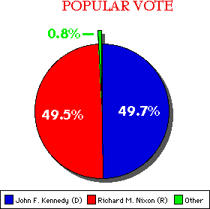
CLOSEST ELECTION SINCE 1884
Kennedy won the election by fewer than 119,000 votes
Nixon dominated the west, while Kennedy won the south and the east coast
RMN
JFK

Slide 12
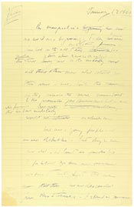
"ASK NOT" . . .
Start at 3:00
In his inaugural address, JFK uttered this famous challenge: “Ask not what your country can do for you --- ask what you can do for your country”
Delivered Friday, January 20, 1961

Slide 13
Structured Academic Discussion
Share with a partner/friend FIRST, then write…
What do you think you can “DO” for your country today?

