Slide 1
Thursday April 23, 2015 Mr. Goblirsch – U.S. History
OBJECTIVE – Students Will Be Able To – SWBAT:
Explain how the Cuban Missile Crisis was resolved.
AGENDA:
WARM-UP: Leadership Journal
CONCEPT: Crisis over Cuba
VIDEO CLIP: Hour of Maximum Danger
DOCUMENTS: Cuban Missile Crisis Communication
CLOSURE: Debrief
*****SBAC Math Testing ALL NEXT WEEK in this class
Leadership Journal WARM-UP: (Follow the directions below)
***5 Minutes***
Write a paragraph journal entry on the topic below.
What do you think are the qualities of an effective leader? What characteristics will help a leader to respond to a crisis?

Slide 2
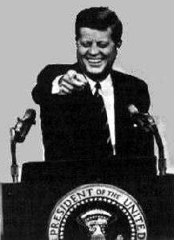
JFK & THE COLD WAR
Crisis Over
Cuba

Slide 3
PRIOR KNOWLEDGE
During the Cold War, a __________ attack was a real threat and fear of Americans & Soviets.
U.S. and Soviet relations during the Cold War could be described as …
President Kennedy’s new military policy was known as ______________.

Slide 4
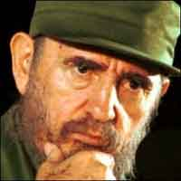
CONCEPT: CRISIS OVER CUBA
Just 90 miles off the coast of Florida, Cuba presented the first big test of JFK’s foreign policy
Openly Communist, Cuba was led by revolutionary leader Fidel Castro who welcomed aid from the USSR
Relations between the U.S. and Cuba were deteriorating

Slide 5
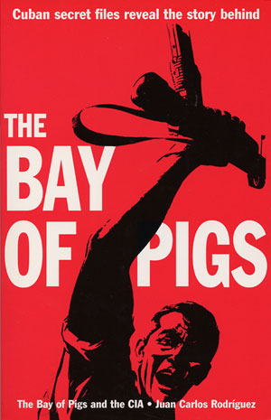
CONCEPT: BAY OF PIGS
In March 1960, Eisenhower gave the CIA permission to secretly train Cuban exiles for an invasion of Cuba
Kennedy learned of the plan only nine days into his presidency
JFK approved the mission
It turned out to be a disaster when in April, 1961, 1,200 Cuban exiles met 25,000 Cuban troops backed by Soviet tanks and were soundly defeated
“We looked like fools to our friends, rascals to our enemies and incompetents to the rest”
Quote from U.S. Commentator

Slide 6
Structured Academic Discussion
Cuba …
The Bay of Pigs…

Slide 7
CONCEPT: THE CUBAN MISSILE CRISIS
Castro had a powerful ally in Moscow
Soviet leader Nikita Khrushchev promised to defend Cuba with Soviet weapons
During the summer of 1962 the flow of Soviet weapons into Cuba – including nuclear – increased greatly

Slide 8
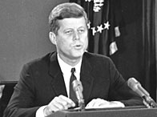
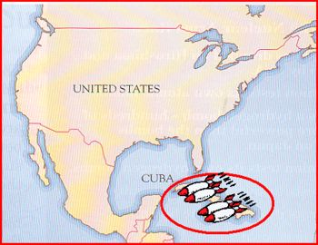
CONCEPT: KENNEDY RESPONDS
American president John F Kennedy making his dramatic television broadcast to announce the Cuba blockade during the Cuban Missile Crisis
Kennedy made it clear the U.S. would not tolerate nuclear weapons in Cuba
When surveillance photos revealed nukes ready to launch in Cuba, JFK said the U.S. would respond to any attack from Cuba with an all-out nuclear retaliation against the Soviets

Slide 9
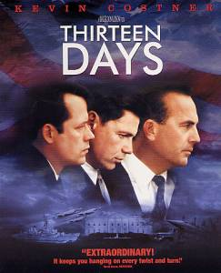
CONCEPT: 13 DAYS
When
more Soviet ships headed for the U.S. with weapons, JFK ordered a blockade
The first break in the crisis occurred when the Soviets ships turned back
Finally, Khrushchev agreed to remove the nuclear weapons from Cuba in exchange for a U.S. promise NOT to invade Cuba
For 13 days in October, 1962 the world stood still as the threat of nuclear war gripped the planet

Slide 10
Structured Academic Discussion
The Cuban Missile Crisis…
During the crisis, President Kennedy …

Slide 11
QUESTION FOR THOUGHT
As you watch the video, think about this question:
According to the video, why did the Russians pull their missiles out of Cuba?

Slide 12
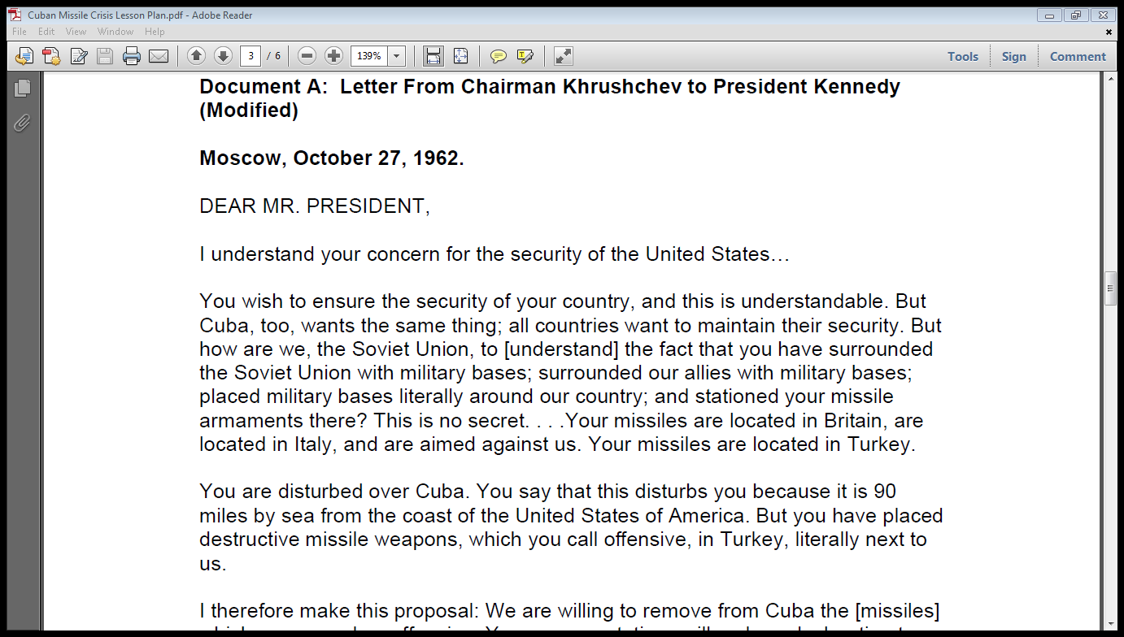
STEPS:
Look at the Guiding Questions
Read the document
Highlight key information relating to the Guiding Questions
Write your answers on the worksheet
CENTRAL HISTORICAL QUESTION:
How was the Cuban Missile Crisis resolved?

Slide 13
CLOSURE: Debrief
CENTRAL HISTORICAL QUESTION:
Based on our notes, the video, and the documents:
How was the Cuban Missile Crisis resolved?
Why was part of the deal kept secret?

Slide 14
NEW FRONTIER PROGRAMS READING & ASSIGNMENT
Read Pgs. 679 – 683 in your textbook
Complete Workbook Pg. #80
ON A SEPARATE PIECE OF PAPER
Skip Part B***

Slide 15
5
Describe the picture.
What would be a result of either side starting a war? What advice would you give to either side?
What vocabulary word best represents this picture? Why?

Slide 16
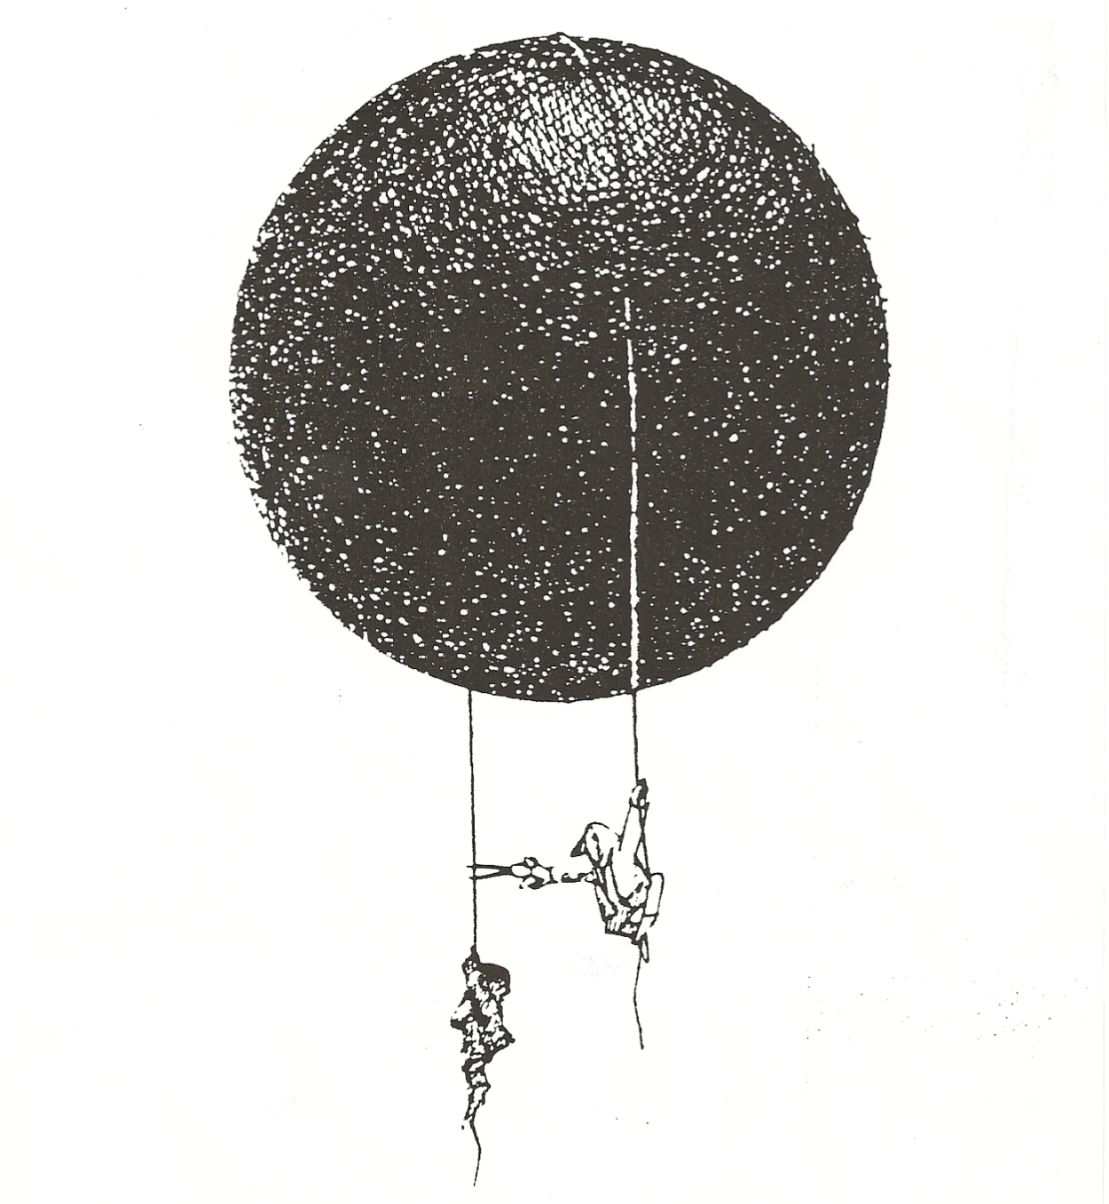
4
Describe the picture.
What is the artist saying about war?
What vocabulary word best represents this picture? Why?

