Slide 1
Monday May 4, 2015 Mr. Goblirsch – U.S. History
OBJECTIVE – Students Will Be Able To – SWBAT:
Identify the early events that brought the U.S. into conflict in Vietnam.
AGENDA:
WARM-UP: Vietnam Begins Vocab
CONCEPT: The Vietnam War Part I
VIDEO CLIP: Vietnam Begins (0:00 – 17:00)
ASSIGNMENT: Workbook P. 81
*****Workbook P. 81 – DUE WEDNESDAY
Vietnam Begins Vocab WARM-UP: (Follow the directions below)
***5 Minutes***
Define the terms below.
Domino theory 3) Vietcong
Geneva Accords 4) Tonkin Gulf Resolution

Slide 2
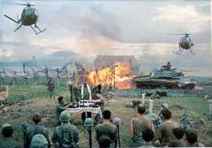
The Vietnam War 1954 - 1975

Slide 3
Background to the War
France controlled “Indochina” since the late 19th century
Japan took control during World War II
With U.S. aid, France attempted re-colonization in the postwar period
Notes:
Ho Chi Minh had been fighting for Vietnamese independence since World War I.
The U.S. gave France aid to win its support in American anticommunist efforts in Western Europe.

Slide 4
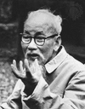
Background to the War
The French lost control to Ho Chi Minh’s Viet Minh forces in 1954 at Dien Bien Phu
President Eisenhower declined to intervene on behalf of France
Notes:
Ho Chi Minh had been fighting for Vietnamese independence since World War I.
The U.S. gave France aid to win its support in American anticommunist efforts in Western Europe.

Slide 5
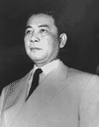
Background to the War
International Conference at Geneva
Vietnam was divided at 17th parallel
Ho Chi Minh’s nationalist forces controlled the North
Ngo Dinh Diem, a French-educated, Roman Catholic claimed control of the South
Notes:
Realizing he would Diem backs out of elections.

Slide 6
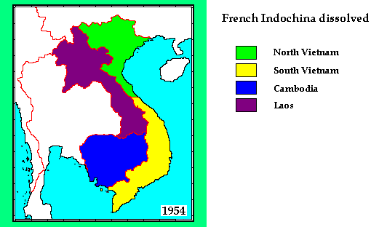

Slide 7
Background to the War
A date was set for democratic elections to reunify Vietnam
Diem backed out of the elections, leading to military conflict between North and South
Notes:
Realizing he would lose, Diem backed out of elections.

Slide 8
Structured Academic Discussion
Vietnam was originally controlled by…
Vietnam was split…

Slide 9
U.S. Military Involvement Begins
Repressive dictatorial rule by Diem
Diem’s family holds all power
Wealth is hoarded by the elite
Buddhist majority persecuted
Torture, lack of political freedom prevail
The U.S. aided Diem’s government
Ike sent financial and military aid
675 U.S. Army advisors sent by 1960.
Notes:
Realizing he would Diem backs out of elections.

Slide 10
Early Protests of Diem’s Government
Self-Emolation by a Buddhist Monk

Slide 11
U.S. Military Involvement Begins
Kennedy elected 1960
Increases military “advisors” to 16,000
1963: JFK supports a Vietnamese military coup d’etat – Diem and his brother are murdered (Nov. 2)
Kennedy was assassinated just weeks later (Nov. 22)
Notes:
Kennedy’s advisors were clearly fighting a covert war by 1963.
MacNamara has suggested that he believes Kennedy would have pulled the U.S. out, but evidence in inconclusive.
JFK realizes Diem is a liability; offers quiet support to a Vietnamese military coup d’etat.
The coup results in the brutal murders of Diem and his brother
The Vietnamese generals overthrow one another. A relatively stable, but tyrannical government emerges. It is little better than Diem’s.

Slide 12
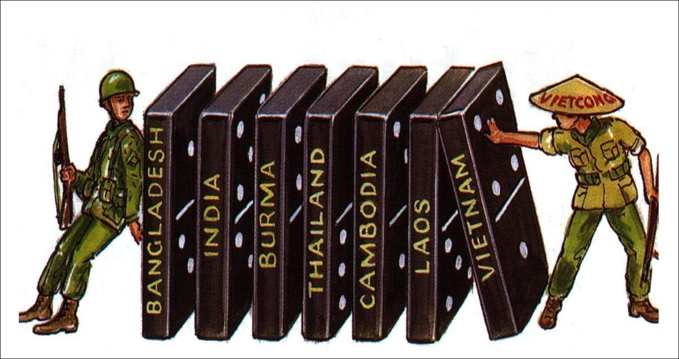
Domino Theory
If one nation falls to Communism all will fall like Dominoes

Slide 13
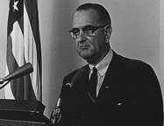
Johnson Sends Ground Forces
Remembers Truman’s “loss” of China → Domino Theory revived
I’m not going to be the president who saw Southeast Asia go the way China went.
Notes:
What Johnson told Congress
What he didn’t tell Congress:
He had already written the resolution before the “incident.”
The U.S. naval vessels were aiding ARVN in commando raids in North Vietnam at the time.
He learned that the attack probably hadn’t occurred.
The U.S. navy was not on the “high seas” but in N. Vietnam’s 12 mile territorial limit.

Slide 14
Structured Academic Discussion
JFK’s contributions to Vietnam…
The Domino Theory…

Slide 15
Johnson Sends Ground Forces
Advised to rout the communists by Secretary of Defense, Robert S. McNamara
Tonkin Gulf Incident → 1964 (acc. to Johnson, the attacks were unprovoked)
Tonkin Gulf Resolution
“The Blank Check” *
Notes:
What Johnson told Congress
What he didn’t tell Congress:
He had already written the resolution before the “incident.”
The U.S. naval vessels were aiding ARVN in commando raids in North Vietnam at the time.
He learned that the attack probably hadn’t occurred.
The U.S. navy was not on the “high seas” but in N. Vietnam’s 12 mile territorial limit.

Slide 16
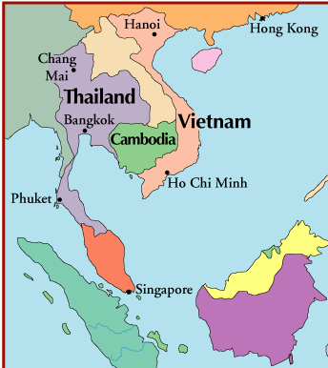
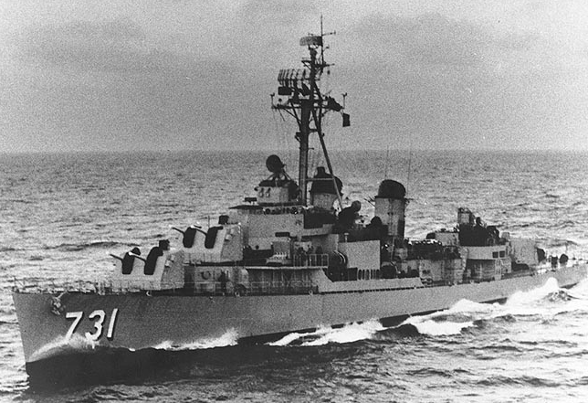
Gulf of Tonkin
USS Maddox on Patrol in Tonkin Gulf

Slide 17
Structured Academic Discussion
The Domino Theory…
The “Blank Check” …

