Slide 1
Tuesday May 5, 2015 Mr. Goblirsch – U.S. History
OBJECTIVE – Students Will Be Able To – SWBAT:
Analyze documents about the Tonkin Gulf incident.
AGENDA:
WARM-UP: Vietnam Map
TIMELINE: Vietnam War Timeline
DOCUMENTS: Gulf of Tonkin Resolution
*****Workbook P. 81 – DUE TOMORROW
Vietnam Map WARM-UP: (Follow the directions below)
***5 Minutes***
Analyze the map on P. 733. Answer the questions below.
What is the name of the route the North Vietnamese used to transport supplies to the Vietcong (Red Line)?
Through which countries did the Ho Chi Minh Trail pass?
How might North Vietnam’s location have enabled it to get aid from its ally China?

Slide 2
The Vietnam War 1954 - 1975

Slide 3
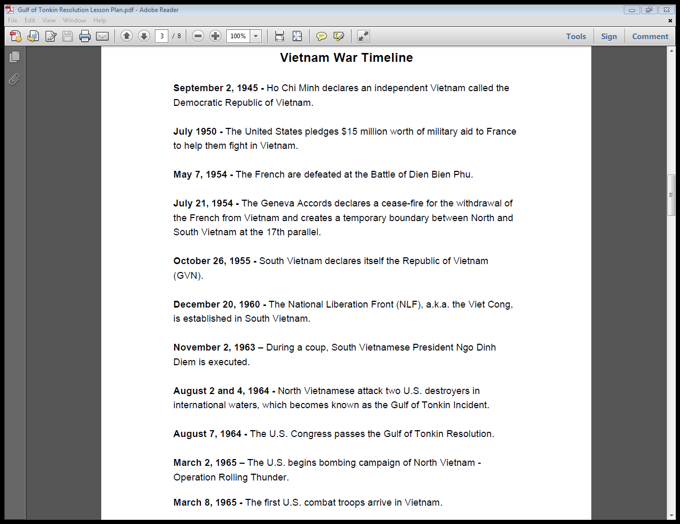

Slide 4
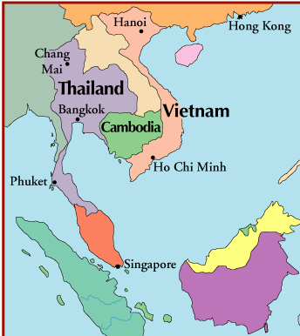
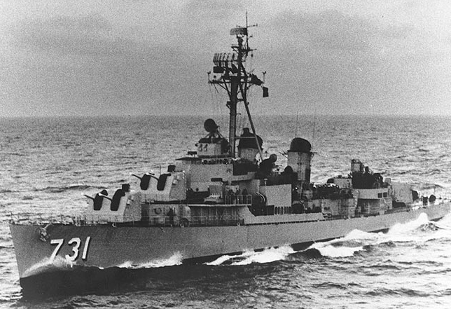
Gulf of Tonkin
USS Maddox on Patrol in Tonkin Gulf

