Slide 1
Wednesday May 6, 2015 Mr. Goblirsch – U.S. History
OBJECTIVE – Students Will Be Able To – SWBAT:
Describe how the U.S. escalated the Vietnam War.
AGENDA:
WARM-UP: War Vocab
READING: Chapter 22 Section 2 & 3
ASSIGNMENT: Workbook Pgs. 86 & 87
*****Workbook P. 81 – DUE TODAY – Turn into the basket
War Vocab WARM-UP: (Follow the directions below)
***5 Minutes***
Define the terms below.
Search & Destroy missions 3) Hawks
Credibility gap 4) Doves

Slide 2
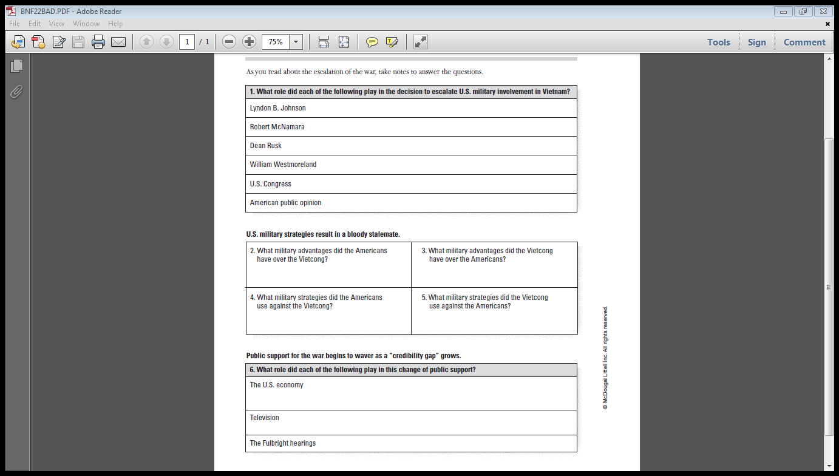
WORKBOOK PG. 86

Slide 3
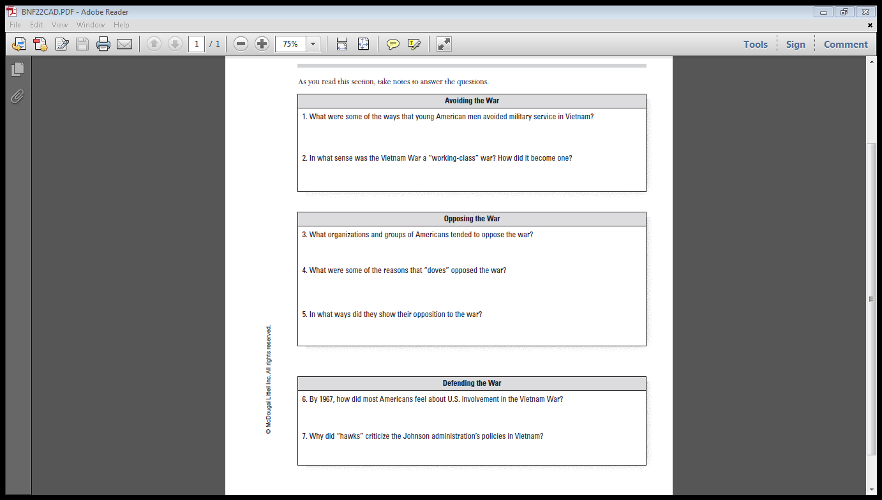
WORKBOOK PG. 87

