Slide 1
Thursday May 7, 2015 Mr. Goblirsch – U.S. History
OBJECTIVE – Students Will Be Able To – SWBAT:
Describe the tactics used and the problems faced for the U.S. in the Vietnam War.
AGENDA:
WARM-UP: Military Vocab
CONCEPT: The Vietnam War
VIDEO: The Vietnam War
ASSIGNMENT: Workbook P. 87
*****Workbook P. 87 – DUE TOMORROW
Military Vocab WARM-UP: (Follow the directions below)
***5 Minutes***
Define the terms below.
Army of the Republic of Vietnam (ARVN)
Napalm 3) Agent orange

Slide 2
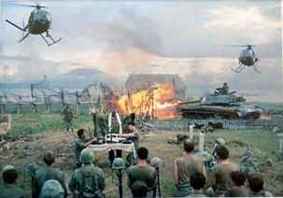
The Vietnam War 1954 - 1975

Slide 3
Johnson Sends Ground Forces
Advised to rout the communists by Secretary of Defense, Robert S. McNamara
Tonkin Gulf Incident → 1964 (acc. to Johnson, the attacks were unprovoked)
Tonkin Gulf Resolution
“The Blank Check” *
Notes:
What Johnson told Congress
What he didn’t tell Congress:
He had already written the resolution before the “incident.”
The U.S. naval vessels were aiding ARVN in commando raids in North Vietnam at the time.
He learned that the attack probably hadn’t occurred.
The U.S. navy was not on the “high seas” but in N. Vietnam’s 12 mile territorial limit.

Slide 4
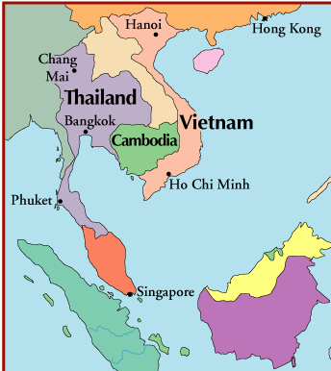
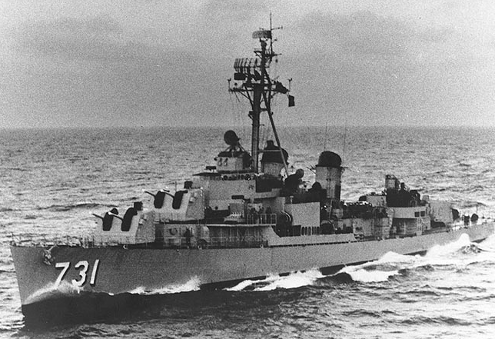
Gulf of Tonkin
USS Maddox on Patrol in Tonkin Gulf

Slide 5
U.S. Troop Deployments in Vietnam
Notes:
Kennedy’s advisors were clearly fighting a covert war by 1963.
MacNamara has suggested that he believes Kennedy would have pulled the U.S. out, but evidence in inconclusive.
JFK realizes Diem is a liability; offers quiet support to a Vietnamese military coup d’etat.
The coup results in the brutal murders of Diem and his brother
The Vietnamese generals overthrow one another. A relatively stable, but tyrannical government emerges. It is little better than Diem’s.

Slide 6
Structured Academic Discussion
The “Blank Check” …

Slide 7
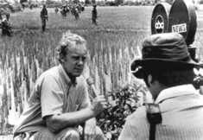
The Ground War 1965-1968
No territorial goals
Body counts on TV every night (first “living room” war)
Viet Cong supplies over the Ho Chi Minh Trail

Slide 8
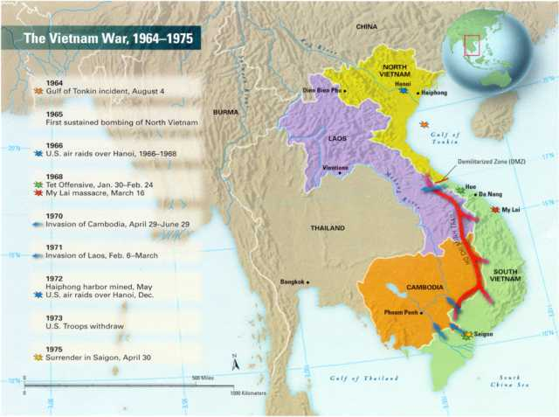

Slide 9
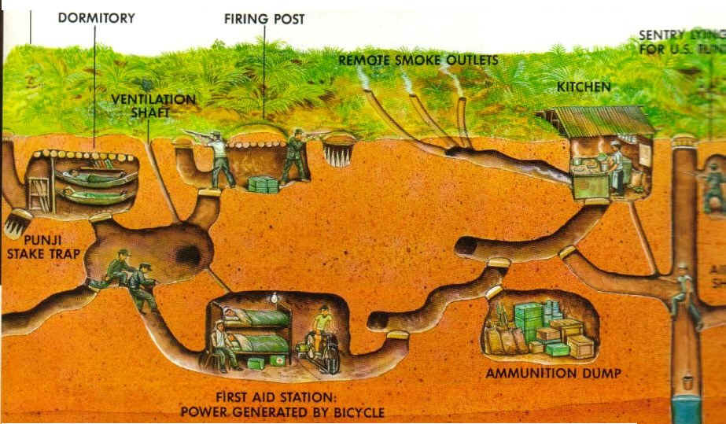
STRATEGY
B. War of Attrition
US General Westmoreland's strategy destroy Vietcong moral (relentless bombing)
Even as VC casualties increasing they had
had no intention of quitting
North Vietnam gets Supplies from China & Soviet Union
VC getting supplies from N Viet
1) US - War = military struggle
2) Vietcong - War = Battle for Survival
C. U.S. divided over war
Hawks support
Doves oppose

Slide 10
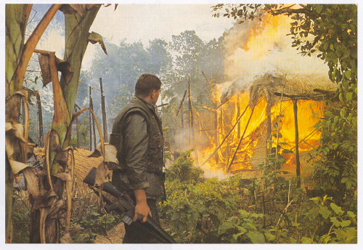
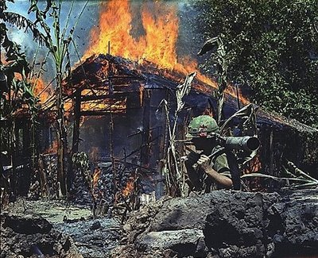
Search and Destroy Missions
Remove civilians with suspected ties to VC
Burn villages and Kill livestock

Slide 11
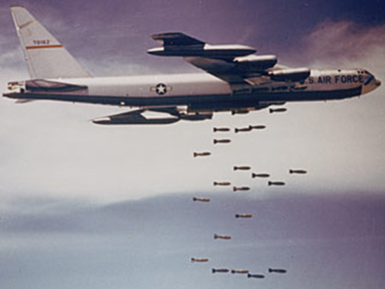
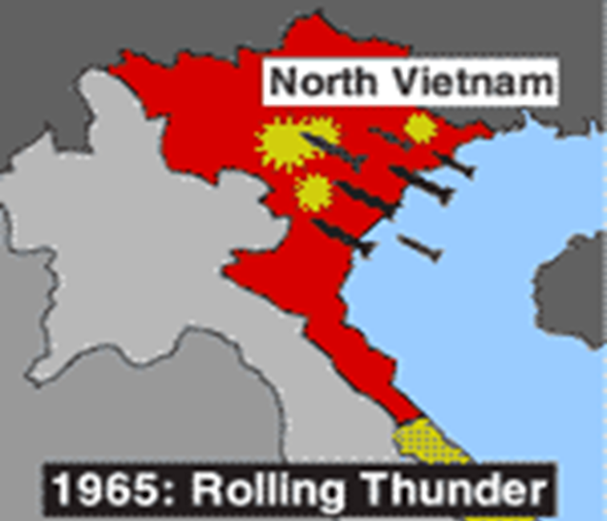
The Air War 1965-1968
1965: Sustained bombing of North Vietnam
Operation Rolling Thunder (March 2, 1965)
1966-68: Ongoing bombing of Hanoi nonstop for 3 years! Esp. targets the Ho Chi Minh Trail.
Downed Pilots: P.O.W.s
Carpet Bombing – napalm

Slide 12
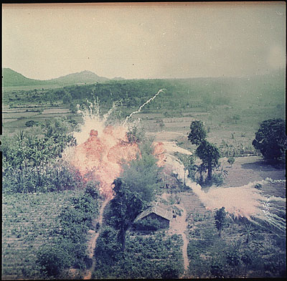
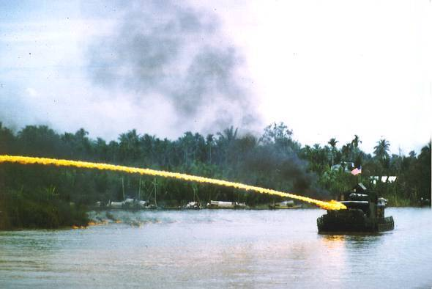
Napalm
Gasoline based bomb set fire the jungle
Used to burn out tunnels of the VC
Killed civilians and destroyed villages

Slide 13
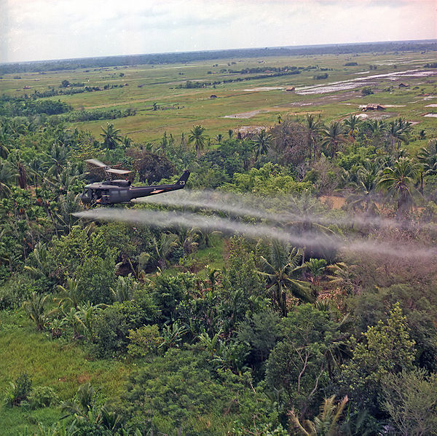
Agent Orange
Toxic Chemical used to kill foliage
Spray often landed on villages and civilians

Slide 14
The Air War: A Napalm Attack

Slide 15
Structured Academic Discussion
Operation Rolling Thunder …

Slide 16
Who Is the Enemy?
Vietcong:
Farmers by day; guerillas at night.
Very patient people willing to accept many casualties.
The US grossly underestimated their resolve and their resourcefulness.
The guerilla wins if he does not lose, the conventional army loses if it does not win. -- Mao Zedong

Slide 17
US Troops Unfamiliar with Land

Slide 18
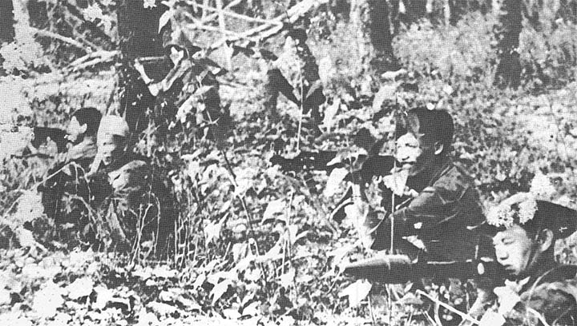
Viet Cong use ambush attacks

Slide 19
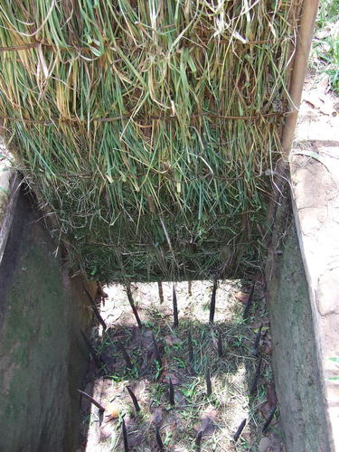
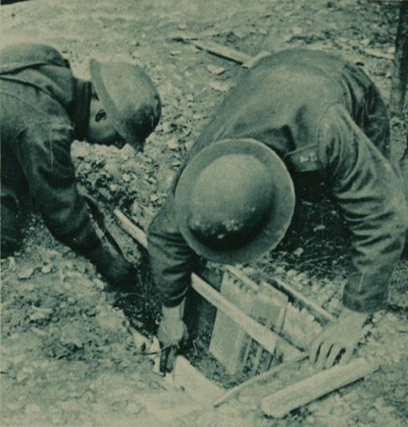
VC laced the Jungle with Booby Traps and Land Mines

Slide 20
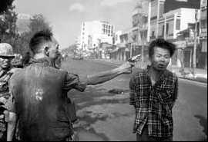
Who Is the Enemy?

Slide 21
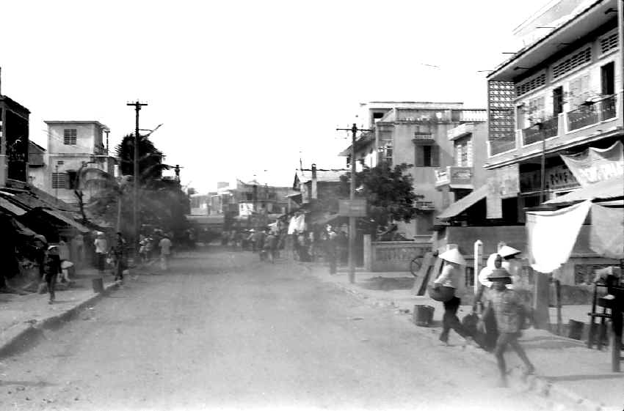
US received no support from civilian Vietnamese

Slide 22
Structured Academic Discussion
It was hard to identify the enemy because…

Slide 23
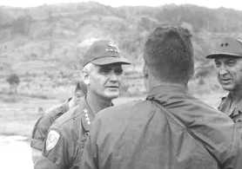
The Ground War 1965-1968
General Westmoreland, late 1967:
We can see the “light at the end of the tunnel.”

Slide 24
The Tet Offensive, January 1968
N. Vietnamese Army + Viet Cong attack South simultaneously (67,000 attack 100 cities, bases, and the US embassy in Saigon)
Take every major southern city
U.S. + ARVN beat back the offensive
Viet Cong destroyed
N. Vietnamese army debilitated
BUT…it’s seen as an American defeat by the media

Slide 25
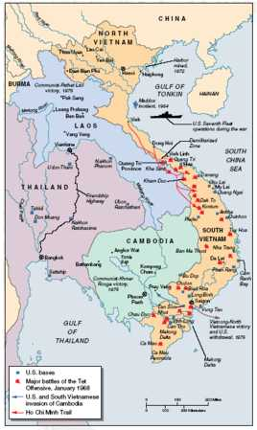
The Tet Offensive, January 1968

Slide 26
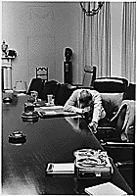
Impact of the Tet Offensive
Domestic U.S. Reaction: Disbelief, Anger, Distrust of Johnson Administration
Hey, Hey LBJ! How many kids did you kill today?

Slide 27
IV. TET Offensive – Jan 1968
A. VC launched a surprise attack on 12 US airbases and over 100 cities
TET fighting lasted over a month
Militarily VC lost
Psychologically and Politically US lost
B. TET changed public opinion
VC is not close to surrendering
Gov’ts credibility is ruined

Slide 28
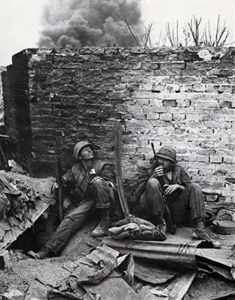
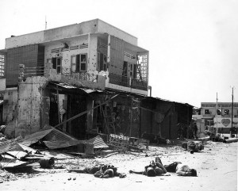
Some Targets during TET Offensive

Slide 29
Structured Academic Discussion
The Tet Offensive…

Slide 30
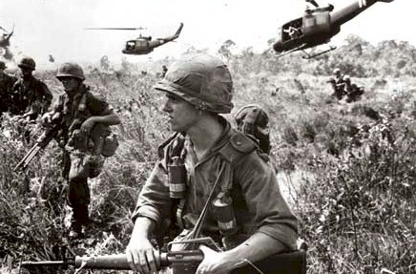
US Soldiers Moral Sinking
Frustrated with Guerrilla Warfare
Brutal jungle conditions
Lack of success against the enemy

Slide 31
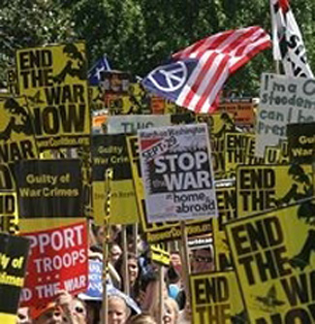
Vietnam War unpopular in US

Slide 32
Vietnam Review Questions
Directions: Read Chapter 22. Answer the following questions on a separate sheet of paper.
Why was Vietnam referred to as a “working-class” war? (P. 742-743)
For what reasons did protestors oppose the war? (P. 745)
How did they demonstrate their opposition to the war? (P. 745 – 746)
Why did American support for the war change after the Tet offensive? (P. 749)
Describe the legacy of the Vietnam war (the Vietnam syndrome). (P. 761)
Answer Critical Thinking Question #4 on P. 747.
Answer Critical Thinking Question #5 on P. 747.
Answer History Through Photojournalism Skillbuilder Question #1 on P. 757.
Answer History Through Photojournalism Skillbuilder Question #2 on P. 757.
Answer Review Question #1 on the Vietnam Summary handout.
Answer Review Question #2 on the Vietnam Summary handout.
Answer Review Question #5 on the Vietnam Summary handout

