Slide 1
Friday May 8, 2015 Mr. Goblirsch – U.S. History
OBJECTIVE – Students Will Be Able To – SWBAT:
Describe the impact of the Tet offensive.
AGENDA:
WARM-UP: Tet Vocab & Map
CONCEPT: Tet Offensive
VIDEO: The Vietnam War
ASSIGNMENT: Workbook P. 87
*****Workbook P. 87 – DUE TODAY
Tet Vocab & Map WARM-UP: (Follow the directions below)
***5 Minutes***
Analyze the Map on P. 749.
Define the term: Tet Offensive
What were the geographic destinations of the Tet offensive attacks?
What does this suggest about the Vietcong forces?

Slide 2
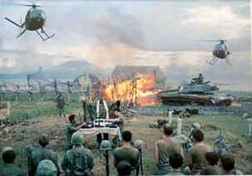
The Vietnam War 1954 - 1975

Slide 3
The Tet Offensive, January 1968
N. Vietnamese Army + Viet Cong attack South simultaneously (67,000 attack 100 cities, bases, and the US embassy in Saigon)
Take every major southern city
U.S. + ARVN beat back the offensive
Viet Cong destroyed
N. Vietnamese army debilitated
BUT…it’s seen as an American defeat by the media

Slide 4
TET Offensive – Jan 1968
VC launched a surprise attack on 12 US airbases and over 100 cities
TET fighting lasted over a month
Militarily VC lost
Psychologically and Politically US lost
***TET changed public opinion
VC is not close to surrendering
Gov’ts credibility is ruined

Slide 5
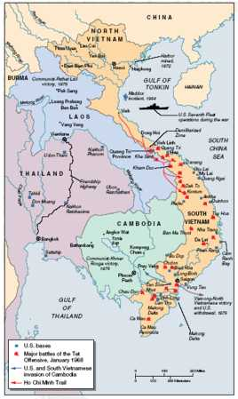
The Tet Offensive, January 1968

Slide 6
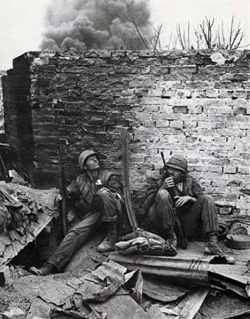
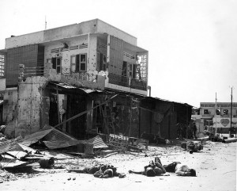
Some Targets during TET Offensive

Slide 7
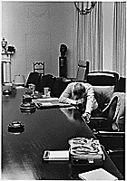
Impact of the Tet Offensive
Domestic U.S. Reaction: Disbelief, Anger, Distrust of Johnson Administration
Hey, Hey LBJ! How many kids did you kill today?

Slide 8
Structured Academic Discussion
The Tet Offensive…

Slide 10
Johnson’s popularity dropped in 1968 from 48% to 36%.

Slide 11
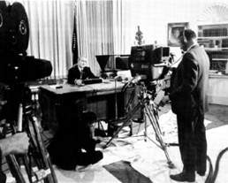
Impact of the Vietnam War
Johnson announces (March, 1968):
…I shall not seek, and I will not accept, the nomination of my party for another term as your President.

