Slide 1
Monday May 11, 2015 Mr. Goblirsch – U.S. History
OBJECTIVE – Students Will Be Able To – SWBAT:
Explain why many people opposed the Vietnam War.
AGENDA:
WARM-UP: Anti– Journal
VIDEO CLIP: Vietnam Homefront (37:40 – 44:10)
CONCEPT: Anti-War Movement
DOCUMENTS: Anti-Vietnam
CLOSURE: Protest Discussion
***Vietnam Quiz THURSDAY***
Anti– Journal WARM-UP: (Follow the directions below)
***5 Minutes***
Write a paragraph journal on the question below.
Think about how you generally react when confronted with something you disagree with. Do you usually voice your opposition or do you usually go with it anyway, even though you may disagree? Provide a personal experience for an example.

Slide 2
PRIOR KNOWLEDGE
Use the section of the timeline labeled “Prior Knowledge”
How many troops had the U.S. sent to Vietnam by 1965? What about 1967?
By 19__, the U.S. had sent _________ troops
How did Americans respond to the Tet Offensive?
Americans were ________ in response to the Tet Offensive.
What % of Americans disapproved of President LBJ’s handling of the war?
_______% of Americans disapproved of LBJ’s handling of the Vietnam War.

Slide 3
VIDEO Discussion Questions
As you watch the video, think about:
Why did Americans oppose the Vietnam War?
Based on the video, Americans opposed the Vietnam War because …
How did Americans show their opposition to the war?
Based on the video, Americans showed their opposition by …

Slide 4
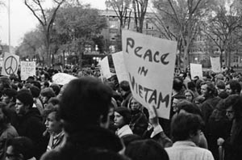
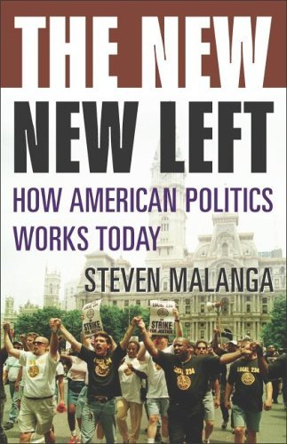
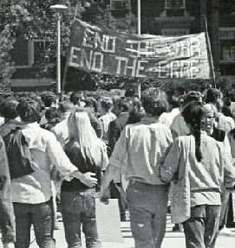
CONCEPT: College Opposition to the War
College Students powerful & vocal protesters
New Left Demand Changes in Society

Slide 5
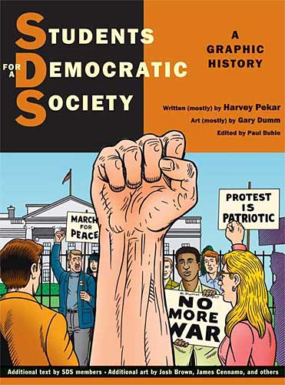
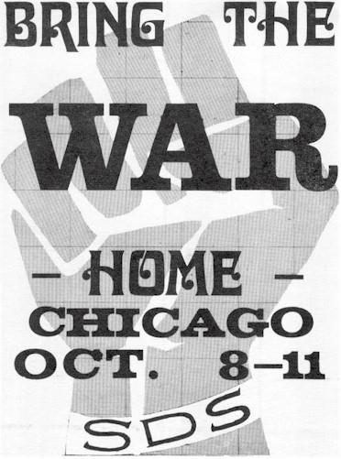
Students for a Democratic Society
CONCEPT: College Opposition to the War
Stop the War
Restore “Participatory Democracy”

Slide 6
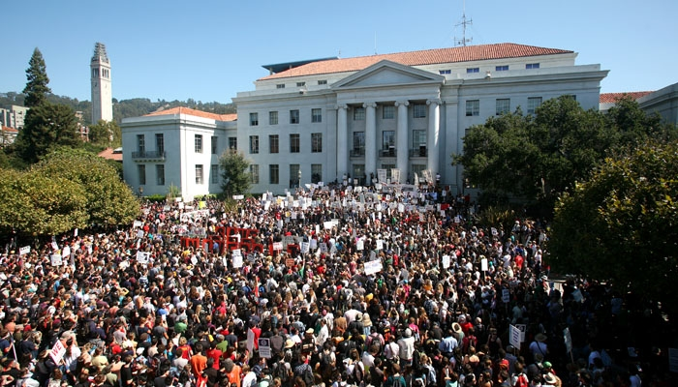
Free Speech Movement
CONCEPT: College Opposition to the War
Protest the Vietnam War
University of California at Berkeley
Criticized powerful business & govt institutions

Slide 7
Anti-War
Demonstrations
Columbia University 1967

Slide 8
Anti-War Demonstrations
Student Protestors at Univ. of CA in Berkeley, 1968
Democratic Convention in Chicago, 1968

Slide 9
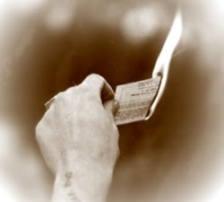
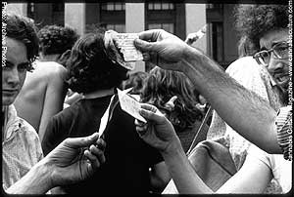
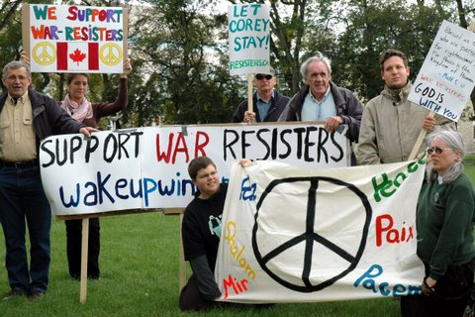
Protest to Resistance
Anti War Demonstrations become Violent
Burn Draft Card
Refuse to Serve
Flee to Canada

Slide 10
Hell no, we won’t go!

Slide 11
Structured Academic Discussion
Where did many anti-war demonstrations occur?
Many anti-war demonstrations occurred …

Slide 12
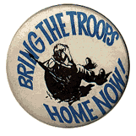
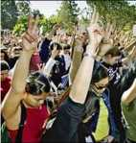
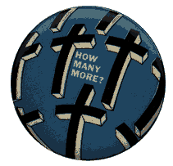

Slide 13
Anti-War Demonstrations
May 4, 1970
4 students shot dead.
11 students wounded
Jackson State University
May 10, 1970
2 dead; 12 wounded
Kent State University

Slide 14
Structured Academic Discussion
Name one event from the Vietnam War on the timeline that sparked increased opposition.
One event the sparked increased opposition was …

Slide 15
DOCUMENTS:
Analyzing Documents steps:
Look at the graphic organizer
Read the document
Highlight key information
Fill in the graphic organizer
FOCUS QUESTION:
Why did Americans oppose the Vietnam War?

Slide 16
CLOSURE Protest Discussion
Based on everything we’ve looked at today, why did many Americans oppose the Vietnam War?
One reason many Americans opposed the Vietnam War was …

Slide 17
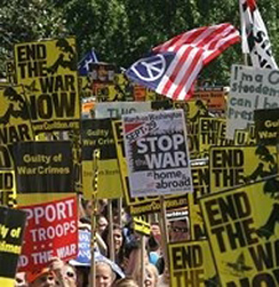
Vietnam War unpopular in US

Slide 18
Unpopular War
Draft--men 18-26 must serve in the military
Most soldiers fighting in Vietnam were drafted
Men looked for ways to avoid the Draft
Most Deferments given to Whites with money
College Deferments & Medical Exceptions
Join National Guard or Coast Guard
80% of the Soldiers (lower economic & social levels)
Vietnam was a working class war

Slide 19
US is a Nation Divided
Doves oppose the war
Hawks want to win the war
Silent Majority supports the war
Protesters are Disloyal
(America Love It or Leave It)
LBJ continues to slowly escalate the war

Slide 20
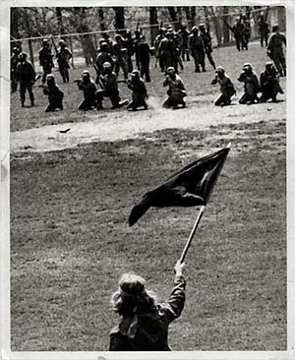
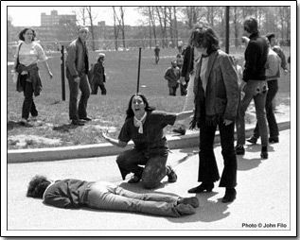
May 4, 1970 - National Guard kills 4 at Kent State
110 days later-National Guard kills 2 at Jackson State

Slide 21
Vietnam Quick Write – The Draft
Resist The Draft or Serve Your Country?
As the fighting in Vietnam intensified, young men of draft age who opposed the war found themselves considering one of two options: register with the draft board and risk heading off to war, or find a way to avoid military service. Ways to avoid service included medical & educational deferments. But a great many men did not qualify for these. The choices that remained, such as fleeing the country, going to jail, or giving in and joining the ranks, came with a high price. Once a decision was made, there was no turning back.
Imagine you oppose the war and are called to serve in Vietnam. What decision would you make? Would you feel guilty if you avoided the draft? If you chose to serve, how would you view those who did not serve your country?
Do you think more men would have been willing to serve had this been a different war? Explain.

