Slide 1
Tuesday May 12, 2015 Mr. Goblirsch – U.S. History
OBJECTIVE – Students Will Be Able To – SWBAT:
Identify how President Nixon eventually brings an end to the Vietnam conflict.
AGENDA:
WARM-UP: War Ends Vocab
QUICK WRITE: The Draft
CONCEPT: Vietnam under Nixon
VIDEO CLIP: The Vietnam War (start @ 49:56)
***Vietnam Quiz THURSDAY***
War Ends Vocab WARM-UP: (Follow the directions below)
***5 Minutes***
Define the terms below.
Draft 4) My Lai
Vietnamization 5) Kent State University
Silent majority 6) Pentagon Papers

Slide 2
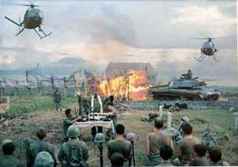
The Vietnam War 1954 - 1975

Slide 3
US is a Nation Divided
- Doves oppose the war
- Hawks want to win the war
Silent Majority supports the war
Protesters are Disloyal
(America Love It or Leave It)
LBJ continues to slowly escalate the war

Slide 4
Unpopular War
Draft--men 18-26 must serve in the military
Most soldiers fighting in Vietnam were drafted
Men looked for ways to avoid the Draft
Most Deferments given to Whites with money
College Deferments & Medical Exceptions
Join National Guard or Coast Guard
80% of the Soldiers (lower economic & social levels)
Vietnam was a working class war

Slide 5
Vietnam Quick Write – The Draft
Resist The Draft or Serve Your Country?
As the fighting in Vietnam intensified, young men of draft age who opposed the war found themselves considering one of two options: register with the draft board and risk heading off to war, or find a way to avoid military service. Ways to avoid service included medical & educational deferments. But a great many men did not qualify for these. The choices that remained, such as fleeing the country, going to jail, or giving in and joining the ranks, came with a high price. Once a decision was made, there was no turning back.
Imagine you oppose the war and are called to serve in Vietnam. What decision would you make? Would you feel guilty if you avoided the draft? If you chose to serve, how would you view those who did not serve your country?
Do you think more men would have been willing to serve had this been a different war? Explain.

Slide 6
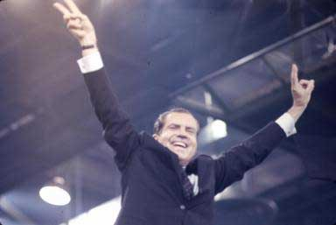
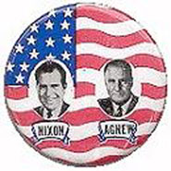
I. Richard Nixon
Promises to Restore Law and Order
Promised to End the War in Vietnam
(won the voters tired of riots & protests)
A. Elected in 1968

Slide 7
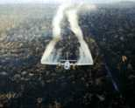
Nixon on Vietnam
Nixon’s 1968 Campaign promised an end to the war: Peace with Honor
Appealed to the great “Silent Majority”
Vietnamization
Expansion of the conflict → The “Secret War”
Cambodia
Laos
Agent Orange (chemical defoliant)
Notes:
Nixon’s “secret” plan never materializes.
He involved us more.
“Peace with Honor” We’ll win befoe we withdraw.
Expansion:Cambodia invaded in 1970: Ho Chi Minh Trail
Laos invaded in 1971: Ho Chi Minh Trail

Slide 8
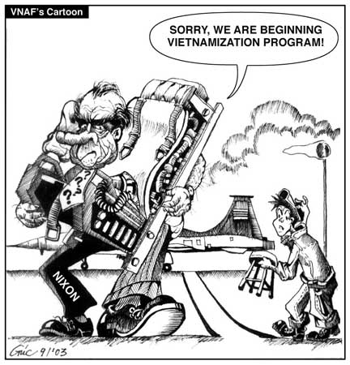

Slide 9
C. Nixon orders invasion of Cambodia – April 1970
Congress is not notified of his actions
Losses political support
1. 1.5 million college students protest
2. 1200 College Campuses closed
Violence erupts

Slide 10
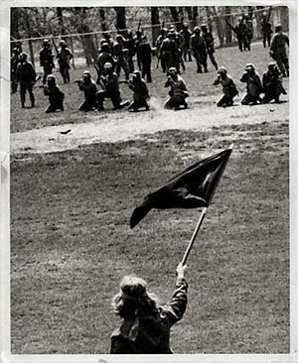
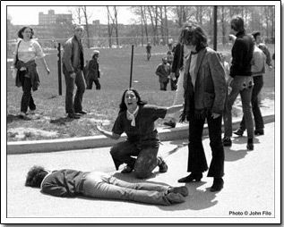
May 4, 1970 - National Guard kills 4 at Kent State
110 days later-National Guard kills 2 at Jackson State

Slide 11
“Pentagon Papers,” 1971
Former defense analyst Daniel Ellsberg leaked govt. docs. regarding war efforts during Johnson’s administration to the New York Times.
Docs.→ Govt. misled Congress & Amer. People regarding its intentions in Vietnam during mid-1960s.
Primary reason for fighting not to eliminate communism, but to avoid humiliating defeat.
New York Times v. United States (1971) *
Notes:
Nixon resigns over the Watergate Scandal in 1974.
Ford takes the helm.

Slide 12
Structured Academic Discussion
Vietnamization …
The Pentagon Papers …

Slide 13
III. Pentagon Papers
7,000 page document
Information for Defense Secretary leaked to public
Showed US planned to enter war no matter what
Showed never was a plan to end war as long as VC persisted
A. Proved Govt Lied to Public about its War Intentions

Slide 14
The Ceasefire, 1973
Peace is at hand → Kissinger, 1972
North Vietnam attacks South
Most Massive U.S. bombing commences
1973: Ceasefire signed between
U.S., South Vietnam, & North Vietnam
Peace with honor (President Nixon)
Notes:
Nixon resigns over the Watergate Scandal in 1974.
Ford takes the helm.

Slide 15
IV. Longest War Ends
1) 1973 Last US Combat Troops Leave Vietnam
War continues in Vietnam
N invades S and captures Saigon
South surrenders 1975
2) US failed to prevent the Spread of Communism
V. Legacy – Vietnam syndrome & War Powers Act

Slide 16
The Ceasefire, 1973
Conditions:
U.S. to remove all troops
North Vietnam could leave troops already in S.V.
North Vietnam would resume war
No provision for POWs or MIAs
Last American troops left South Vietnam on March 29, 1973
1975: North Vietnam defeats South Vietnam
Saigon renamed Ho Chi Minh City
Notes:
Many U.S.-loyal South Vietnamese attempt to flee for fear of execution by the North.

Slide 17
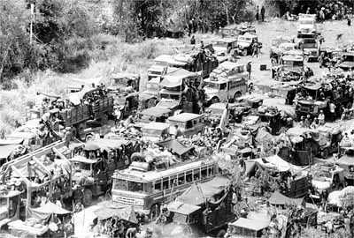
The Fall of Saigon
South Vietnamese Attempt to Flee the Country

Slide 18
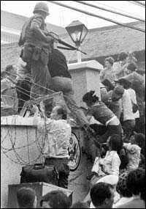
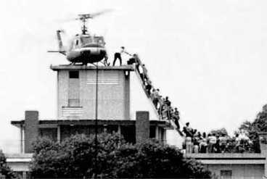
The Fall of Saigon
April 30, 1975
America Abandons Its Embassy

Slide 19
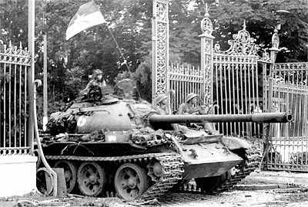
The Fall of Saigon
North Vietnamese at the Presidential Palace

Slide 20
Structured Academic Discussion
A condition of the ceasefire was …
The Fall of Saigon …

