Slide 1
Wednesday May 13, 2015 Mr. Goblirsch – U.S. History
OBJECTIVE – Students Will Be Able To – SWBAT:
Identify how the Vietnam conflict ended, and the lasting legacy of the war.
AGENDA:
WARM-UP: Vietnam Questions
CONCEPT: Vietnam Ends & Legacy
VIDEO CLIP: The Vietnam War (start @ 49:56 – 20 min left)
STUDY GUIDE: Vietnam War Quiz (15 MC & 1 response)
***Vietnam Quiz THURSDAY***
Vietnam Questions WARM-UP: (Follow the directions below)
***5 Minutes***
Answer the questions below.
Look at the political cartoon on P. 747, answer Section 3 Assessment “Analyzing Visual Sources” question #5.
Look at the 2 charts on P. 755, answer SkillBuilder question #1.
Look at the 2 charts on P. 755, answer SkillBuilder question #2.

Slide 2
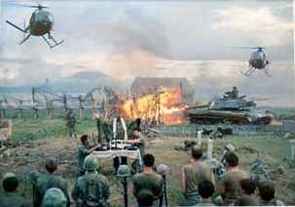
The Vietnam War 1954 - 1975

Slide 3
The Ceasefire, 1973
Peace is at hand → Kissinger, 1972
North Vietnam attacks South
Most Massive U.S. bombing commences
1973: Ceasefire signed between
U.S., South Vietnam, & North Vietnam
Peace with honor (President Nixon)
Notes:
Nixon resigns over the Watergate Scandal in 1974.
Ford takes the helm.

Slide 4
IV. Longest War Ends
1) 1973 Last US Combat Troops Leave Vietnam
War continues in Vietnam
N invades S and captures Saigon
South surrenders 1975
2) US failed to prevent the Spread of Communism
V. Legacy – Vietnam syndrome & War Powers Act

Slide 5
The Ceasefire, 1973
Conditions:
U.S. to remove all troops
North Vietnam could leave troops already in S.V.
North Vietnam would resume war
No provision for POWs or MIAs
Last American troops left South Vietnam on March 29, 1973
1975: North Vietnam defeats South Vietnam
Saigon renamed Ho Chi Minh City
Notes:
Many U.S.-loyal South Vietnamese attempt to flee for fear of execution by the North.

Slide 6
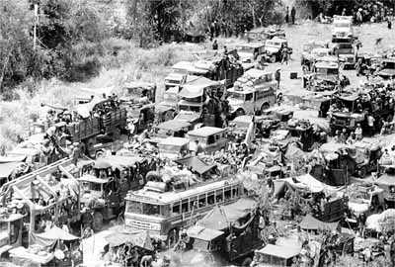
The Fall of Saigon
South Vietnamese Attempt to Flee the Country

Slide 7
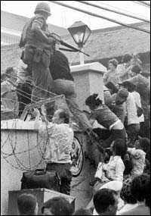
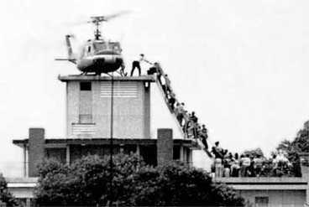
The Fall of Saigon
April 30, 1975
America Abandons Its Embassy

Slide 8
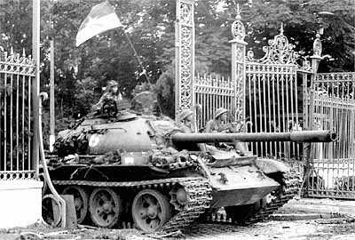
The Fall of Saigon
North Vietnamese at the Presidential Palace

Slide 9
Structured Academic Discussion
A condition of the ceasefire was …
The Fall of Saigon …

Slide 10
A United Vietnam
Formerly Saigon

Slide 11
The Costs
3,000,000 Vietnamese killed
58,000 Americans killed; 300,000 wounded
Under-funding of Great Society programs
$150,000,000,000 in U.S. spending
U.S. morale, self-confidence, trust of government, decimated
Notes:
Diversion of capital to the war indirectly caused economic recession: 11% inflation and 12% unemployment!

Slide 12
The Impact
26th Amendment: 18-year-olds vote
Nixon abolished the draft→ all-volunteer army
War Powers Act, 1973 ٭
President must notify Congress within 48 hours of deploying military force
President must withdraw forces unless he gains Congressional approval within 90 days
Disregard for Veterans → seen as “baby killers”
POW/MIA issue lingered
Notes:
War Powers Act., 1973, passed over Nixon's veto, requires the President to
notify Congress within 48 hours of his use of military force in a foreign country or enlarging an ongoing conflict.
The President must secure Congressional approval if he intends to keep these troops overseas for more than 60 days. If he doesn't, he must withdraw the forces.
Congress can pass a joint resolution to withdraw the troops before the 60 day deadline. (Each President since has denied its validity, though the issue has never been tested.)
No welcome home (shamed and ashamed), high unemployment, alcohol & drug abuse; poor care of disabled vets: underfunded vets hospitals, Post-Traumatic Stress Disorder; Agent Orange health problems, birth defects in vets’ children.

Slide 13
Some American POWs Returned from the “Hanoi Hilton”
Senator John McCain (R-AZ)

Slide 14
2,583 American POWs / MIAs still unaccounted for today.

Slide 15
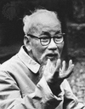
And in the End….
Ho Chi Minh:
If we have to fight, we will fight. You will kill ten of our men and we will kill one of yours, and in the end it will be you who tires of it.

Slide 16
Lessons for Future American Presidents
Wars must be of short duration.
Wars must yield few American casualties.
Restrict media access to battlefields.
Develop and maintain Congressional and public support.
Set clear, winnable goals.
Set deadline for troop withdrawals.

Slide 17
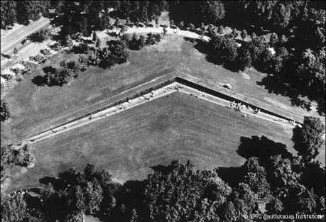
The Vietnam Memorial, Washington, D.C.

Slide 18
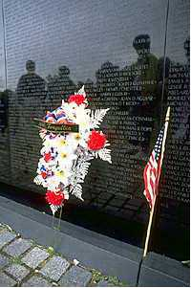
58,000

Slide 19
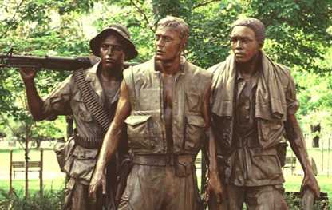
Memorial to US Servicemen in Vietnam

Slide 20
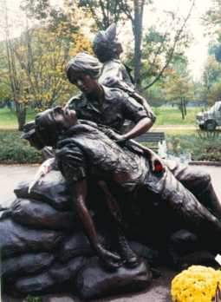
Memorial to US Nurses in Vietnam

Slide 21
STUDY GUIDE: Vietnam Quiz
MULTIPLE CHOICE:
Domino theory
Vietnam was colonized by who: before WWII? During WWII? After WWII?
Vietcong
Ho Chi Minh Trail
Tonkin Gulf Resolution
Problems fighting in Vietnam
Search & destroy missions
Credibility gap
The draft
Protesting the war
Hawks/Doves
Tet offensive impact
Vietnamization
Pentagon Papers
War Powers Act
WRITING OPTIONS:
Why do you believe that the U.S. did not achieve victory or meet their goals in the Vietnam War? Give 3 reasons and support those reasons with facts.
OR
Why do you believe that there was such a large anti-war following for the Vietnam War? Give 3 reasons and support those reasons with facts.
Notes:
Nixon resigns over the Watergate Scandal in 1974.
Ford takes the helm.

Slide 22
Structured Academic Discussion
The legacy of Vietnam…

