Slide 1
Friday May 15, 2015 Mr. Goblirsch – U.S. History
OBJECTIVE – Students Will Be Able To – SWBAT:
Describe the early expansion of the Civil Rights movement, focusing on the legal activity and Brown v. Board decision.
AGENDA:
WARM-UP: Segregation Vocab
CONCEPT: Civil Right Movement Begins
HANDOUT: Brown v. Board of Ed., Topeka, KS
Segregation Vocab WARM-UP: (Follow the directions below)
***5 Minutes***
Define the terms below.
Jim Crow Laws 3) Plessy v. Ferguson
De jure segregation 4) Brown v. Board of Ed.

Slide 2
Taking on Segregation
Chapter 21, Section 1 Notes

Slide 3
Objectives
Explain how legalized segregation deprived African Americans of their rights as citizens
Summarize civil rights legal activity and the response to the Plessy and Brown cases
Trace MLK, Jr’s civil rights activities, beginning with the Montgomery Bus Boycott
Describe the expansion of the civil rights movement

Slide 4
Main Idea and Terms/Names
Activism and a series of Supreme Court decisions advanced equal rights for African Americans in the 1950s and 1960s
Thurgood Marshall
Brown v. Board of Education of Topeka
Rosa Parks
Martin Luther King, Jr.
Southern Christian Leadership Conference (SCLC)
Student Nonviolent Coordinating Committee (SNCC)
Sit-in

Slide 5
The Segregation System
Dred Scott v Sanford
Slaves were not citizens
Slavery spread to the western states
Plessy v. Ferguson
“separate but equal” did not violate the 14th amendment (equal treatment)
Southern states passed Jim Crow laws (separating the races)
Allowed restrictions on inter-race contact

Slide 6
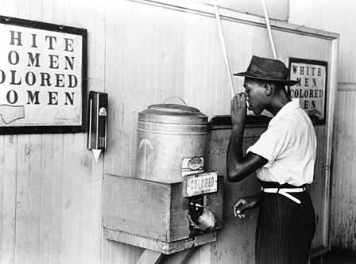
“Separate but Equal”
Plessy vs Ferguson
Supreme Court Decision declared “Separate but Equal” was Constitutional

Slide 7
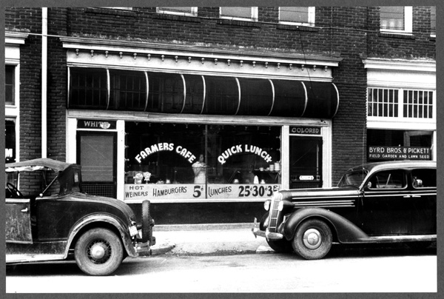
Jim Crow Laws de jure segregation
Separated the Races (Black & White)
No Marriages
No Social or Religious Contact
Separate Schools, restaurants, restrooms etc

Slide 8
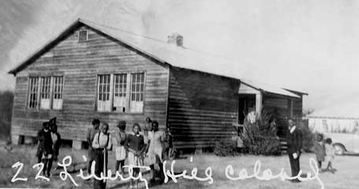
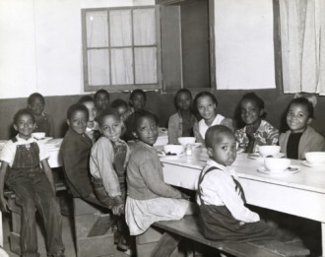
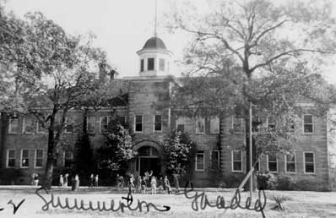
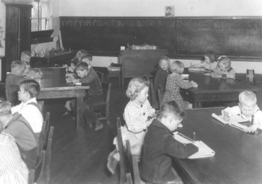
Separate but Equal School?

Slide 9
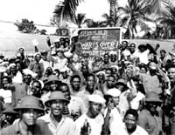
Civil Rights Movement
WW2 set the stage for the civil rights movement
Opened new job opportunities
One million African Americans served
Came home and fought to end discrimination
During the war, civil rights organizations fought for voting rights and challenged Jim Crow laws

Slide 10
WWII Starts Civil Rights Movement
During the War African Am new job opportunities filling the labor shortage
Black Soldiers returned and began to fight for their own freedom and rights
1941 – FDR Executive Order - Racial Discrimination prohibited in Fed agencies and companies making war supplies
1948 – Truman Exec. Order – Integrating the armed forces

Slide 11
Structured Academic Discussion
Plessy V. Ferguson …
WWII set the stage for the Civil Rights movement because …

Slide 12
NAACP
National Association for the Advancement of Colored People
Fought to End Segregation through courts
Goal: Prove “Separate but Equal” Unconstitutional – end de jure segregation
Violated 14th Amend. Equal Protection Clause

Slide 13
Challenging Segregation in Court
Campaign led by the NAACP
Took legal action to end discrimation
Thurgood Marshall argued many of these cases; later became Supreme Ct. justice
Brown v. Board of Education of Topeka
Marshall’s most stunning victory
Supreme Court struck down segregation in public schools as a violation of 14th amendment
To be implemented “with all deliberate speed”

Slide 14
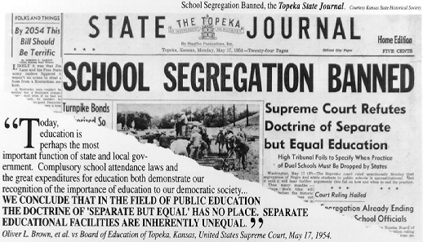
Brown vs Board of Education of Topeka
“Separate but Equal” has no place in education

Slide 15
Reaction to Brown
Official reaction was mixed
Within a year, 500 school districts had desegregated
Some areas resisted
Reappearance of KKK
Governor of Georgia (Talmadge) – “Georgia will not comply”!

Slide 16
Structured Academic Discussion
Brown v. Board of Education of Topeka, Kansas…
Reaction to the Brown case …

Slide 17
Brown V. Board of Education
Directions: Highlight key information as you read the document. Use the chart below.
SYMBOL | TOPIC / QUESTION | INSTRUCTIONS
I | Issue / Arguments – What is being challenged? | Highlight key information relating to the issue/arguments of the case. Label the highlight with an “I”.
D | Decision – What did the Supreme Court decide? | Highlight key information relating to the decision of the case. Label the highlight with an “D”.
E | Effect / Impact – How did the decision effect/impact society? | Highlight key information relating to the effects/impact of the case. Label the highlight with an “E”.

Slide 18
Brown V. Board of Education
Directions: After reading Brown v. the Board of Education, answer the questions below on the bottom of the handout
What is the issue before the Supreme Court?
What facts were presented in the case? (What evidence did they use for their argument)
What was the decision of the Court? What was the rationale behind the decision?
What was the effect of the decision?

Slide 19
School Segregation Questions
Directions: Answer the questions below in your notebook.
How many states either required or permitted segregated schools in 1952? What region of the U.S. was segregation required?
How many states prohibited segregated schools? What region of the U.S. was segregation mostly prohibited?
Relate the information on the map to your knowledge of the Civil War? (Hint: think about the Union vs. the Confederacy)

