Slide 1
Monday May 18, 2015 Mr. Goblirsch – U.S. History
OBJECTIVE – Students Will Be Able To – SWBAT:
Explain why the Montgomery Bus Boycott was successful.
AGENDA:
WARM-UP: Rosa Parks Bio
CONCEPT: Montgomery Bus Boycott
VIDEO CLIP: Rosa Parks (2 ½ Minutes)
DOCUMENTS: Why was the Montgomery Bus Boycott Successful?
Rosa Parks Bio WARM-UP: (Follow the directions below)
***5 Minutes***
Read the brief biography on Rosa Parks on P. 704.
How did Rosa Parks protest segregation before Dec of 1955?
What civil rights organization was Parks a member of?
What did her actions inspire?

Slide 2
TAKING ON SEGREGATION
Chapter 21, Section 1
Montgomery Bus Boycott

Slide 3
PRIOR KNOWLEDGE
1896 – Plessy v. Ferguson established “separate but equal”
NAACP takes legal action against segregation
1954 – Brown v. Board of Ed. overruled “separate but equal” in public schooling
Following the Brown decision, some schools desegregated, but many refused to comply with the ruling

Slide 4
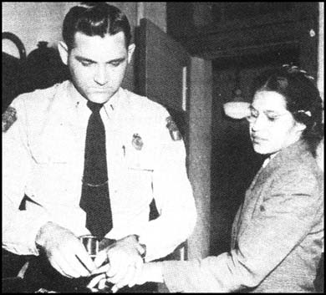
MONTGOMERY BUS BOYCOTT
African Americans were impatient with the slow speed of change
Took direct action
1955 – Rosa Parks refused to
give up her seat and was arrested
JoAnn Robinson suggested a boycott of the buses
Leaders of the African American community formed the Montgomery Improvement Association (MIA)
Elected 26 yr old Martin Luther King to lead

Slide 5
MONTGOMERY BUS BOYCOTT
Dr. King made a passionate speech and filled the audience with a sense of mission
African Americans boycotted the buses for 381 days and filed a lawsuit
Organized car pools
Walked long distances
1956 – Supreme Court outlawed
bus segregation

Slide 6
Brown V. Board of Education
Directions: Highlight key information as you read the document. Use the chart below.
SYMBOL | TOPIC / QUESTION | INSTRUCTIONS
I | Issue / Arguments – What is being challenged? | Highlight key information relating to the issue/arguments of the case. Label the highlight with an “I”.
D | Decision – What did the Supreme Court decide? | Highlight key information relating to the decision of the case. Label the highlight with an “D”.
E | Effect / Impact – How did the decision effect/impact society? | Highlight key information relating to the effects/impact of the case. Label the highlight with an “E”.

Slide 7
Brown V. Board of Education
Directions: After reading Brown v. the Board of Education, answer the questions below on the bottom of the handout
What is the issue before the Supreme Court?
What facts were presented in the case? (What evidence did they use for their argument)
What was the decision of the Court? What was the rationale behind the decision?
What was the effect of the decision?

