Slide 1
Friday May 22, 2015 Mr. Goblirsch – U.S. History
OBJECTIVE – Students Will Be Able To – SWBAT:
Identify challenges and changes to the Civil Rights movement.
AGENDA:
WARM-UP: Challenges Vocab
TIMELINE DISCUSSION: Civil Rights Triumphs
CONCEPT: Challenges & Changes
VIDEO: The Civil Rights Movement (Start @ 52:55)
Challenges Vocab WARM-UP: (Follow the directions below)
***5 Minutes***
Define the terms below.
De facto segregation 3) Black Power
Nation of Islam 4) Black Panthers

Slide 2
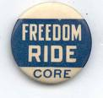
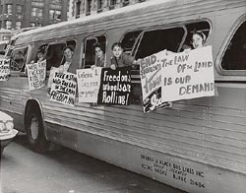
Freedom Riders
Civil Rights activists (blacks and college
students) would ride busses to test the
Supreme Court decision that banned segregation on buses and in bus terminals
Provoking a violent reaction to force the
JFK administration to enforce the law
Riders were tormented and beaten
Newspaper coverage and the violence provoked JFK to send federal marshals to protect the riders, the rest of the way to Jackson, Miss.
OUTCOME = Segregation in all interstate travel facilities (including restrooms, waiting rooms, etc.) was banned

Slide 3
Integrating Ole Miss & Alabama
Air Force Veteran James Meredith
won a federal court case that allowed him to enroll in the all-white University of Mississippi (Ole Miss)
Governor Ross Barnett refused to let him register
Kennedy ordered federal marshals to escort Meredith
Riots broke out and resulted in 2 deaths
Federal officials accompanied Meredith to
class to protect him
June 11, 1963 – JFK sends troops to force Gov. Wallace to desegregate the University of Alabama

Slide 4
Birmingham
Strictly enforced its segregation
Reputation for racial violence
Reverend Shuttlesworth, MLK, and the SCLC tested their non-violence
MLK and others were arrested during a nonviolent demonstration
MLK wrote Letters from a Birmingham Jail
With MLK out of jail, the SCLC planned a children’s march in Birmingham
Police Commissioner “Bull” Connor arrested them
Later, the police met the marchers with high pressure fire hoses and attack dogs
TV cameras captured the scene
Birmingham officials finally ended segregation
Convinced JFK to write a civil rights act

Slide 5
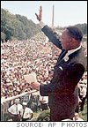
March on Washington
To show support for JFK’s civil rights bill
Aug. 28, 1963, 250,000 people in Washington
MLK gave his “I have a Dream” speech
Pressure Congress to pass Civil Rights legislation

Slide 6
CIVIL RIGHTS ACT of 1964
Two weeks after the I have a Dream speech, four girls were killed in a Birmingham church
Two months later, JFK is assassinated
NEW IMPORTANT LAW
LBJ pledges to carry out JFK’s work
Passes Civil Rights Act of 1964
Prohibited discrimination
Gave equal access to public accommodations

Slide 7
Freedom Summer - 1964 Voting Rights Act
CORE and SNCC worked to register as many African-American voters as possible
Project is known as Freedom Summer
Attempt to influence Congress to pass as voting rights bill
College Students were trained to help the project
Met with resistance and violence

Slide 8
Selma Campaign
SNCC led a voting rights campaign in Selma, Alabama
After a demonstrator was shot, MLK organized a 50 mile march to Montgomery
Mayhem broke out and TV crews caught police beating and gassing marchers
Johnson presented a voting rights act and gave marchers federal protection

Slide 9
Voting Rights Act of 1965
Eliminated literacy tests
Local officials could not deny suffrage
The percentage of African American voters tripled in the south

Slide 10
CHALLENGES & CHANGES
Chapter 21, Section 3 Notes

Slide 11
I. 2 Kinds of Segregation
A. de facto -- exists by practice and custom (North)
B. de jure -- exists by law (South)
C. Elimination
1. de jure requires repealing laws (S)
2. de facto requires changing peoples attitudes (N)
Problem
Harder to convince Whites to share economic and
Social pwr with Blacks (N)
Easier to convince Whites to share lunch counters
or bus seats with Blacks (S)

Slide 12
Challenges and Changes in the Movement
Black Americans sought greater equality in the 1960’s
Northern segregation was de facto (segregation that exists because of custom or practice – harder to deal with)
De jure segregation was by law – had to change laws, not attitude

Slide 13
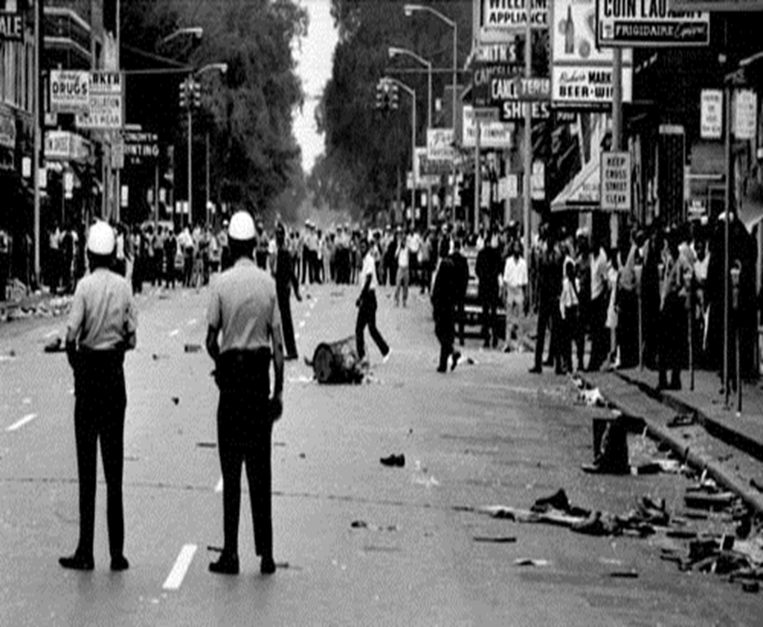
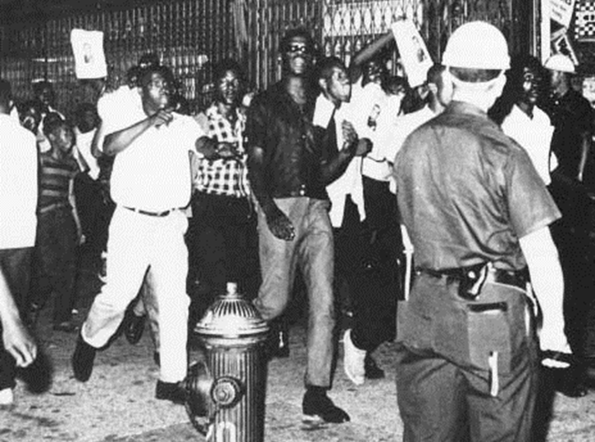
Turmoil of the 1960’s
Race riots in
-Central Harlem, 1964
-Watts, South Central LA (after LBJ signed the Voting Rights Act), 1965
-100 other cities in 1967

Slide 14
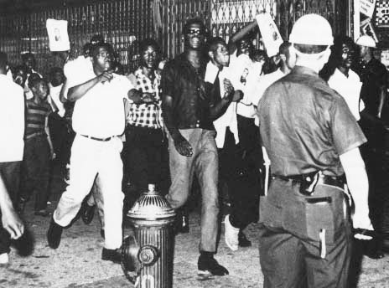
Violence Erupts
Between 1964-1968 more than 100 Race Riots in US cities
1964 Harlem Riot (NY)
Black teenagers and White police
15 yr old killed

Slide 15
1965 Watts Riot (LA)
One of the worst in history
34 people killed
$100’s of millions of property destroyed
1967 Detroit Riots
43 people killed
Over $40 million property damage

Slide 16
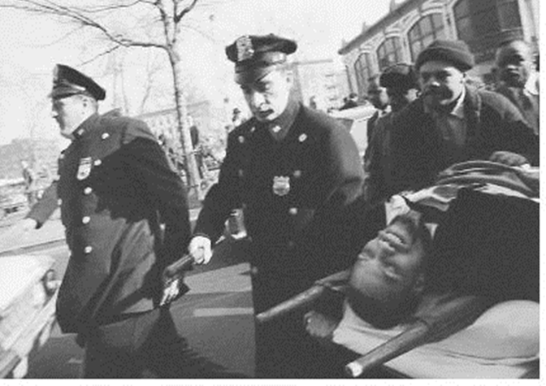
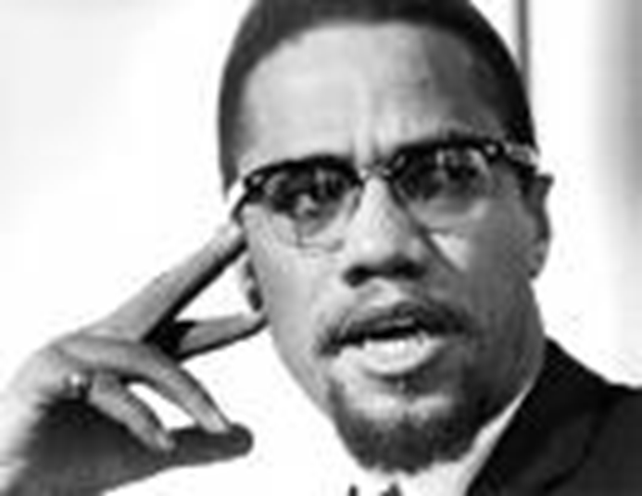
Malcolm X
New black leader who advocated armed self-defense
Head of Nation of Islam (black Muslims)
Broke from that group and was becoming less violent when assassinated (1965)

Slide 17
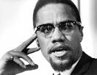
III. New Leaders
A. Malcolm X
1. Studied the teachings of Elijah Muhammad
Black Muslim
Islamic Minister

Slide 18
2. Malcolm X Preached
a) Whites were the cause of Black problems
b) Blacks should separate from White society
c) Advocated Armed Self-Defense
Malcolm X frightened most Whites
Some Black Muslims resented Malcolm X

Slide 19
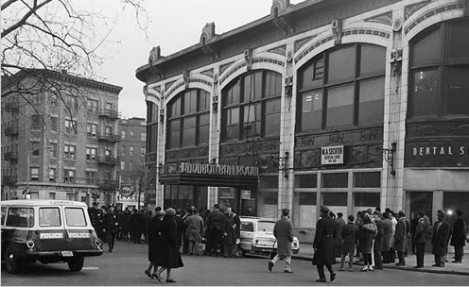
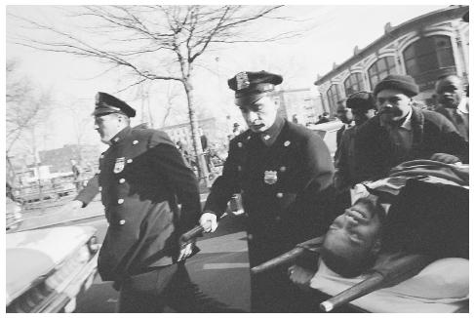
3. 1964 Malcolm X broke from Elijah Muhammad over differences in strategy and doctrine
Formed his own Muslim Organization
4. 1965 Malcolm X was shot & killed while giving a speech in Harlem

Slide 20
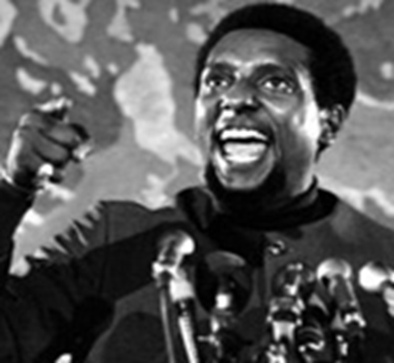
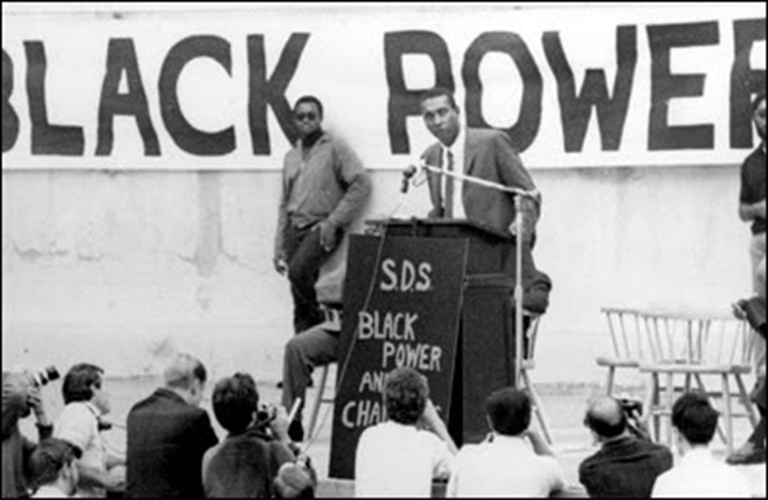
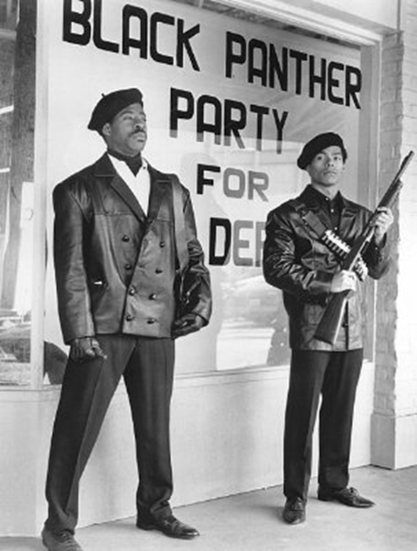
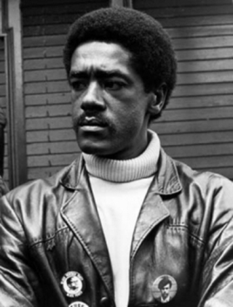
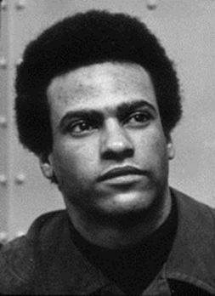
Black Power
Stokely Carmichael coined the phrase to rally militant activists 1966
MLK urged him to NOT use phrase
Black Panthers formed in Oakland, CA
(Bobby Seale, Huey Newton founded)
-Fight police brutality in the ghettos
-Full employment for blacks
-Self sufficiency
-Decent Housing

Slide 21
B. Stokley Carmichael - SNCC
Militant & followed ideas of Malcolm X
1. “Black Power” battle cry of militant civil rights activists
2. Use violence and antagonize Whites
Develop Black Pride

Slide 22
C. Huey Newton & Bobby Seal
1. Black Panthers formed in Oakland Ca 1966
Political Party fought police brutality
2. Used violence to protect the neighborhood
Bobby Seale Huey Newton

Slide 23
1968 Turning Point in Civil Rights
MLK objected to “Black Power” movement
MLK assassinated April 3, 1968
Led to the worst urban rioting in U.S. history (Baltimore, Chicago, Kansas City, Washington, D.C.)
Robert Kennedy assassinated in June, 1968

Slide 24
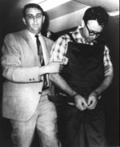
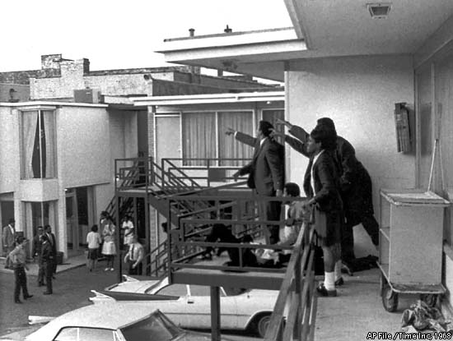
1968
April 4, 1968 MLK shot & killed
James Earl Ray the killer

Slide 25
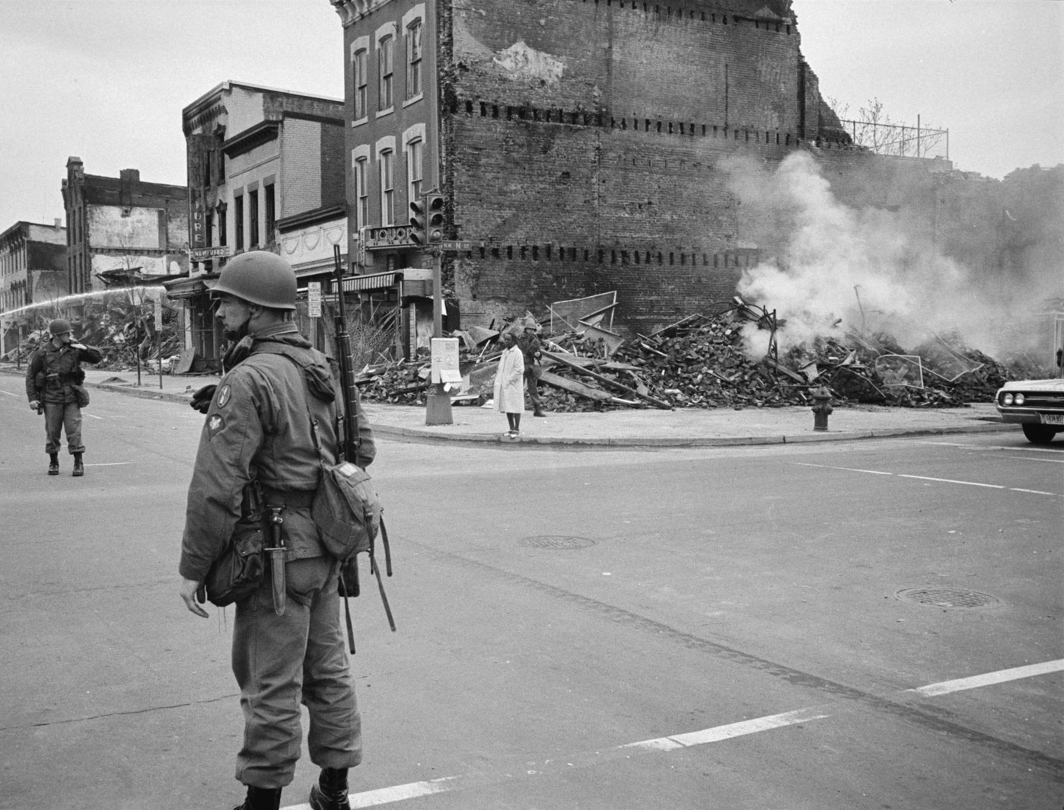
MLK death led to the worst urban rioting in US History
Over 100 cities exploded in flames
1. Washington D C

Slide 26
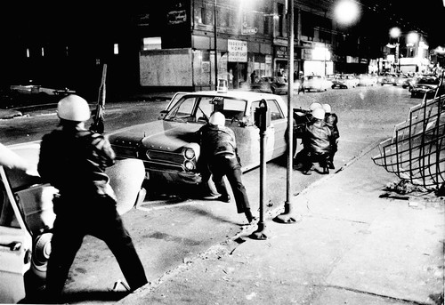
2. Chicago

Slide 27
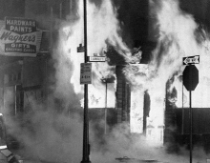
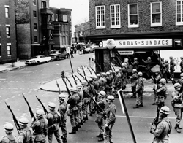
3. Baltimore

Slide 28
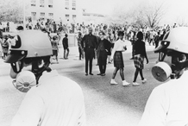
4. Kansas City

