Slide 1
Thursday February 5, 2015 Mr. Goblirsch – American Government
OBJECTIVE – Students Will Be Able To – SWBAT:
- Explain the American system of Federalism, focusing on the powers of governments.
AGENDA:
WARM-UP: Division of Power Journal
CONCEPT: Federalism
JIGSAW: State Powers (P. 92)
TASK: Name That Power
If Time - GROUP WORK: State Poster
*****TOMORROW – Constitution Quiz
Division of Power Journal WARM-UP: (Follow the directions below)
***5 minutes***
Write a paragraph journal entry answering the question below.
Define the terms Federalism using your glossary.
Do you get to make decisions in your life, or do your parents make all the decisions in your life? What is an example of a decision you got to make? What is an example of a decision you didn’t get to make because your parents made it for you?

Slide 2
FEDERALISM
Division of Power

Slide 3
Powers of the National Government
The National Government is a government of delegated powers, meaning that it only has those powers delegated (granted) to it in the Constitution. There are three types of delegated powers:
The expressed powers are those found directly within the Constitution.
The implied powers are not expressly stated in the Constitution, but are reasonably suggested, or implied by, the expressed powers.
The inherent powers belong to the National Government because it is the government of a sovereign state within the world community. There are few inherent powers, with an example being the National Government’s ability to regulate immigration.
2
3
Chapter 4, Section 1

Slide 4
JIGSAW: The States
Powers Reserved to the States
Partner A (Partner on the Left) read the “Powers Reserved to the States” on Pg. 92.
Write 2 powers reserved to the states
Powers Denied to the States
Partner B (Partner on the Right) read the “Power Denied to the States” on Pgs. 92-93.
Write 2 powers denied to the states
2
3
Chapter 4, Section 1

Slide 5
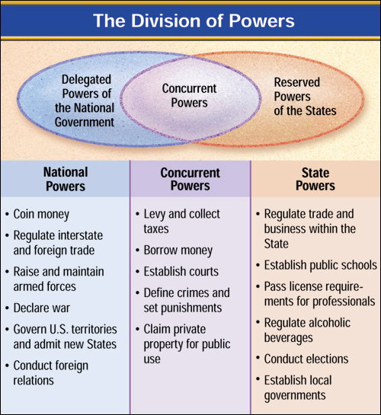
The Division of Powers
2
3
Chapter 4, Section 1

Slide 6
NAME THAT POWER DIRECTIONS: With your partner, discuss which classification the power below belongs in. - Expressed Power - Reserved Power - Implied or Inherent Power - Concurrent Power
Declare War
Implement the draft
Establish public schools
Levy taxes
Creation of the IRS
Coin money
Maintain a military
Establish courts
Regulate intrastate commerce
Establish a minimum drinking age
Build an interstate highway
License doctors
Regulate immigration
Make Treaties
Punish crimes
Issue a driving licenses

Slide 7
NEED TO KNOW: CONSTITUTION QUIZ
MULTIPLE CHOICE:
Introduction to Constitution
Art. IV – Relations among States
Art. IV – Admitting New states
Art. V – Proposing & Ratifying amendments
Art. VII – Ratification
Art. I – Congress qualifications
Art. I – President of the Senate
Art I,II,III – Term Lengths
Art. VI – Supremacy Clause
Art. I – Monetary Powers (power of the “purse”)
SHORT RESPONSE:
Describe how the United States Constitution set up a government based on Separation of Powers with Checks and Balances, along with setting up a government system of Federalism.
THINK ABOUT:
3 Branches of Government & Powers/Duties of each
Division of Power between the National & State governments

Slide 8
The Supreme Law of the Land
The Supremacy Clause in the Constitution establishes the Constitution and United States laws as the “supreme Law of the Land.”
2
3
Chapter 4, Section 1

Slide 9
Ch 3 Sec 2 & Ch 4 Sec 1 TITLE: 3 Branches & Federalism
L
E
J
Delegated National Powers
Expressed powers – stated in Articles I – III
Implied powers – needed to carry out expressed powers – “necessary & proper” – EX. In order to maintain a military (expressed) the government can implement a draft (implied)
Inherent powers – are needed for a government to function – EX. Control immigration
Reserved Powers - States
Powers not granted to federal government are reserved for the states
Conflict = Supremacy clause (Art VI Sec. 2) – can not conflict with national law or the Constitution
Concurrent Powers
Powers both federal & states have - CHART on P. 97
Denied Powers
Not allowed for any level of government
Fed. Govt. cannot: tax exports, cannot interfere w/ states ability to carry out responsibilities
No state can: EX. make treaties, coin money

Slide 10
Ch 4 Sec 1 TITLE: Federalism & Powers
Delegated Powers from The Constitution
Legislative Powers – Founding Fathers saw Congress as the most important branch
Expressed Powers – directly stated
Art. 1 Sec. 8 = Enumerated powers
5 - economy/money/taxing
7 – defense
5 – Naturalizing citizens, post offices, patents, courts, Wash DC
#18 – elastic clause – “necessary & proper” – McCulloch v. Maryland (1819) Supreme Court ruled in favor of a broad interpretation
Executive Powers – Created in response to weakness of the Articles of Confederation
Head of the executive Branch – fire officials, make foreign agreements, emergency action
Vague – his powers are not expressly laid out - “Wild Card” – “The executive Power shall be vested in a President of the United States of America”
Specific Powers
Commander in Chief – commissions all military officers
Appoint department heads
Pardon
Make treaties, appoint ambassadors
Ensures laws are “faithfully executed
Delivers annual State of the Union, calls Congress into special session when necessary, suggests legislation/agenda to Congress
Judicial Jurisdiction
Congress establishes “inferior” courts & sets # of Supreme Court judges
Try cases that involve federal laws, treaties, & constitutional interpretation
Also try cases dealing with maritime law (law of the sea) & bankruptcy

Slide 11
The States
Powers Reserved to the States
The 10th Amendment declares that the States are governments of reserved powers.
The reserved powers are those powers that the Constitution does not grant to the National Government and does not, at the same time, deny to the States.
Powers Denied to the States
Just as the Constitution denies many powers the National Government, it also denies many powers to the States.
Powers denied to the States are denied in much the same way that powers are denied to the National Government; both expressly and inherently.
2
3
Chapter 4, Section 1

Slide 12
Federalism Defined
Federalism is a system of government in which a written constitution divides the powers of government on a territorial basis between a central, or national, government and several regional governments, usually called states or provinces.
The Constitution provides for a division of powers, assigning certain powers to the National Government and certain powers to the States.
2
3
Chapter 4, Section 1

Slide 13
Powers Denied to the National Government
Powers are denied to the National Government in three distinct ways:
Some powers, such as the power to levy duties on exports or prohibit the freedom of religion, speech, press, or assembly, are expressly denied to the National Government in the Constitution.
Also, some powers are denied to the National Government because the Constitution is silent on the issue.
Finally, some powers are denied to the National Government because the federal system does not intend the National Government to carry out those functions.
2
3
Chapter 4, Section 1

Slide 14
The Exclusive and Concurrent Powers
Exclusive Powers
Powers that can be exercised by the National Government alone are known as the exclusive powers.
Examples of the exclusive powers are the National Government’s power to coin money, to make treaties with foreign states, and to lay duties (taxes) on imports.
Concurrent Powers
The concurrent powers are those powers that both the National Government and the States possess and exercise.
Some of the concurrent powers include the power to levy and collect taxes, to define crimes and set punishments for them, and to claim private property for public use.
2
3
Chapter 4, Section 1

Slide 15
The Federal System and Local Governments
There are more than 87,000 units of local government in the United States today.
Each of these local units is located within one of the 50 States. Each State has created these units through its constitution and laws.
Local governments, since they are created by States, are exercising State law through their own means.
2
3
Chapter 4, Section 1

Slide 16
GROUP TASK: State Flag
DIRECTIONS:
The members of your State (the whole Senate section will work together) are to create a State Flag. All members are to contribute. Your State flag should represent your State meaning that it should include pictures/symbols that represent your State. Your poster should include the names of all section members and the name of your State.

