Slide 1
Wednesday February 18, 2015 Mr. Goblirsch – American Government
OBJECTIVE – Students Will Be Able To – SWBAT:
- Identify the path to becoming the President of the U.S.
AGENDA:
WARM-UP: Presidential Timeline
CONCEPT: The Path to the Presidency
READING: The Framer’s Electoral College Plan (P. 366)
EXIT TICKET: Electoral College Writing
ASSIGNMENT: Workbook Pgs. 62 & 63
*****Workbook Pgs. 62 & 63 – DUE FRIDAY
Presidential Timeline WARM-UP: (Follow the directions below)
***5 minutes***
Analyze the timeline on P. 360-361. Answer the questions below.
What year was the 12th Amendment passed?
For what reason do you think the 20th Amendment was passed?
What does the 25th Amendment deal with? Since it’s passing in 1967, how many times has the 25th Amendment been implemented?

Slide 2
PRIOR KNOWLEDGE: Presidential Roles/Titles
Chief of State
Ceremonial head of U.S. government
Chief Executive
Executive power from the Constitution
Chief Administrator
Head of Executive Branch of Government
Chief Diplomat
National spokesperson and determines foreign policy
Commander in Chief
Controls armed forces
Chief Legislator
Initiates, suggests, requests, insists, and demands Congress enact much of its major legislation
Chief of Party
Leader of his political party
Chief citizen
Represents the American people and their interests

Slide 3
The President Part II

Slide 4
Road to the White House Running for President
I. File Candidacy
II. Campaign
A. Campaign and Debates (1-2 years prior to election)
B. Nominating Primaries or Caucuses; President must campaign first to be his parties representative (Starting January of election year by tradition)
1. New Hampshire
Has a state law that says they hold their primary the Tuesday before any other state schedules theirs
2. Iowa
Use the caucus convention process
3. Other 48 (“front loading” – holding primaries earlier)
4. Result = Presidential nominees by the Summer

Slide 5
Road to the White House Running for President
C. Summer National Convention
Each party will name their Presidential and Vice-Presidential candidates
Incumbent Presidents have large advantage if re-running for office
D. Fall Campaign
Includes Presidential debates (today they are televised)
E. Election Night (First Tuesday of First Week of November by law)
Usually known by Midnight of Election Night who the winner is
Must get 270 electoral votes or else sent to the House of Representatives to select (twice happened 1800 & 1824)
F. The Electoral College (December by Constitution)
“rubber stamp” electors cast vote
Popular vote doesn’t always win (hasn’t 4x – 1824, 1876, 1888, 2000)
G. Inauguration Day (January 20 by Amendment)

Slide 6
The Electoral College
Read the Electoral College handout, write your exit ticket, and turn it into the basket as you leave.

Slide 7
EXIT TICKET: What do you think of the Electoral College?
The Founding Fathers created the Electoral College as our system to elect the President of the U.S.. Write a paragraph defending or opposing the Electoral College system. Use examples as to why you think it is a good system or a flawed system.
Hints: Not popular vote, winner-take-all in States, Apportionment of Electors

Slide 8
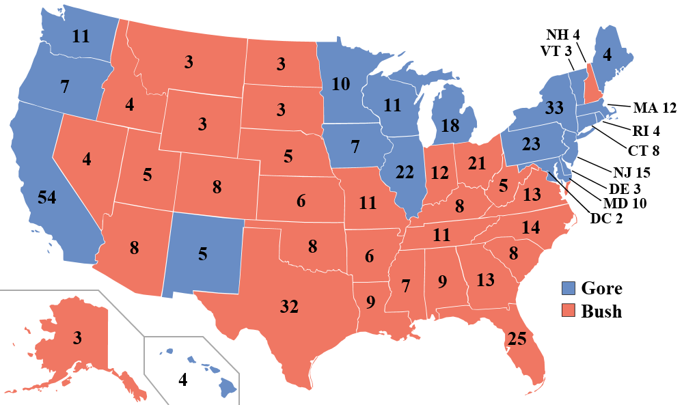
2000 Red = G.W. Bush Blue = A. Gore

Slide 9
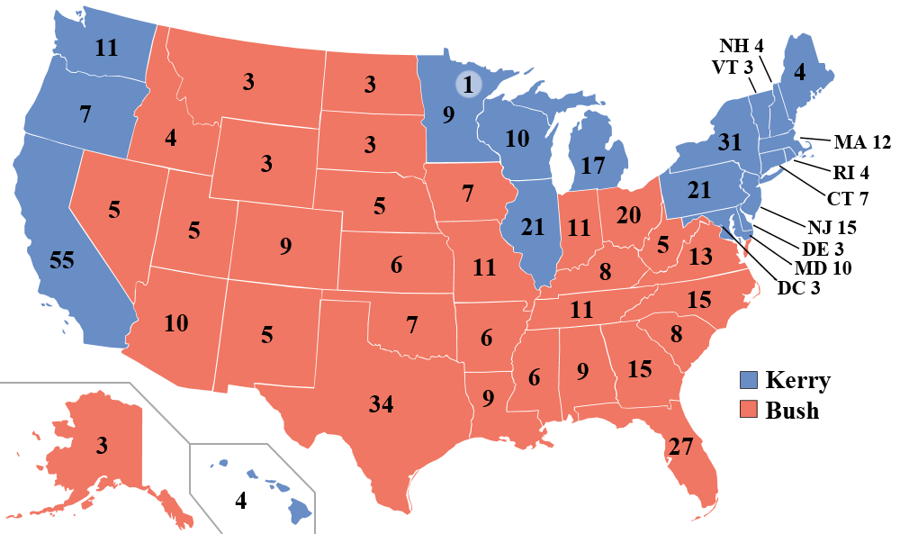
2004 Red = G.W. Bush Blue = J. Kerry

Slide 10
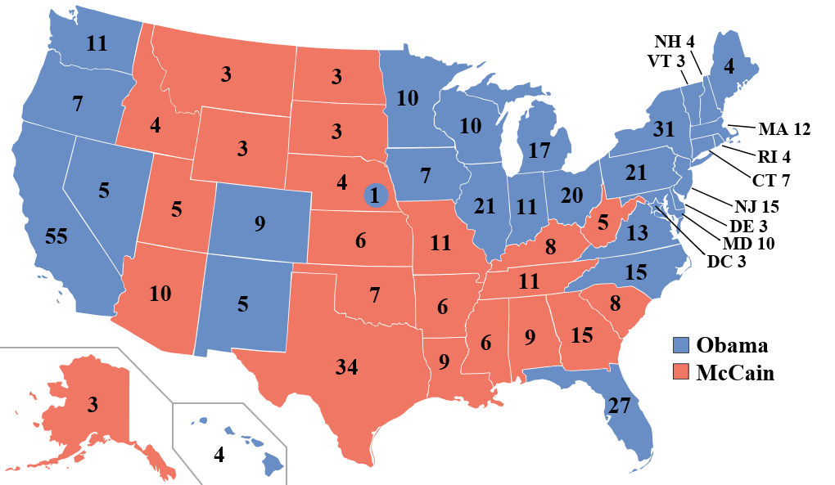
2008 Red = J. McCain Blue = B. Obama

Slide 11
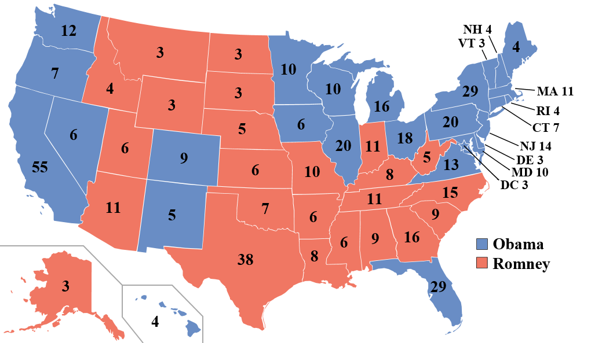
2012 Red = M. Romney Blue = B. Obama

Slide 12
Red State, Blue State
Red States | Blue States | Swing States
1) List all of the states that voted Republican in all 4 elections from 2000 – 2012 2) Add up the number of Red States 3) Add up the electoral votes of the Red States (use the 2012 electoral numbers) 4) What regions are primarily Red States | 1) List all of the states that voted Democrat in all 4 elections from 2000 - 2012 2) Add up the number of Blue States 3) Add up the electoral votes of the Blue States (use the 2012 electoral numbers) 4) What regions are primarily Blue States | 1) List all of the states that flipped at least one time during the elections of 2000 – 2012 2) Add up the number of Swing States 3) Add up the electoral votes of the Swing States (use the 2012 electoral numbers)

Slide 13
Red State, Blue State
Solid Red States | Solid Blue States | Swing States
Texas – 38 Georgia – 16 Tennessee – 11 Arizona – 11 Missouri – 10 Alabama – 9 South Carolina – 9 Louisiana – 8 Kentucky – 8 Oklahoma – 7 Arkansas – 6 Kansas – 6 Mississippi – 6 Utah – 6 Nebraska – 5 West Virginia – 5 Idaho – 4 Alaska – 3 Montana -3 North Dakota – 3 South Dakota – 3 Wyoming – 3 2) 22 states 3) 180 electoral votes (need 90 for 270) 4) South, Midwest | California – 55 New York – 29 Pennsylvania – 20 Illinois – 20 Michigan – 16 New Jersey – 14 Washington – 12 Massachusetts – 11 Maryland – 10 Minnesota – 10 Wisconsin – 10 Connecticut – 7 Oregon – 7 Hawaii – 4 Maine – 4 Rhode Island – 4 Delaware – 3 Vermont – 3 Washington DC – 3 2) 19 states 3) 239 electoral votes (need 31 for 270) 4) West Coast, Northeast, Great Lakes | Florida – 29*** Ohio – 18*** North Carolina – 15 Virginia – 13 Indiana – 11 Colorado – 9 Iowa – 6 Nevada – 6 New Mexico – 5 New Hampshire – 4 2) 10 states 3) 116 electoral votes “up for grabs”

Slide 14
Proposed Reforms to the Electoral College
I. District Plan
A. District electors of state cast vote for the winner of their district
B. State’s 2 at-large electors (representing senate seats) cast vote for candidate who wins entire state
Pros – eliminates winner-take-all system
Cons – increases importance of congressional redistricting and gerrymandering

Slide 15
Proposed Reforms to the Electoral College
II. Proportional Plan
A. Candidates receive electoral votes in proportion to popular vote in state
Pros – eliminates winner-take-all system and would more closely resemble popular vote
Cons – 3rd party influence, less chance to get 270 majority

Slide 16
Proposed Reforms to the Electoral College
III. Direct Popular Election
A. President would be selected by popular vote, most votes wins
Pros – everyone’s vote is equal, eliminates confusion of Electoral College
Cons – State’s lose identity in election, Huge impact on candidates campaign time, effort, and money

