Slide 1
Friday February 20, 2015 Mr. Goblirsch – American Government
OBJECTIVE – Students Will Be Able To – SWBAT:
- Determine Red States, Blue States, and Swing States of the Electoral College.
AGENDA: 3rd & 6th Period ONLY
WARM-UP: Tax Day
ELECTION: Section Leader Election Day
VOTE: State Flag Poster Voting
TASK: Red State, Blue State
*****WORKBOOK P. 62 & 63 DUE TODAY – Turn into the basket
Tax Day WARM-UP: (Follow the directions below)
***5 minutes***
Calculate your weekly taxes and make your Weekly Deposit.
Ask your Section Leader if you received any daily bonus pay
If so, add it to your pay for that day on your Weekly Time Sheet
Add up your daily pay from the week to get your Gross Total
Calculate your taxes using the TAX BRACKETS below:
Gross Total Less than $35.00 ================→28% tax rate (X 0.28)
Gross Total $35 through $45.00 ==============→ 33% tax rate (X 0.33)
Gross Total More than $45.00 ================→38% tax rate (X 0.38)
Subtract your taxes from your gross to get your net pay
Your net pay for the week = your Weekly Deposit

Slide 2
Friday February 20, 2015 Mr. Goblirsch – American Government
OBJECTIVE – Students Will Be Able To – SWBAT:
- Determine Red States, Blue States, and Swing States of the Electoral College.
AGENDA: 4th & 5th Period ONLY
WARM-UP: Tax Day
ELECTION: Section Leader Election Day
VOTE: State Flag Poster Voting
TASK: Red State, Blue State
*****WORKBOOK P. 62 & 63 DUE TODAY – Turn into the basket
Tax Day WARM-UP: (Follow the directions below)
***5 minutes***
Calculate your weekly taxes and make your Weekly Deposit.
Ask your Section Leader if you received any daily bonus pay
If so, add it to your pay for that day on your Weekly Time Sheet
Add up your daily pay from the week to get your Gross Total
Calculate your taxes using the TAX BRACKETS below:
Gross Total Less than $35.00 ================→30% tax rate (X 0.30)
Gross Total $35 through $45.00 ==============→ 35% tax rate (X 0.35)
Gross Total More than $45.00 ================→40% tax rate (X 0.40)
Subtract your taxes from your gross to get your net pay
Your net pay for the week = your Weekly Deposit

Slide 3
STATE FLAG POSTER VOTE
VOTE #1 DIRECTIONS: Rank the Posters from each class period.
STATE | RANK | STATE | RANK
PERIOD 3 |  | PERIOD 5
SENATE |  | SENATE
FLORIDA |  | NEW YORK
OREGON |  | OREGON
MISSISSIPI |  | HAWAII
PERIOD 4 |  | PERIOD 6
SENATE |  | SENATE
NEW YORK |  | CALIFORNIA
GEORGIA |  | COLORADO
MAINE |  | NEVADA
VOTE #2 DIRECTIONS: Vote for the 3 top posters OVERALL (class period does not matter)
OVERALL RANK | CLASS PERIOD | STATE
#1
#2
#3

Slide 4
Red State, Blue State
Red States | Blue States | Swing States
1) List all of the states that voted Republican in all 4 elections from 2000 – 2012 2) Add up the number of Red States 3) Add up the electoral votes of the Red States (use the 2012 electoral numbers) 4) What regions are primarily Red States | 1) List all of the states that voted Democrat in all 4 elections from 2000 - 2012 2) Add up the number of Blue States 3) Add up the electoral votes of the Blue States (use the 2012 electoral numbers) 4) What regions are primarily Blue States | 1) List all of the states that flipped at least one time during the elections of 2000 – 2012 2) Add up the number of Swing States 3) Add up the electoral votes of the Swing States (use the 2012 electoral numbers)

Slide 5
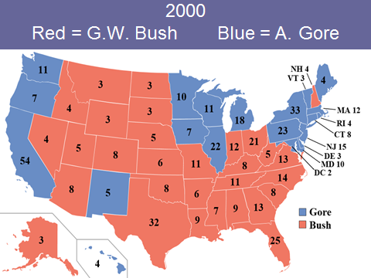
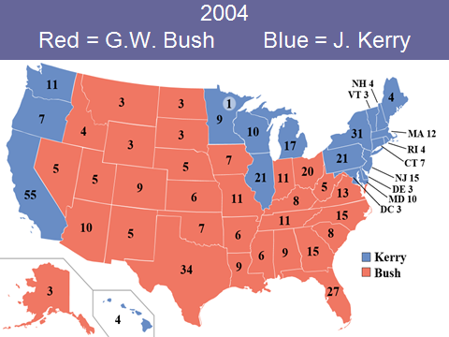
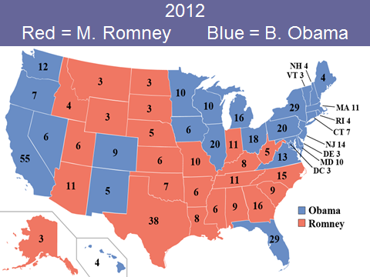

Slide 6
Red State, Blue State
Red States | Blue States | Swing States
1) TX - 38 2) 3) 4) | 1) CA - 55 2) 3) 4) | 1) FL - 29 2) 3)

Slide 7
Red State, Blue State
Solid Red States | Solid Blue States | Swing States
Texas – 38 Georgia – 16 Tennessee – 11 Arizona – 11 Missouri – 10 Alabama – 9 South Carolina – 9 Louisiana – 8 Kentucky – 8 Oklahoma – 7 Arkansas – 6 Kansas – 6 Mississippi – 6 Utah – 6 Nebraska – 5 West Virginia – 5 Idaho – 4 Alaska – 3 Montana -3 North Dakota – 3 South Dakota – 3 Wyoming – 3 2) 22 states 3) 180 electoral votes (need 90 for 270) 4) South, Midwest | California – 55 New York – 29 Pennsylvania – 20 Illinois – 20 Michigan – 16 New Jersey – 14 Washington – 12 Massachusetts – 11 Maryland – 10 Minnesota – 10 Wisconsin – 10 Connecticut – 7 Oregon – 7 Hawaii – 4 Maine – 4 Rhode Island – 4 Delaware – 3 Vermont – 3 Washington DC – 3 2) 19 states 3) 239 electoral votes (need 31 for 270) 4) West Coast, Northeast, Great Lakes | Florida – 29*** Ohio – 18*** North Carolina – 15 Virginia – 13 Indiana – 11 Colorado – 9 Iowa – 6 Nevada – 6 New Mexico – 5 New Hampshire – 4 2) 10 states 3) 116 electoral votes “up for grabs”

Slide 8
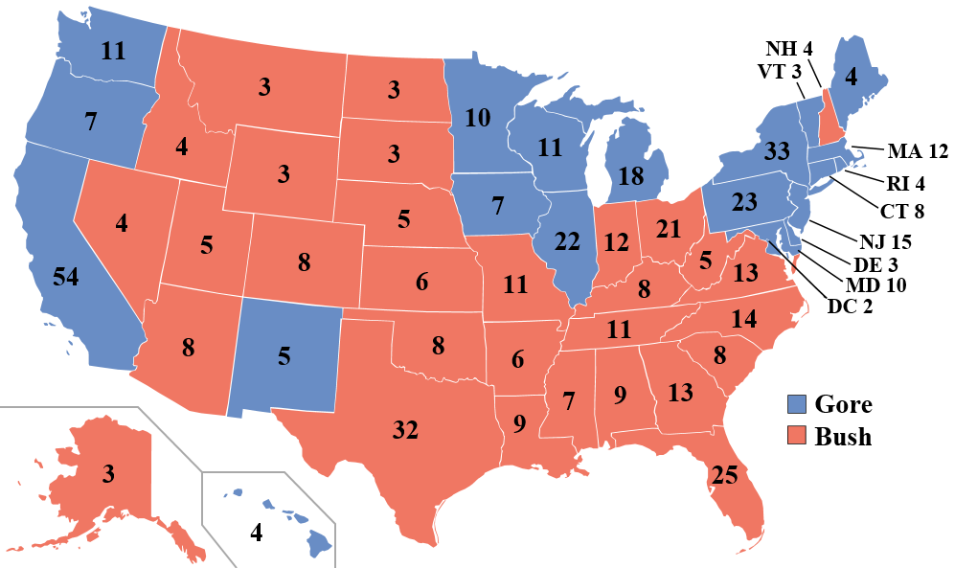
2000 Red = G.W. Bush Blue = A. Gore

Slide 9
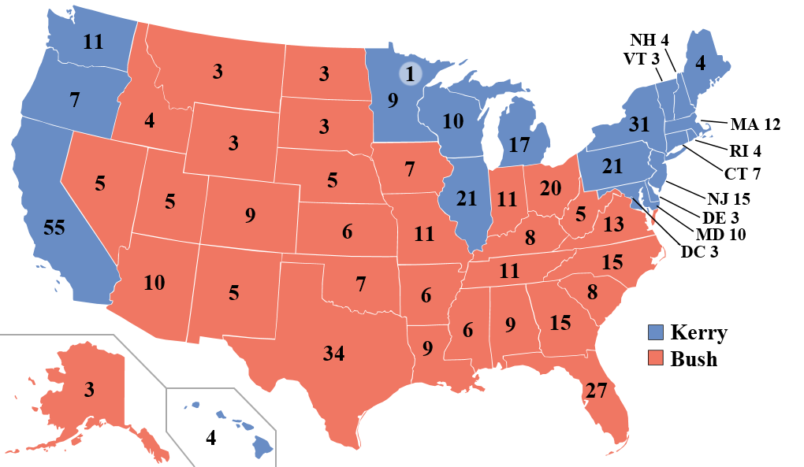
2004 Red = G.W. Bush Blue = J. Kerry

Slide 10
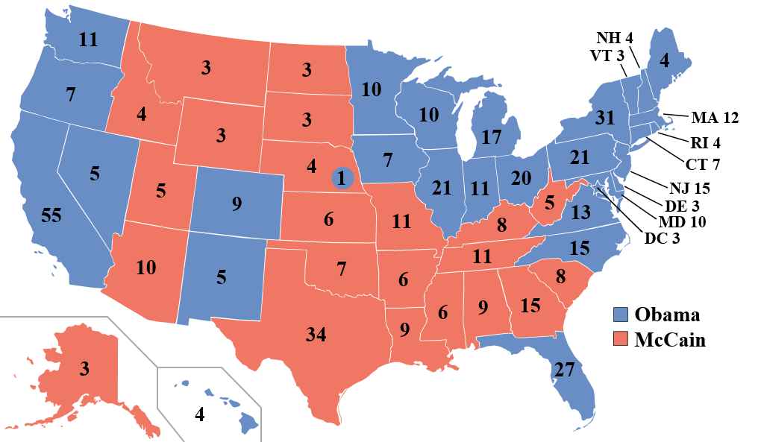
2008 Red = J. McCain Blue = B. Obama

Slide 11
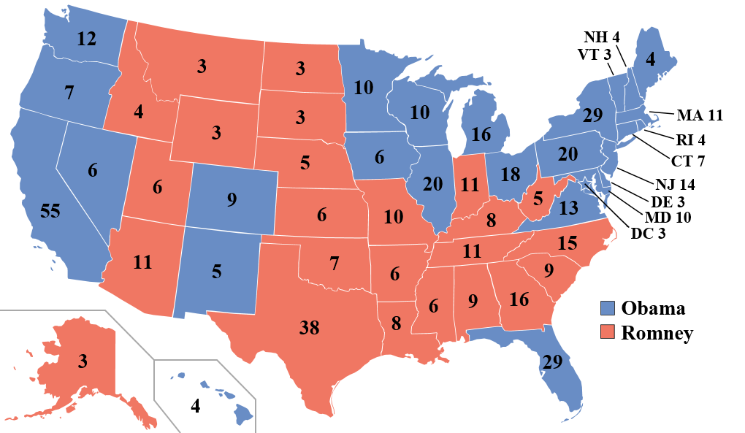
2012 Red = M. Romney Blue = B. Obama

Slide 12
BALLOT
Representative/Senator Name:
_________________________
_______________________
VOTE: Section Leader
WRITE IN: ________________

Slide 13
Section Leader Bonus Pay Summary
DIRECTIONS: Each section leader has $5 a day in Bonus Pay to distribute to workers within their section. This includes any Bonus Pay the section leaders pay themselves, and any Bonus Pay they pay any employees they hired.
On the chart below, write down the amount of Bonus Pay each member received each day. EXAMPLE – If Mr. Goblirsch received a $2 bonus on Monday, then I would write Mr. Goblirsch - $2 under the Monday column.
MONDAY | TUESDAY | WEDNESDAY | THURSDAY | FRIDAY

Slide 14
EXAM ASSISTANCE PROGRAM: (1) Find out each members taxes (2) Add them up (3) Write the Total Tax amount on back.
MEMBER | TAX AMOUNT | MEMBER | TAX AMOUNT
1. | 1. | 7. | 7.
2. | 2. | 8. | 8.
3. | 3. | 9. | 9.
4. | 4. | 10. | 10.
5. | 5. | 11. | 11.
6. | 6. | 12. | 12.

Slide 15
LIST OF INDIVIDUALS WHO HAVE PAID FOR THE FINAL
Tino A.
Cristian C.
Illene C.
Lucy F.
Casidy J.
Jennifer L.
Ashley
Ramon
Lesley
Arvinder
Vanessa S
Alicia M.
Lili O.
Jaskaran S.
Ricky V.
Perla V.
Brandon V.
Jesus
John
Total = 18 / 31

Slide 16
LIST OF INDIVIDUALS WHO HAVE PAID FOR THE FINAL
Rafael A.
Gabriella B.
Cristian C.
Tristan D.
Maria F.
Alexis G.
Leo M.
Hilsa A.
Kime Y.
Destiny B.
Caleb M.
Andrew M.
Victor P.
Cynthia S.
Elizabeth S.
Miranda S.
Kyndall S.
Manuel Z.
TOTAL = 18 / 35

