Slide 1
Tuesday February 24, 2015 Mr. Goblirsch – American Government
OBJECTIVE – Students Will Be Able To – SWBAT:
- Describe how the power of the Presidency has expanded over time.
AGENDA:
WARM-UP: Presidential Quotes
CONCEPT: Expanding Presidential Power
READING: Presidential View (P. 392)
CONGRESSIONAL VOTE: Redistributing Funding
ASSIGNMENT: Workbook Pg. 73 – DUE THURSDAY
Presidential Quotes WARM-UP: (Follow the directions below)
***5 minutes***
Analyze the quotes on P. 391 from former Presidents.
Which Presidents seemed to enjoy the job? Which seemed to not enjoy the job?
Why do you think President Harry Truman compared being President to “riding a tiger”?

Slide 2
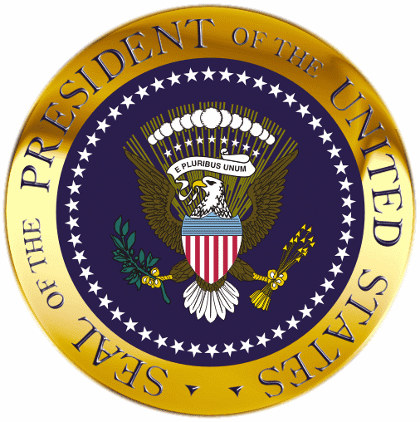
The President: Expanding Powers

Slide 3
DRAW A PICTURE OF A TREE

Slide 4
Article II
Article II, the Constitution’s Executive Article, begins this way:
“The executive power shall be vested in a President of the United States of America.”
With these few words, the Framers established the presidency.
2
3
4
Chapter 14, Section 1

Slide 5
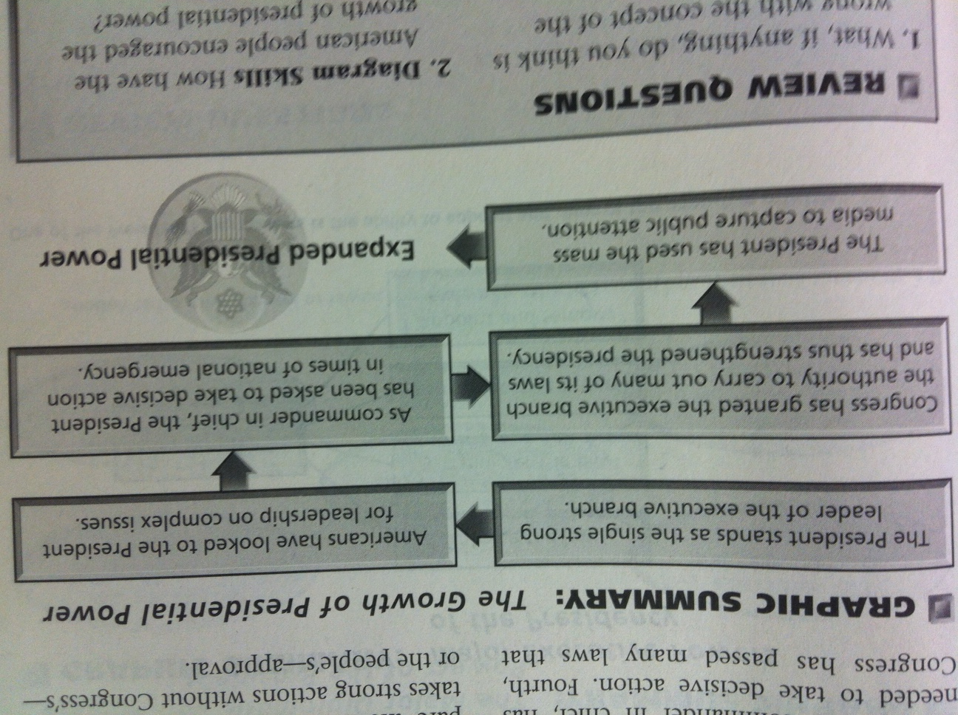
Why Presidential Power Has Grown
STRUCTURED ACADEMIC DISCUSSION:
How have the American people encouraged the growth of power by the president?
Do you think it is a legitimate use of power for the President to use the mass media to capture public attention?
2
3
4
Chapter 14, Section 1

Slide 6
Presidential Powers
Presidents that Expanded their Power
Jefferson – Louisiana Purchase (acquired territory, not stated in Const., Senate ratified)
Lincoln – “Preserve the Union” suspended habeas corpus, jailed Union opponents w/o trial, implemented draft, blockaded Southern ports, Emancipation Proclamation
Teddy Roosevelt – “Do anything necessary that the needs of the nation demanded, unless such action forbidden by Constitution.” – Trust Buster, Strike arbitrator
FDR – New Deal increased economic power – created agencies to run programs
LBJ – Tonkin Gulf Resolution “necessary steps” to protect Americans in Vietnam, expanded war powers
G.W. Bush – “War on Terrorism” – PATRIOT Act to combat terrorism
Mandate of the People – uses the media to gain public support
STRUCTURED ACADEMIC DISCUSSION:
Which President above do you feel expanded the power of the Presidency the most?

Slide 7
CONGRESSIONAL VOTE: Redistributing Funding
PROPOSED BILL:
Currently, our government as some additional funding. It will be up to Congress to determine how that funding will be distributed. There are two options below. This vote will be a two-step process. First we will vote on which proposal, then we will vote “Yes” or “No” to implement the proposal.
PROPOSAL:
A) 8% tax cut to all members
OR
B) $2.00 raise for House members, a $0.75 raise for Senate members
A “Yes” vote will implement the selected proposal
A “No” vote will keep everything they way it currently is

Slide 8
Presidential Cabinet Assignment
READ CH 15-3 Pg. 424 - 429
COMPLETE WORKBOOK PG. 73

Slide 9
BALLOT
Representative/Senator Name:
_________________________
_______________________
_____ YES
_____ NO

Slide 10
LIST OF INDIVIDUALS WHO HAVE PAID FOR THE FINAL
Tino A.
Cristian C.
Illene C.
Lucy F.
Casidy J.
Jennifer L.
Ashley
Ramon
Lesley
Arvinder
Vanessa S
Alicia M.
Lili O.
Jaskaran S.
Ricky V.
Perla V.
Brandon V.
Jesus
John
Total = 19 / 31

Slide 11
LIST OF INDIVIDUALS WHO HAVE PAID FOR THE FINAL
Rafael A.
Gabriella B.
Cristian C.
Tristan D.
Maria F.
Alexis G.
Leo M.
Hilsa A.
Kime Y.
Destiny B.
Fatima O.
Caleb M.
Andrew M.
Victor P.
Cynthia S.
Elizabeth S.
Miranda S.
Kyndall S.
Manuel Z.
TOTAL = 19 / 35

Slide 12
The Presidential View
The nature of the presidency depends on how each President views the office and exercises its powers.
Two Views:
TEDDY ROOSEVELT
WILLIAM HOWARD TAFT
Read the 2 Quotes on P. 392 about the Power of the President. Compare and contrast the quotations. (a) Whose view do you favor? (b) Which view do you think most modern-day Presidents have favored?
2
3
4
Chapter 14, Section 1

Slide 13
Why Presidential Power Has Grown
Over the course of American history, the champions of a stronger presidency have almost always prevailed.
The nation’s increasingly complex social and economic life has also influenced the growth of presidential power.
By passing laws and expanding the role of the Federal Government, Congress has increased presidential power as well.
The ability to use the mass media, as every President since Franklin D. Roosevelt has, aids in gathering and holding public attention.
2
3
4
Chapter 14, Section 1

Slide 14
Presidential Powers
Article II
Executive Power – enforce laws
head of more than 2 million executive branch employees, federal agencies
Executive order – enforce policies & programs enacted by Congress (1948 – Truman desegregated the armed forces)
Impoundment – refusal to spend money Congress has appropriated
Appoint executive heads/Cabinet of advisors (w/ Senate consent) (remove appointed officials)
Judicial Powers – appoint federal judges (w/ Senate consent), grant reprieve, pardon, amnesty
Annual State of the Union Address–propose legislation–call Special Session of Congress
Approve/Veto legislation – uses veto threat to influence Congress, hard to override
*pocket veto – set aside *line-item veto–declared unconstitutional 1998
Directs foreign policy – treaties (w/ 2/3 Senate consent), appoint/accept ambassadors
Executive Agreement – do not require Senate consent
acknowledge foreign governments
Commander in Chief – head of armed forces, national security
Send forces into action w/o formal declaration of war w/ or w/o Congressional approval
Make key military decisions (including using the atomic bomb)
Special War Powers (more control at home) price controls, government control of war industries, rationing
Emergency Powers – rioting, natural disaster (flood, hurricane, tornado)

Slide 15
Presidential Powers
Expanding Presidential Power
Jefferson – Louisiana Purchase (acquired territory, not stated in Const., Senate ratified)
Lincoln – “Preserve the Union” suspended habeas corpus, jailed Union opponents w/o trial, implemented draft, blockaded Southern ports, Emancipation Proclamation
Teddy Roosevelt – “Do anything necessary that the needs of the nation demanded, unless such action forbidden by Constitution.” – Trust Buster, Strike arbitrator
FDR – New Deal increased economic power – created agencies to run programs
LBJ – Tonkin Gulf Resolution “necessary steps” to protect Americans in Vietnam, expanded war powers
G.W. Bush – “War on Terrorism” – PATRIOT Act to combat terrorism
Mandate of the People – uses the media to gain public support
Limits on Presidential Power
Congress
Override veto – very difficult
Senate confirmations – treaties, appointments – executive & justices
Power of the Purse – $ power, pass tax, authorization, and appropriation bills
Impeachment – majority of House votes to impeach, 2/3 of Senate votes to convict
War Powers Act – limits Pres. to 60 days of combat w/o Congressional approval
Court
Marbury v. Madison – judicial review – determine constitutionality (laws, programs)
Public Opinion -> Low/Losing support = limitations

