Slide 1
Monday March 2, 2015 Mr. Goblirsch – American Government
OBJECTIVE – Students Will Be Able To – SWBAT:
- Identify the major elements of the federal bureaucracy.
AGENDA: 6th Period ONLY
WARM-UP: President Journal
READING: Chapter 15 Sections 1 & 2 (P. 414 – 422)
ASSIGNMENT: Complete Workbook Pgs. 71 & 72
***TURN INTO THE BASKET BEFORE YOU LEAVE***
***Workbook Pg. 69 – DUE TOMORROW
*President Quiz WEDNESDAY
President Journal WARM-UP: (Follow the directions below)
***5 minutes***
Write a paragraph journal entry on the topic below.
“Mothers all want their sons to grow up to be president, but they don’t want them to become politicians in the process.” – John F. Kennedy
Explain what President Kennedy meant by this remark. Do you believe it is possible for a person to be an active, successful President without being a politician?

Slide 2
Monday March 2, 2015 Mr. Goblirsch – American Government
OBJECTIVE – Students Will Be Able To – SWBAT:
- Identify the major elements of the federal bureaucracy.
AGENDA: 3rd, 4th, & 5th Periods ONLY
WARM-UP: President Journal
CONCEPT: The US Bureaucracy
READING: Executive Office of the President (P. 419)
ASSIGNMENT: Workbook P. 69
***ASSIGNMENT: Workbook Pg. 69 – DUE TOMORROW
*President Quiz WEDNESDAY
President Journal WARM-UP: (Follow the directions below)
***5 minutes***
Write a paragraph journal entry on the topic below.
“Mothers all want their sons to grow up to be president, but they don’t want them to become politicians in the process.” – John F. Kennedy
Explain what President Kennedy meant by this remark. Do you believe it is possible for a person to be an active, successful President without being a politician?

Slide 3
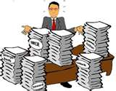
The US Bureaucracy
American Government
Copy the White

Slide 4
Bureaucracy
I. Definition
A. a large, complex administrative structure that handles everyday business of government
1. Hierarchical authority
(pyramid chain of command)
2. Job specialization
(defined duties, division of labor)
3. Formalized rules (set regulations & procedures)
Formerly the spoils/patronage system, now Known as the civil service system.

Slide 5
Bureaucracy
C. Facts
Large and layered (P. 417)
Created by Congress, funded by Congress, responsible to the President
Provides essential public services
Responsible for the implementation of the various laws and policy set forth by Congress and the President

Slide 6
Bureaucracy
II. Power
As implementers of policy (laws, rules and regulations), the bureaucracy enjoys broad powers. It is sometimes called the 4th branch of govt.
A) Discretionary Power
Defined as the broad power of choice as to how policy is to be implemented.

Slide 7
Bureaucracy
II. Bureaucrats
Workers in a federal, state or local agency. Job gained through a merit system.
Facts:
1. Not very visible
2. “helpful, efficient, fair and courteous”
3. most likely work for a state or local govt.
4. has to work through a lot of “red tape”

Slide 8
Bureaucracy
III. Structure
A. 15 Cabinet Depts
(See Chart on P. 426)
B. Independent Agencies
1. over 100 (Pres. Appoints head) –
Ex. NASA, CIA, American Battle Monuments Commission
Some help Exec. Branch
GSA – General Services Admin. – builds/maintain Govt. buildings
National Archives and Records Admin – keeps all records/documents
CIA – gather intel on foreign govts., pass to Pres. & policy-makers
2. Government Corporations
Provide public services (EX – TVA, FDIC, U.S. Postal Service)
Organized similar to private business (Board of Directors, earn $ and put back into “business”)
DIFFERENCE: $ from Congress, not investors, funds

Slide 9
Read P. 419 - 422 Complete the outline below
D. Executive Office of the President (“right arm”)
1. White House Office:
Chief of Staff –
Press Secretary –
2. National Security Council –
3. OMB (Office of Management & Budget)

Slide 10
STATE FLAG POSTER CONTEST RESULTS BY PERIOD
PERIOD 3 –
4 - Mississippi
3 - Oregon
2 - Senate
1 – Florida

Slide 11
STATE FLAG POSTER CONTEST RESULTS OVERALL
OVERALL RESULTS
3 – P3 – Senate
2 – P5 – Senate
1 – P3 – Florida

Slide 12
STATE FLAG POSTER CONTEST RESULTS BY PERIOD
PERIOD 3 –
4 - Mississippi
3 - Oregon
2 - Senate
1 – Florida
PERIOD 4 –
4 – New York
3 – Senate
2 – Maine
1 – Georgia

Slide 13
STATE FLAG POSTER CONTEST RESULTS OVERALL
OVERALL RESULTS
3 – P3 – Senate
2 – P5 – Senate
1 – P3 – Florida

Slide 14
STATE FLAG POSTER CONTEST RESULTS BY PERIOD
PERIOD 3 –
4 - Mississippi
3 - Oregon
2 - Senate
1 – Florida
PERIOD 4 –
4 – New York
3 – Senate
2 – Maine
1 – Georgia
PERIOD 5 –
4 – Oregon
3 – New York
2 – Hawaii
1 – Senate

Slide 15
STATE FLAG POSTER CONTEST RESULTS OVERALL
OVERALL RESULTS
3 – P3 – Senate
2 – P5 – Senate
1 – P3 – Florida

Slide 16
STATE FLAG POSTER CONTEST RESULTS BY PERIOD
PERIOD 3 –
4 - Mississippi
3 - Oregon
2 - Senate
1 – Florida
PERIOD 4 –
4 – New York
3 – Senate
2 – Maine
1 – Georgia
PERIOD 5 –
4 – Oregon
3 – New York
2 – Hawaii
1 – Senate
PERIOD 6 –
4 – Colorado
3 – California
2 – Nevada
1 – Senate

Slide 17
STATE FLAG POSTER CONTEST RESULTS OVERALL
OVERALL RESULTS
3 – P3 – Senate
2 – P5 – Senate
1 – P3 – Florida

Slide 18
The Executive Office of the President:
The President’s Closest Advisors and the Pinnacle of Power

Slide 19
The West Wing
The Mansion
The Oval Office

Slide 20
1. The Chief of Staff
Name: Denis McDonough
Job Description:
Manage the president's schedule
Decide who is allowed to meet with the president.
Select key White House staff and supervise them
Structure the White House staff system
Control the flow of people into the Oval Office
Manage the flow of information
Protect the interests of the President
Negotiate with Congress, other members of the executive branch, and extragovernmental political groups to implement the President's agenda

Slide 21
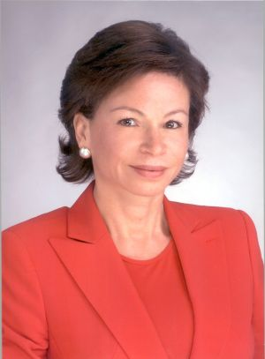
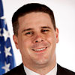
2. Senior Advisors
Names: Valerie Jarrett, Daniel Pfieffer
Job Description:
Have responsibility for the following four groups:
White House Office of Strategic Initiatives
Intergovernmental Affairs
Political Affairs
Public Liaison

Slide 22
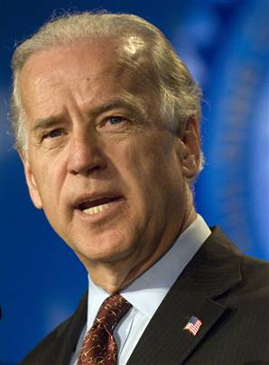
3. The Vice President
Name: Joe Biden
Job Description:
Has been tasked with implementing the American Recovery and Reinvestment Act, helping to rebuild our economy and lay the foundation for a sustainable economic future
Chair of the Middle Class Task Force, a major White House initiative targeted at raising the living standards of middle class families in America.
President of the Senate
Presides over counting and presentation of votes of Electoral College.
May preside over impeachment trials of federal officers

Slide 23
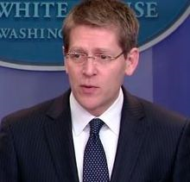
4. The White House Press Secretary
Name: Jay Carney
Job Description:
Act as spokesperson for the government administration
Responsible for collecting information about actions and events within the president's administration and around the world
Interacting with the media, generally in a daily press briefing

Slide 24
5. The National Security Advisor
Name: Susan Rice
Job Description:
Chief advisor to President on national security issues
Serves on the National Security Council
Operates from the White House Situation Room in times of crisis, updating the President on the latest events of the crisis

Slide 25
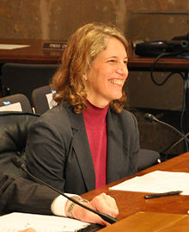
6. OMB Director (Office of Management and Budget)
Name: Sylvia Mathews Burwell
Job Description:
Assist the President in overseeing the preparation of the federal budget and supervise its administration
Evaluate the effectiveness of agency programs, policies, and procedures
Set funding priorities
Ensure that agency reports, rules, testimony, and legislation are consistent with the President’s Budget

Slide 26
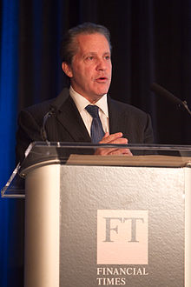
7. Director of the National Economic Council
Name: Gene Sperling
Job Description:
Work in conjunction with the numerous department and agency heads within the NEC to coordinate and implement the President’s economic policy objectives
Coordinate policy-making for domestic and international economic issues
Coordinate economic policy advice for the President
Ensure that policy decisions and programs are consistent with the President's economic goals

Slide 27
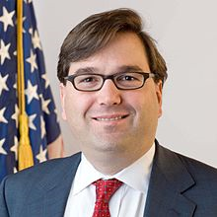
8. Chief Economic Advisors (3)
Names: Jason Furman, James Stock, Jessica Schumer
Job Description:
Assist the President with the development and implementation of our nation’s economic policy
Advise the President
Prepare the Annual Economic Report

Slide 28
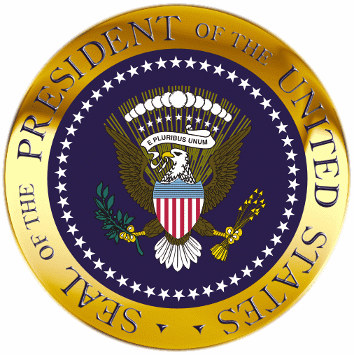
The President: Powers

Slide 29
Executing the Law
As chief executive, the President executes (enforces, administers, carries out) the provisions of federal law.
The oath of office instructs the President to carry out the laws of the land.
The other provision is the Constitution’s command that “he shall take care that the laws be faithfully executed.”
Executive Power – enforce laws
head of more than 2 million executive branch employees, federal agencies
Executive order – enforce policies & programs enacted by Congress
(1948 – Truman desegregated the armed forces)
Impoundment – refusal to spend money Congress has appropriated
Appoint executive heads/Cabinet of advisors
(w/ Senate consent) (remove appointed officials)
1
3
4
Chapter 14, Section 2

Slide 30
The Ordinance Power
The President has the power to issue executive orders. An executive order is a directive, rule, or regulation that has the effect of law. (Implied Power)
The power to issue these orders, the ordinance power, arises from two sources: the Constitution and acts of Congress.
Although not specifically mentioned in the Constitution, the ordinance power is clearly intended.
The size of government has caused Congress to delegate more and more discretion to the President and presidential subordinates.
1
3
4
Chapter 14, Section 2

Slide 31
Commander in Chief
The Constitution makes the President the commander in chief of the nation’s armed forces.
Making Undeclared War
Many Presidents have used the armed forces abroad without a declaration of war.
Wartime Powers
The President’s powers as commander in chief are far greater during a war than they are in normal times.
The War Powers Resolution
The War Powers Resolution of 1973 limits the President’s war-making powers.
Commander in Chief – national security
Send forces into action w/o formal declaration of war w/ or w/o Congressional approval
Make key military decisions (including using the atomic bomb)
Special War Powers (more control at home) price controls, government control of war industries, rationing
Emergency Powers – rioting, natural disaster (flood, hurricane, tornado)
1
2
4
Chapter 14, Section 3

Slide 32
Judicial Powers
The Constitution gives the President the power to “...grant reprieves and pardons for offenses against the United States, except in cases of impeachment.” —Article II, Section 2, Clause 1
A reprieve is the postponement of the execution of a sentence.
A pardon is legal forgiveness for a crime.
These powers of clemency (mercy or leniency) may be used only in cases of federal crimes.
Judicial Powers – appoint federal judges (w/ Senate consent)
1
2
3
Chapter 14, Section 4

Slide 33
The Power to Make Treaties
A treaty is a formal agreement between two or more sovereign states.
The President, usually through the secretary of state, negotiates these international agreements.
All treaties must pass approval by a two thirds of the members present vote in the Senate.
(1) Appoints & accepts ambassadors and other diplomats;
1
2
4
Chapter 14, Section 3

Slide 34
Executive Agreements
An executive agreement is a pact between the President and the head of a foreign state, or a subordinate.
Unlike treaties, executive agreements do not require Senate consent.
1
2
4
Chapter 14, Section 3

Slide 35
The Power of Recognition
The power of recognition is exercised when the President, acting for the United States, acknowledges the legal existence of another sovereign state.
The President may show American displeasure with the conduct of another country by asking for the recall of that nation’s ambassador or other diplomatic representatives in this country.
The official is declared to be persona non grata, or an unwelcome person.
1
2
4
Chapter 14, Section 3

Slide 36
The Appointment Power
With Senate consent, the President names most of the top-ranking officers of the Federal Government, including:
(1) ambassadors and other diplomats;
(2) Cabinet members and their top aides;
(3) the heads of such independent agencies as the EPA and NASA;
(4) all federal judges, attorneys, and U.S. marshals;
(5) all officers in the armed forces.
1
3
4
Chapter 14, Section 2

Slide 37
The Removal Power
The Historical Debate
Debate ensued in the First Congress as to whether the President could remove appointees without the consent of the Senate.
The view that the President may remove the officials he appoints without Senate consent has prevailed over time.
In general, the President may remove any appointees except federal judges.
1
3
4
Chapter 14, Section 2

Slide 38
Legislative Powers
Recommending Legislation
The Constitution provides that the President shall report to Congress on the state of the Union and recommend necessary legislation.
This power is often called the message power.
The Veto Power
All legislation passed by Congress is sent to the President for approval.
If the President disapproves of a bill, he can veto it. That veto can only be overturned by a two-thirds vote of both houses of Congress.
Other Legislative Powers
According to Article II, Section 3 of the Constitution, only the President can call a Congress into special session.
1
2
3
Chapter 14, Section 4

