Slide 1
Friday August 14, 2015 Mr. Goblirsch – Economics
OBJECTIVE – Students Will Be Able To – SWBAT:
- Identify fundamental concepts of the stock market and select stocks to follow during our class stock market simulation.
AGENDA:
WARM-UP: Econ Quick Think
CONCEPT: The Stock Market
PARTNERS: Stock Worksheet
ACTIVITY: Begin Selecting Stocks
INTRODUCE: Job Application Process
***HW: Spiral Notebook DUE TODAY 8/14
Syllabus Signature DUE TODAY 8/14
Econ Quick Think WARM-UP: (Follow the directions below)
***5 minutes***
When you hear the word economics, what are the first words that you think of?
Create a list of 10 words that come to your mind.
Compare your list with your partner.
Compare your lists with your pod.

Slide 2
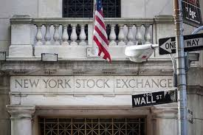
THE STOCK MARKET

Slide 3
What is Stock?
Stock represents partial ownership in the corporation.
A piece of stock is called a share.
Stocks are also called equities.
Corporations can raise money by issuing/selling stock.

Slide 4
The Stock Market
Why to Buy Stock?
Benefits of buying stock
Dividends — portions of companies profits paid to shareholders ($ .58 Div. / share)
capital gains — selling a stock at a higher price than you bought it for (capital losses can occur as well)
Bought at $35.00 / share
Sold at $40.00 / share
Gain of $5.00 / share

Slide 5
Risks of Buying Stock
capital losses
If the Sale price drops below the purchase price
Buy at $25.00 and Sell at $20.00 = loss $5.00
stockholders get dividends only if money is available
If the company profits they share some
Company earns $5 million in profits. $.53 per share

Slide 6
Measuring Stock Performance
Bull and Bear markets
bull market—stock prices rise steadily over time
bear market—stock prices decline over time
Dow Jones Industrial Average (the Dow)
the closing prices of 30 selected stocks

Slide 7
PARTNERS: READING A STOCK TICKER
Work with your partner to complete the NYSE Made Easy worksheet. The goal of this worksheet is to familiarize yourself with terms and symbols you will come across when analyzing the stock market.
The website you will use to complete the worksheet is:
www.howthemarketworks.com

Slide 8
General Electric CO. (GE) 1907 – Conglomorate

Slide 9
Exxon Mobil 1928 – Oil & gas

Slide 10
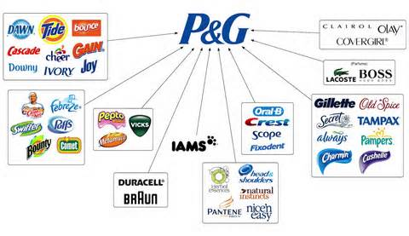
Proctor and Gamble 1932 – Consumer goods

Slide 11
DuPont 1935 – Chemical industry

Slide 12
United Technologies Corp 1939 - Conglomorate

Slide 13
3M Company 1976 - Conglomorate

Slide 14
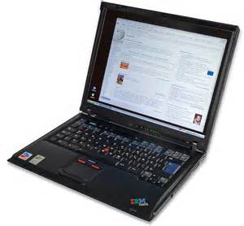
International Business Machines (IBM) 1979 – Computers & Technology

Slide 15
Merck and Co. Inc. 1979 - Pharmaceuticals

Slide 16
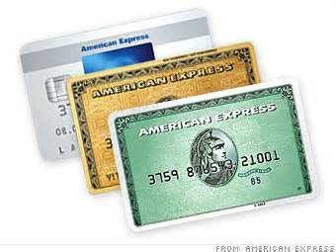
American Express Co. 1982 – Consumer Finance

Slide 17
McDonalds Corp 1985 – Fast food

Slide 18
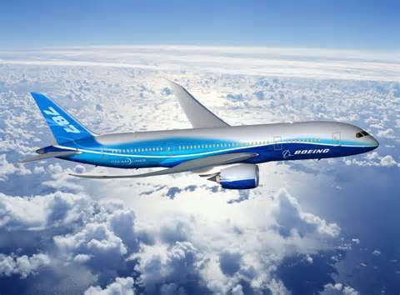
Boeing Co. 1987 – Aerospace and defense

Slide 19
Coca Cola 1987 Beverages

Slide 20
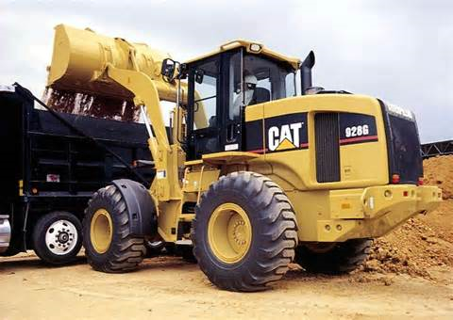
Caterpillar INC 1991 – Construction & Mining Equipment

Slide 21
JP Morgan and Chase 1991 - Banking

Slide 22
Walt Disney Co. 1991 Broadcasting & Entertainment

Slide 23
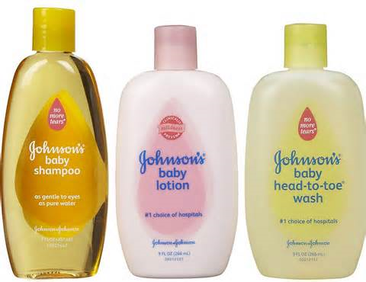
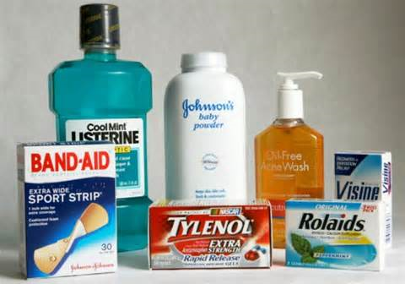
Johnson and Johnson 1997 - Pharmeceuticals

Slide 24
Wal-Mart 1997 - Retail

Slide 25
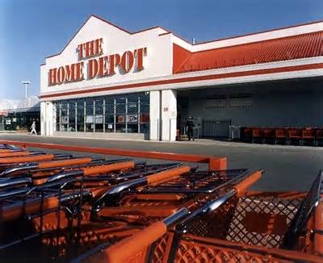
Home Depot Inc 1999 – Home Improvement retailer

Slide 26
Intel Corp. 1999 - Semiconductors

Slide 27
Microsoft Corp 1999 - software

Slide 28
Pfizer Inc. 2004 - Pharmaceuticals

Slide 29
Verizon Communications 2004 - Telecommunications

Slide 30
Chevron Corp. 2008 – Oil & Gas

Slide 31
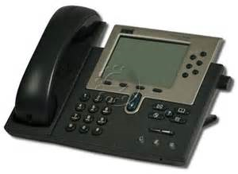
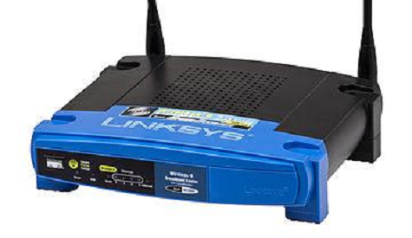
Cisco Systems Inc. 2009 Computer Networking

Slide 32
Traveler’s Co. Inc 2009 - INSURANCE

Slide 33
United Health group 2012 – Managed Health care

Slide 34
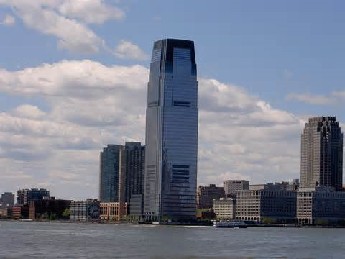
Goldman sachs 2013 – Banking, Financial services

Slide 35
NIKE 2013 - Apparel

Slide 36
Visa 2013 – Consumer banking

Slide 37
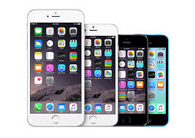
APPLE 2015 – CONSUMER ELECTRONICS

Slide 38
DOW STOCK SIMULATION
You will have $10,000 to spend on buying 5 stocks from the DOW. Choose your stocks wisely because you will not be able to change your stocks for 4 weeks. You will have until NEXT FRIDAY 8/21 to research and decide which stocks you want to start with. This is a competition. There will be weekly winners, and an overall winner at the end of the semester.

Slide 39
Econ Class Jobs
There are a couple of jobs in this class that are available. Students who have an assigned job will be responsible for carrying out their duty, and in return will they will receive a higher pay. The jobs are as follows:
Electrician – turning on and off the lights as needed during the class period
Runner – passing out/collecting papers as needed during the class period
Timer – responsible for notifying the class of “half-time” and the “two-minute warning”
Section Leader & Alternate – responsible for their section. This includes: monitoring attendance, restroom use, and participation. (Per Section)
Clerk & Secretary – keeps track of all info for their class period, including: keeping all records of daily lessons, class infractions, group rankings, student salaries, etc.
Sheriff & Deputy – responsible for writing tickets for all classroom infractions, including: tardies, misbehavior, or any other citations as directed by Mr. Goblirsch
IF YOU ARE INTERESTED IN APPLYING FOR A JOB, GO TO:
http://goo.gl/forms/IFfdphKF5l

