Slide 1
Friday March 13, 2015 Mr. Goblirsch – American Government
OBJECTIVE – Students Will Be Able To – SWBAT:
- Analyze a current event article about President Obama’s current tax proposal.
AGENDA: 3rd & 6th ONLY
WARM-UP: Tax Day
CURRENT EVENTS: “Middle Class Economics”
CHART: Analyzing Taxes
Presidential Inauguration
Tax Day WARM-UP: (Follow the directions below)
***5 minutes***
Calculate your weekly taxes and make your Weekly Deposit.
Ask your Section Leader if you received any daily bonus pay
If so, add it to your pay for that day on your Weekly Time Sheet
Add up your daily pay from the week to get your Gross Total
Calculate your taxes using the TAX BRACKETS below:
Gross Total Less than $45.00 ================→20% tax rate (X 0.20)
Gross Total $45 through $55.00 ==============→25% tax rate (X 0.25)
Gross Total More than $55.00 ================→30% tax rate (X 0.30)
Subtract your taxes from your gross to get your net pay
Your net pay for the week = your Weekly Deposit

Slide 2
Friday March 13, 2015 Mr. Goblirsch – American Government
OBJECTIVE – Students Will Be Able To – SWBAT:
- Analyze a current event article about President Obama’s current tax proposal.
AGENDA: 4th & 5th ONLY
WARM-UP: Tax Day
CURRENT EVENTS: “Middle Class Economics”
CHART: Analyzing Taxes
Presidential Inauguration
Tax Day WARM-UP: (Follow the directions below)
***5 minutes***
Calculate your weekly taxes and make your Weekly Deposit.
Ask your Section Leader if you received any daily bonus pay
If so, add it to your pay for that day on your Weekly Time Sheet
Add up your daily pay from the week to get your Gross Total
Calculate your taxes using the TAX BRACKETS below:
Gross Total Less than $45.00 ================→22% tax rate (X 0.22)
Gross Total $45 through $55.00 ==============→27% tax rate (X 0.27)
Gross Total More than $55.00 ================→32% tax rate (X 0.32)
Subtract your taxes from your gross to get your net pay
Your net pay for the week = your Weekly Deposit

Slide 3
CURRENT EVENTS ARTICLE
“Most Back Obama Plan to
Raise Investment Taxes”
As we read through the article:
Highlight items you agree and disagree with
Label things you Agree with : A
Label things you Disagree with: D

Slide 4
CURRENT EVENTS ARTICLE
TAX CHART
Analyze the tax chart with your partner. Answer the questions below:
What is the pre-tax income of the lowest quintile (1/5th) after adding in government transfers? The middle quintile? The highest quintile?
Which quintile pays the highest dollar amount in taxes?
Which quintile pays the highest taxes in terms of percentage of their income (including government transfers)?
Rank the lowest, middle, and highest from 1-3, with a 1 being who pays the highest percentage and a 3 being who pays the lowest percentage.
Which quintile(s) pay more in taxes than they receive in government transfers (line 6 on chart)?

Slide 5
CURRENT EVENTS ARTICLE
TAX CHART – PART II
Analyze the quote below with your partner. Answer the questions below:
“I think the more you make the more taxes you should pay…I can’t see where a man makes $50,000 a year pays as much as somebody that makes $300,000 a year.”
“…the very wealthy and large corporations are able to take advantage of huge loopholes, which enable them to not pay their fair share of taxes.”
Do these comments reflect an accurate understanding of the data presented in the chart? Explain.

Slide 6
CURRENT EVENTS ARTICLE
TAX CHART – PART II
Analyze the poll results below with your partner. Answer the questions below:
68 percent of those questioned said wealthy households pay too little in federal taxes.
60 percent said middle-class households pay too much in federal taxes.
If more people understood the facts presented in this chart, do you think that would change their responses to the poll questions? Why/Why not?

Slide 7
PRESIDENTIAL OATH OF OFFICE
"I do solemnly swear (or affirm) that I will faithfully execute the Office of President of the United States, and will to the best of my Ability, preserve, protect and defend the Constitution of the United States.“ (So help me God)

Slide 8
CLASS RANKINGS
CLASS AVERAGE
PURCHASED FINAL
5th – 72%
4th – 76%
6th – 77%
3rd – 79%
4) 5th – 57%
6th – 66%
4th – 74%
1) 3rd – 87%

Slide 9
STATE OF THE UNION (CLASS): Class Report Card
3rd PERIOD
A – 3 students
B – 13 students
C – 12 students
D – 4 students
F – 0 students
PROGRAMS:
NO Final assistance
RR Program
Salary Range:
$7.25 – $10.25
Tax Brackets
20% - Lowest
25% - Middle
30% - Highest

Slide 10
STATE OF THE UNION (CLASS): Class Report Card
4th PERIOD
A – 2 students
B – 10 students
C – 10 students
D – 8 students
F – 1 student
PROGRAMS:
Final assistance
RR Program
Salary Range:
$7.25 – $10.25
Tax Brackets
22% - Lowest
27% - Middle
32% - Highest

Slide 11
STATE OF THE UNION (CLASS): Class Report Card
5th PERIOD
A – students
B – students
C – students
D – students
F – students
PROGRAMS:
Final assistance
RR Program
Salary Range:
$7.25 – $10.25
Tax Brackets
22% - Lowest
27% - Middle
32% - Highest

Slide 12
STATE OF THE UNION (CLASS): Class Report Card
6th PERIOD
A – students
B – students
C – students
D – students
F – students
PROGRAMS:
NO Final assistance
RR Program
Salary Range:
$7.25 – $10.25
Tax Brackets
20% - Lowest
25% - Middle
30% - Highest

Slide 13
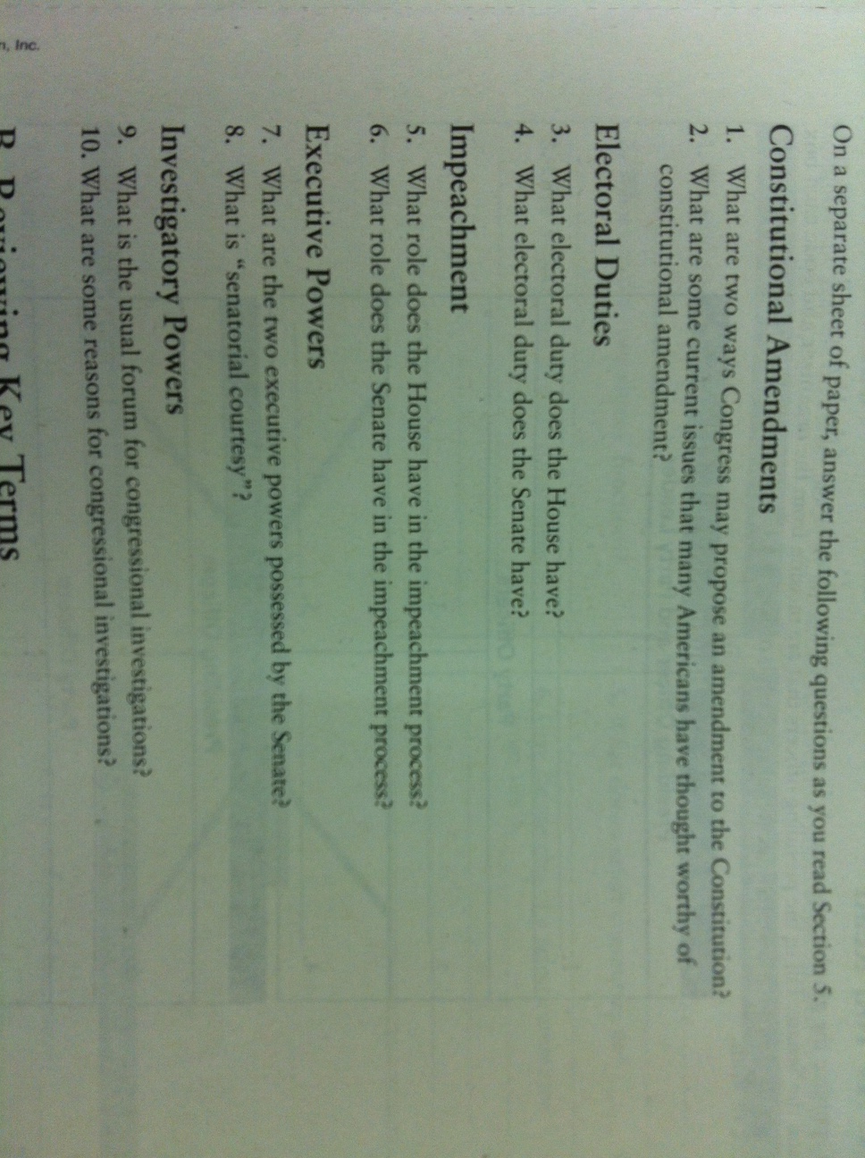
CONGRESS REVIEW QUESTIONS
Refer to Ch. 11 Sec. 5 (Pgs. 310 – 314) to answer the questions.

Slide 14
PRESIDENTIAL CAMPAIGN FUNDING
NAME | JOB TITLE | AMOUNT PAID ($400 Total in Campaign funding available)

Slide 15
Section Leader Bonus Pay Summary
DIRECTIONS: Each section leader has $5 a day in Bonus Pay to distribute to workers within their section. This includes any Bonus Pay the section leaders pay themselves, and any Bonus Pay they pay any employees they hired.
On the chart below, write down the amount of Bonus Pay each member received each day. EXAMPLE – If Mr. Goblirsch received a $2 bonus on Monday, then I would write Mr. Goblirsch - $2 under the Monday column.
MONDAY | TUESDAY | WEDNESDAY | THURSDAY | FRIDAY

Slide 16
EXAM ASSISTANCE PROGRAM: (1) Find out each members taxes (2) Add them up (3) Write the Total Tax amount on back.
MEMBER | TAX AMOUNT | MEMBER | TAX AMOUNT
1. | 1. | 7. | 7.
2. | 2. | 8. | 8.
3. | 3. | 9. | 9.
4. | 4. | 10. | 10.
5. | 5. | 11. | 11.
6. | 6. | 12. | 12.

Slide 17
LIST OF INDIVIDUALS WHO HAVE PAID FOR THE FINAL
Tino A.
Cristian C.
Illene C.
Lucy F.
Casidy J.
Jennifer L.
Ashley
Ramon
Lesley
Arvinder
Vanessa S
Jasmine N.
Elizabeth G.
Chris F.
Diana S.
Alicia M.
Lili O.
Jaskaran S.
Ricky V.
Perla V.
Brandon V.
Jesus
John
Rafael J
Savannah M
Jeniffer C.
Total = 26 / 31

Slide 18
LIST OF INDIVIDUALS WHO HAVE PAID FOR THE FINAL
Rafael A.
Gabriella B.
Cristian C.
Tristan D.
Maria F.
Alexis G.
Leo M.
Hilsa A.
Kime Y.
Destiny B.
Fatima O.
Hailey C.
Caleb M.
Andrew M.
Victor P.
Cynthia S.
Elizabeth S.
Miranda S.
Kyndall S.
Manuel Z.
TOTAL = 20 / 35

