Slide 1
Wednesday March 18, 2015 Mr. Goblirsch – American Government
OBJECTIVE – Students Will Be Able To – SWBAT:
- Explain how districts are drawn to the advantage a particular political party.
AGENDA:
WARM-UP: Apportionment Journal
CONCEPT: House of Representatives: Gerrymandering
READING: Wesberry v. Sanders (P. 271 – 272)
ACTIVITY: Gerrymandering
CONGRESSIONAL VOTE: Defense Spending
*****3rd Quarter Ends FRIDAY*****
Apportionment Journal WARM-UP: (Follow the directions below)
***5 minutes***
Write a paragraph journal entry on the topic below.
In a couple of months you will be graduating from high school. Let’s say tickets are apportioned (distributed) as 10 tickets per graduate.
Which house of Congress does this apportionment more closely represent, the House of Representatives or the Senate? Why?
How would they have to be apportioned differently in order to more closely represent the other house of Congress?

Slide 2
HOUSE OF REPRESENTATIVES: Gerrymandering
Chapter 10

Slide 3
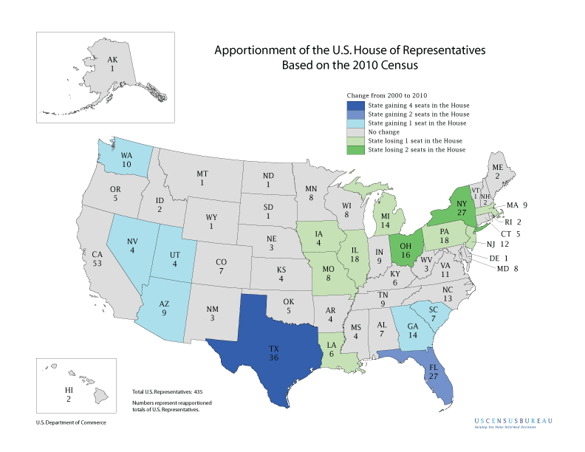

Slide 4
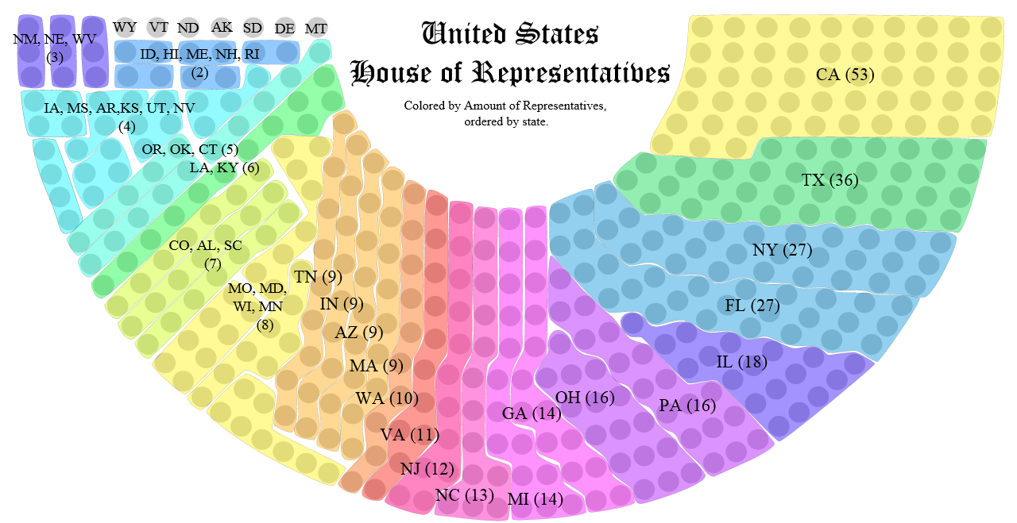
STATE SELECTION OPTIONS:
Big State = 15 – 53 Medium State = 5 – 14 Small State = 1 – 4

Slide 5
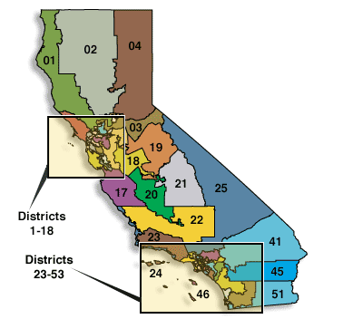
California has 53 Congressional Districts- the most in the nation.
REDISTRICTING – the redrawing of congressional districts; typically completed by the State Legislature
Old California Districts – Prior to 2012
New California Districts – Since 2012

Slide 6
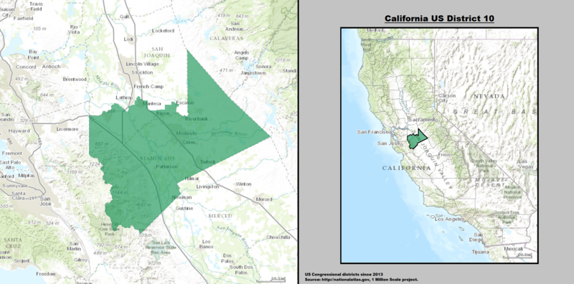
Current 10th District – R Jeff Denham

Slide 7
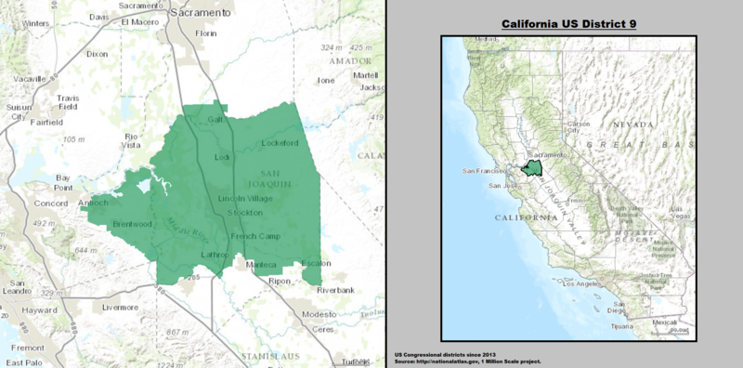
Current 9th District – D Jerry McNerney

Slide 8
Gerrymandering
Definition – the drawing of congressional districts to the advantage of the political party that controls the State legislation.
Two purposes of gerrymandering:
1) Packing - to concentrate the oppositions voters in one or a few districts
2) Cracking - to spread the opposition as thinly as possible throughout several districts

Slide 9
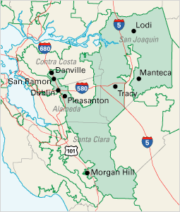
The Old 11th District: Gerrymandered

Slide 10
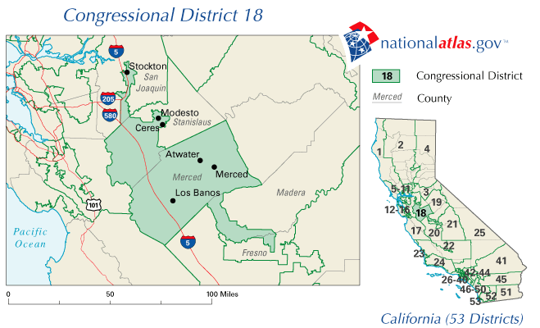
Redistricting : Old District 18 Gerrymandered

Slide 11
Let’s do some drawing of district lines:
D R D R D R
R D R D R D
D R D R D R
R D R D R D

Slide 12
ACTIVITY: Gerrymandering
DIRECTIONS:
Draw 4 congressional districts on each side.
For the Left side, draw the districts so that the Democrats have control in a majority of the districts.
For the Right side, draw the districts so that the Republicans have control in a majority of the districts.
Redistricting rules
Must have the same number of people (letters) in each district.
All districts must be contiguous (connecting).

Slide 13
Let’s do some drawing of district lines:
Gerrymander these Congressional districts in favor of Democrats – meaning the Democrats control the majority of districts
Gerrymander these Congressional districts in favor of Republicans – meaning the Republicans control the majority of districts
D R D R D R
R D R D R D
D R D R D R
R D R D R D
D R D R D R
R D R D R D
D R D R D R
R D R D R D

Slide 14
CONGRESSIONAL VOTE: Defense Spending
PROPOSED BILL:
Currently in Goblirsch’s class, our defense spending is approximately 5%. We are currently maintaining a volunteer military of 50,000. This proposal is to increase military spending to combat hostile relationships with foreign classes.
PROPOSAL OPTIONS:
A) 2% tax increase = gain of 2,500 troops per day
B) 4% tax increase = gain of 5,000 troops per day
C) 6% tax increase = gain of 7,500 troops per day
D) 8% tax increase = gain of 10,000 troops per day
PROCESS (2 Steps):
STEP 1 – Decide which proposal to vote on from A – D
STEP 2 – Vote “Yes” or “No” on the proposal
A “Yes” vote will increase defense spending & number of troops
A “No” vote will keep defense spending & taxes at their current level

Slide 15
BALLOT
Representative/Senator Name:
_________________________
_______________________
_____ YES
_____ NO

Slide 16
CABINET CONFIRMATION
Senator Name:
_________________________
_______________________
_____ DEFENSE – Angelina Vazquez
_____ EDUCATION – Juli Nava
_____ ENERGY – Brian Quintanilla

Slide 17
CABINET CONFIRMATION
Senator Name:
_________________________
_______________________
_____ DEFENSE – Vanessa Soto
_____ EDUCATION – Illene Cruz
_____ ENERGY – Brandon Villacana

