Slide 1
Friday March 20, 2015 Mr. Goblirsch – American Government
OBJECTIVE – Students Will Be Able To – SWBAT:
- Identify the structure and duties of the U.S. Congress.
AGENDA: 3rd & 6th ONLY
WARM-UP: Tax Day
KAHOOT QUIZ
ASSIGNMENT: Workbook P. 52
Introduce War Simulation
Tax Day WARM-UP: (Follow the directions below)
***5 minutes***
Calculate your weekly taxes and make your Weekly Deposit.
Ask your Section Leader if you received any daily bonus pay or restroom bonuses
If so, add it to your pay for that day on your Weekly Time Sheet
Add up your daily pay from the week to get your Gross Total
Calculate your taxes using the TAX BRACKETS below:
Gross Total Less than $45.00 ================→20% tax rate (X 0.20)
Gross Total $45 through $55.00 ==============→25% tax rate (X 0.25)
Gross Total More than $55.00 ================→30% tax rate (X 0.30)
Subtract your taxes from your gross to get your net pay
Your net pay for the week = your Weekly Deposit

Slide 2
Friday March 20, 2015 Mr. Goblirsch – American Government
OBJECTIVE – Students Will Be Able To – SWBAT:
- Identify the structure and duties of the U.S. Congress.
AGENDA: 4th & 5th ONLY
WARM-UP: Tax Day
KAHOOT QUIZ
ASSIGNMENT: Workbook P. 52
Introduce War Simulation
Tax Day WARM-UP: (Follow the directions below)
***5 minutes***
Calculate your weekly taxes and make your Weekly Deposit.
Ask your Section Leader if you received any daily bonus pay or restroom bonuses
If so, add it to your pay for that day on your Weekly Time Sheet
Add up your daily pay from the week to get your Gross Total
Calculate your taxes using the TAX BRACKETS below:
Gross Total Less than $45.00 ================→22% tax rate (X 0.22)
Gross Total $45 through $55.00 ==============→27% tax rate (X 0.27)
Gross Total More than $55.00 ================→32% tax rate (X 0.32)
Subtract your taxes from your gross to get your net pay
Your net pay for the week = your Weekly Deposit

Slide 3
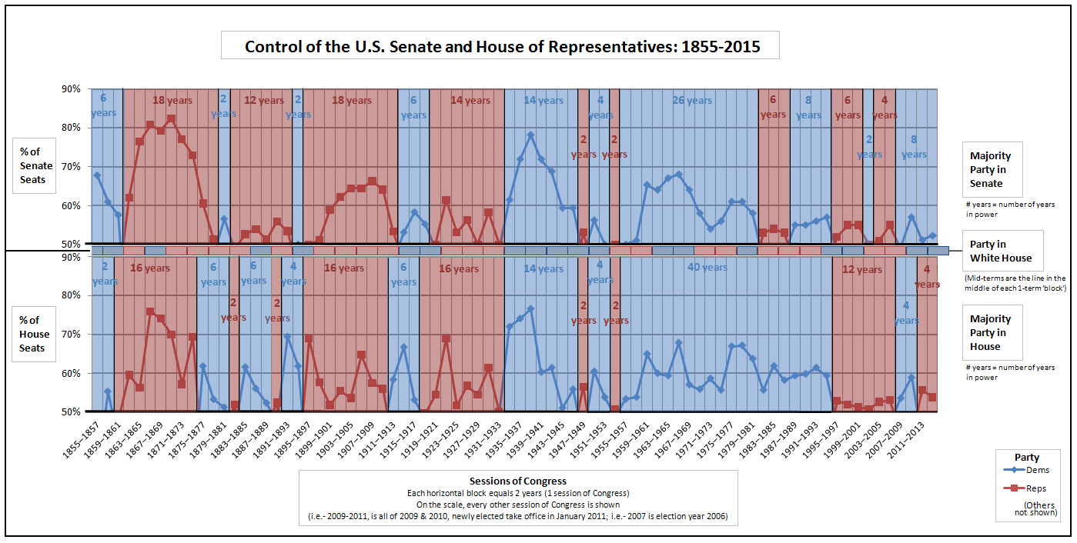

Slide 4
CABINET CONFIRMATION
Senator Name:
_________________________
_______________________
_____ DEFENSE – 5th
_____ EDUCATION – 5th
_____ ENERGY – 5th

Slide 5
CABINET CONFIRMATION
Senator Name:
_________________________
_______________________
_____ DEFENSE – Jonathan Williams
_____ EDUCATION – Joshua Moita
_____ ENERGY – Denise Gutierrez

Slide 6
PRESIDENTIAL SALARY
Your new Presidential salary will be $15.00 per day

Slide 7
VICE - PRESIDENTIAL SALARY
Your new Vice - Presidential salary will be $12.50 per day

Slide 8
CABINET SALARY
Your new Cabinet salary will be $11.25 per day

Slide 9
SECTION LEADER SALARY
Your new Section Leader salary will be $11.25 per day

Slide 10
SENATE SALARY
Your Senatorial salary will be $10.25 per day

Slide 11
HOUSE OF REPRESENTATIVES SALARY
Your Representative salary will be $7.25 per day

Slide 12
Section Leader Bonus Pay Summary
DIRECTIONS: Each section leader has $5 a day in Bonus Pay to distribute to workers within their section. This includes any Bonus Pay the section leaders pay themselves, and any Bonus Pay they pay any employees they hired.
On the chart below, write down the amount of Bonus Pay each member received each day. EXAMPLE – If Mr. Goblirsch received a $2 bonus on Monday, then I would write Mr. Goblirsch - $2 under the Monday column.
MONDAY | TUESDAY | WEDNESDAY | THURSDAY | FRIDAY

Slide 13
EXAM ASSISTANCE PROGRAM: (1) Find out each members taxes (2) Add them up (3) Write the Total Tax amount on back.
MEMBER | TAX AMOUNT | MEMBER | TAX AMOUNT
1. | 1. | 7. | 7.
2. | 2. | 8. | 8.
3. | 3. | 9. | 9.
4. | 4. | 10. | 10.
5. | 5. | 11. | 11.
6. | 6. | 12. | 12.

Slide 14
LIST OF INDIVIDUALS WHO HAVE PAID FOR THE FINAL
Tino A.
Cristian C.
Illene C.
Lucy F.
Casidy J.
Jennifer L.
Ashley
Ramon
Lesley
Arvinder
Vanessa S
Jasmine N.
Elizabeth G.
Chris F.
Diana S.
Jose R
Alicia M.
Lili O.
Jaskaran S.
Ricky V.
Perla V.
Brandon V.
Jesus
John
Rafael J
Savannah M
Jeniffer C.
Susana
Total = 28 / 31

Slide 15
LIST OF INDIVIDUALS WHO HAVE PAID FOR THE FINAL
Rafael A.
Gabriella B.
Cristian C.
Tristan D.
Maria F.
Alexis G.
Leo M.
Hilsa A.
Kime Y.
Destiny B.
Fatima O.
Hailey C.
Caleb M.
Andrew M.
Victor P.
Cynthia S.
Elizabeth S.
Miranda S.
Kyndall S.
Manuel Z.
TOTAL = 20 / 35

