Slide 1
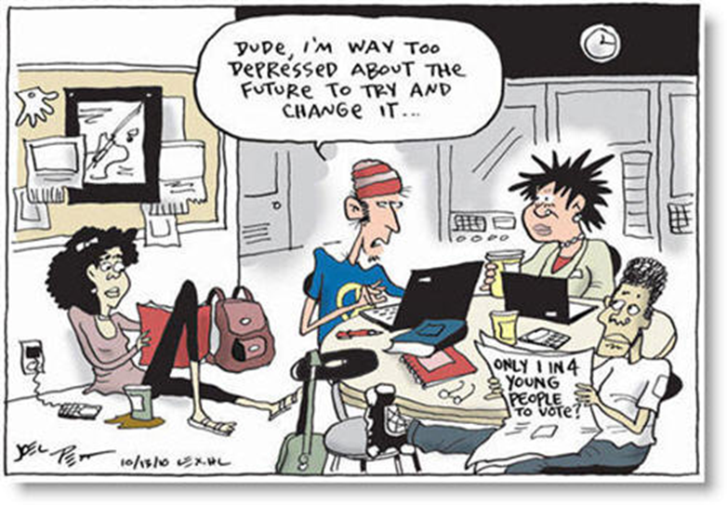
Tuesday March 31, 2015 Mr. Goblirsch – American Government
OBJECTIVE – Students Will Be Able To – SWBAT:
- Identify patterns of voter behavior.
AGENDA:
WARM-UP: Voting Cartoon
VIDEO CLIP: Party Identification
CONCEPT: Voter Behavior
VIDEO CLIP: Should you be forced to Vote?
CONGRESSIONAL VOTE: Tax Brackets
ASSIGNMENT: Workbook Pgs. 31&32 – DUE WEDNESDAY
*****Bill Process Flip Book DUE THURSDAY*****
Voting Cartoon WARM-UP: (Follow the directions below)
***5 minutes***
Write a paragraph journal entry
answering the question below.
1) What does the quote suggest
is the reason young people
don’t vote?
2) What other reasons can be
implied from this cartoon as to why
young people don’t vote?
3) What do you think is the biggest reason
young voters have low turnout?

Slide 2
POLITICAL PARTY VIDEO QUESTIONS
In what ways do people identify with political parties?
What is a leaner?
What is the difference between a strong and weak party voter?
What factors influence party preference?

Slide 3
Party Membership Patterns
Factors that can influence party membership:

Slide 4
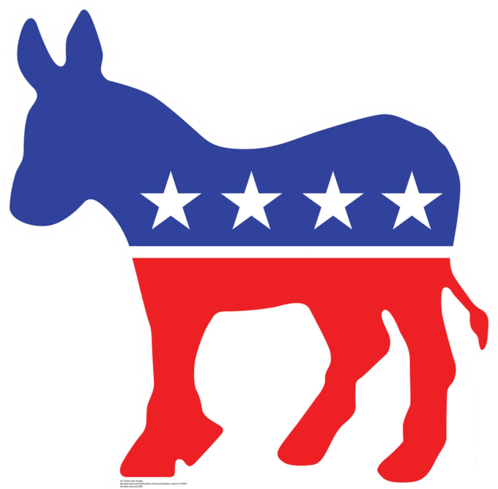
VOTER BEHAVIOR IN AMERICA
CHAPTER 5

Slide 5
Voter Turnout
National – Presidential Elections 50-60%
2000 – 54%
2004 – 60%
2008 – 62%
2012 – 57%
Congressional Elections 25-30%
Local Elections 10-15%
Greek for a person who doesn’t vote
… “idiot”

Slide 6
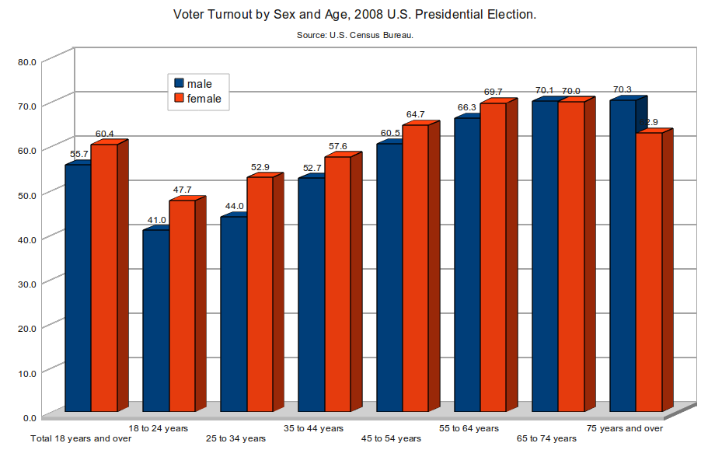
Which group (men or women) has the highest overall voter turnout percentage?
Which age group has the highest voter turnout percentage? Which has the lowest?
Why do you think this is?

Slide 7
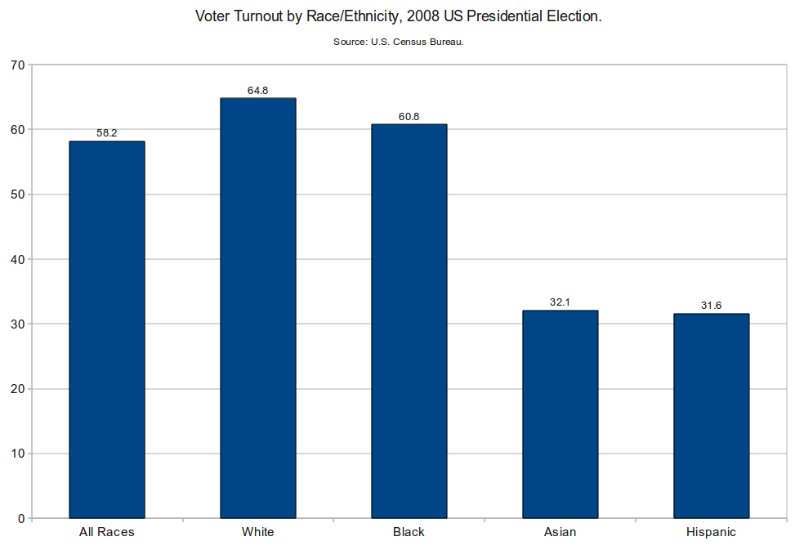
Which 2 groups have the highest overall voter turnout percentages?
Which groups have the lowest voter turnout? Why do you think this is?

Slide 8
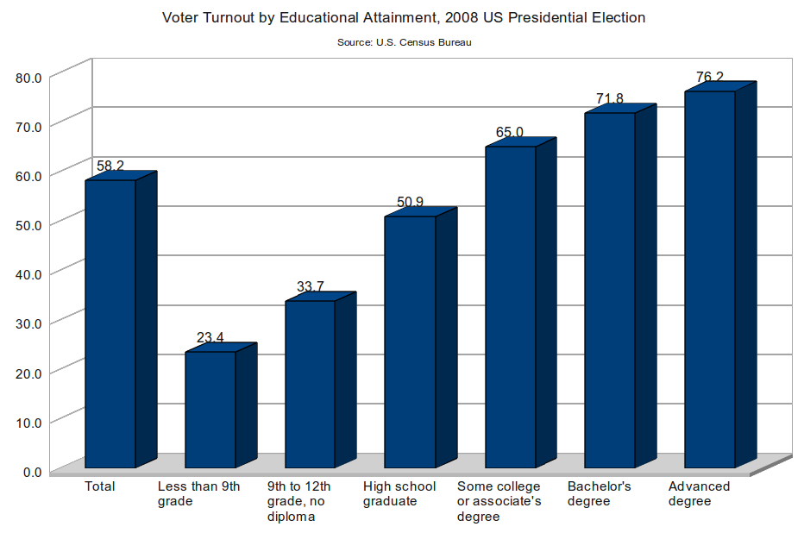
Where does the biggest jump occur from one education level to the next?
Why do you think less educated citizens vote in such low numbers?

Slide 9
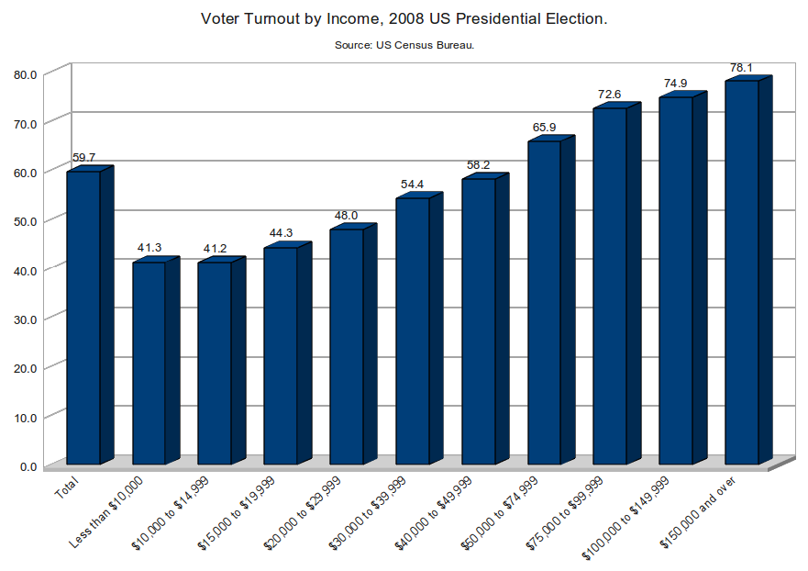
Why do you think that people with higher incomes have higher voter turnout?

Slide 10
Voting QUICK WRITE
After watching the video clip, “Should you be Forced to Vote” write a ½ page journal in which you respond to the questions:
Should everyone who is eligible to vote, vote?
Does it matter if voters are uninformed?
What are the ramifications of uninformed voters?
Should the U.S. pass a law to force voters to vote?

Slide 11
CONGRESSIONAL VOTE: Tax Brackets
PROPOSED BILL:
Currently in Goblirsch’s class, our tax brackets are ___, ___, ___. This is a proposal to reorganize our tax brackets. This would include an 8% defense tax
PROPOSAL: (all amounts are per week)
Lowest 1 – Below $40 = 10%
Bracket 2 – $40 - $60 = 20%
Middle 3 – $60 – 70 = 30%
Bracket 4 – $70 - $80 = 40%
Highest 5 – Above $80 = 50%
A “Yes” vote will implement new Tax Brackets
A “No” vote will keep everything the way it is

Slide 12
BALLOT
Representative/Senator Name:
_________________________
_______________________
_____ YES
_____ NO

