Slide 1
Wednesday April 15, 2015 Mr. Goblirsch – American Government
OBJECTIVE – Students Will Be Able To – SWBAT:
- Explain the purpose and roles of interest groups in American politics
AGENDA:
WARM-UP: Interest Group Vocab
YOUTUBE CLIP: Interest Groups: Cram for the Exam
CONCEPT: Special Interest Groups
YOUTUBE CLIP: CBS Evening News: Super PACs blur the lines
QUICK WRITE: Campaign Regulations vs. 1st Amendment
***Voting, Elections, Political Parties QUIZ FRIDAY***
***Workbook Pgs. 40 & 41 DUE THURSDAY
Interest Group Vocab WARM-UP: (Follow the directions below)
***5 minutes***
Define the terms below.
Public policy 3) Public-interest group
Single-interest group 4) Lobbying

Slide 2
$PECIAL INTERE$T GROUPS
CHAPTER 9

Slide 3
QUOTE: James Madison – Federalist #10
Madison warned of factions in 1787:
“a number of citizens, whether amounting to a majority or minority of the whole, who are united and actuated by some common impulse of passion, or of interest, adverse to the rights of other citizens, or to the permanent and aggregate interests of the community.”

Slide 4
Influencing Public Opinion
Interest groups reach out to the public for these reasons:
1. To supply information in support of the group’s interests
2. To build a positive image for the group
3. To promote a particular public policy

Slide 5
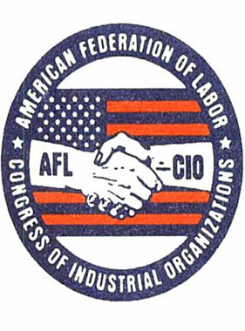
Reasons for Interest Groups
Economic interest:
business, labor, agricultural, and professional interests
Cause or idea:
environmental protection, right to bear arms
Promote the welfare of certain groups of people:
retired citizens, minorities, women
Religious organizations

Slide 6
Political Parties vs. Interest Groups
Political parties (PP) and interest groups (IG) differ in 3 striking respects, in:
(1) making of nominations,
(2) their primary focus
(3) the scope of their interests.
Nominations
PP - responsible for the nominating process
IG - hope to influence those nominated
Primary Focus
PP - interested in winning elections and controlling government
IG - interested in influencing the policies created by government
Scope of Interest
PP - concern themselves with the whole range of public affairs
IG - focus on specific issues

Slide 7
Valuable Functions
Raise awareness of public affairs, or issues of concern
Provide specialized information
Vehicles for political participation
“Watch Dog” on public agencies and officials
Criticisms
Disproportionate influence ($$$)
Don’t always represent the views of the people
In rare cases, groups use tactics such as bribery, threats, etc

Slide 8
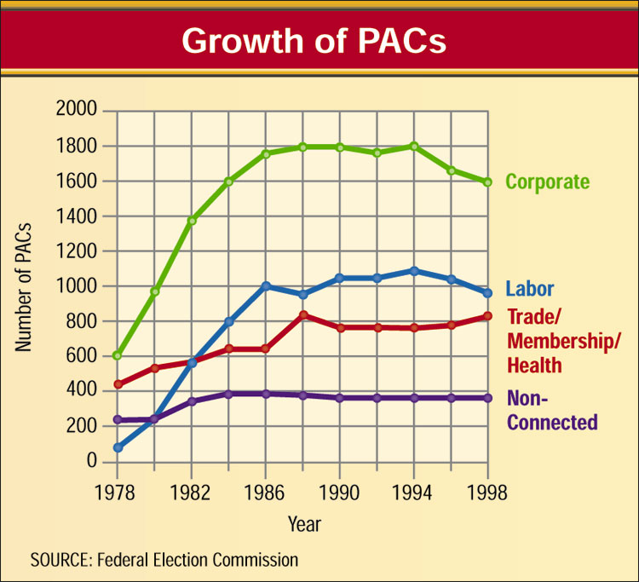
Influencing Parties and Elections
Political Action Committees (PACs)
raise and distribute money to candidates
who will further their goals.
Lobbying is any activity by which a group pressures legislators and influences the legislative process.
Lobbyists use several techniques:
Send articles, reports, and other information to officeholders
Testify before legislative committees (Bill process)
“Grass-roots” pressures through email, letters, or phone calls from constituents
Rate candidates and publicize the ratings
Make campaign contributions.

Slide 9
QUICK WRITE: Campaign Regulations vs. 1st Amendment
Some people argue that there should be more regulations/restrictions on money that can be contributed to a campaign because “elections are won by money”.
Some people argue that your money is your money and our capitalist system along with your 1st amendment rights of free speech and free press allow for you to spend it as you see fit, even if it that means donating large sums to a campaign.
Write a ½ page Quick Write.
Which argument do you tend to support more? Defend your answer with reasoning.

Slide 10
ASSIGNMENT
Read Chapter 7 Sections 1 & 2
Complete Workbook Pgs. 40 & 41
ONLY complete the CHART on each page
TURN INTO THE BASKET WHEN YOU FINISH

Slide 11
The Role of Interest Groups
Interest groups are private organizations whose members share certain views and work to shape public policy.
Public policy includes all of the goals a government sets and the various courses of action it pursues as it attempts to realize these goals.
Interest groups exist to shape public policy.
2
3
Chapter 9, Section 1

Slide 12
Propaganda
Propaganda is a technique of persuasion aimed at influencing individual or group behaviors.
Its goal is to create a particular belief which may be true or false.
Propaganda disregards information that does not support its conclusion. It is not objective. It presents only one side of an issue.
Propaganda often relies on name-calling and inflammatory labels.

Slide 13
Lobbying
Lobbying is any activity by which a group pressures legislators and influences the legislative process.
Lobbying carries beyond the legislature. It is brought into government agencies, the executive branch, and even the courts.
Nearly all important organized interest groups maintain lobbyists in Washington, D.C.

Slide 14
Lobbyists at Work
Lobbyists use several techniques:
They send articles, reports, and other information to officeholders.
They testify before legislative committees.
They bring “grass-roots” pressures to bear through email, letters, or phone calls from constituents.
They rate candidates and publicize the ratings.
They make campaign contributions.

