Slide 1
Monday April 20, 2015 Mr. Goblirsch – American Government
OBJECTIVE – Students Will Be Able To – SWBAT:
- Identify the structure of the federal judiciary
AGENDA:
WARM-UP: Court Vocab
REVIEW: Constitution – Article III
CONCEPT: National Judiciary
CHART: Federal Jurisdiction (P. 508)
VIDEO CLIP: Intro to Federal Judiciary (6 min)
CLOSURE: Judiciary Questions
Court Vocab WARM-UP: (Follow the directions below)
***5 minutes***
Define the terms below.
Exclusive jurisdiction 4) Appellate jurisdiction
Concurrent jurisdiction 5) Plaintiff
Original jurisdiction 6) Defendant

Slide 2
THE FEDERAL JUDICIARY
CHAPTER 18

Slide 3
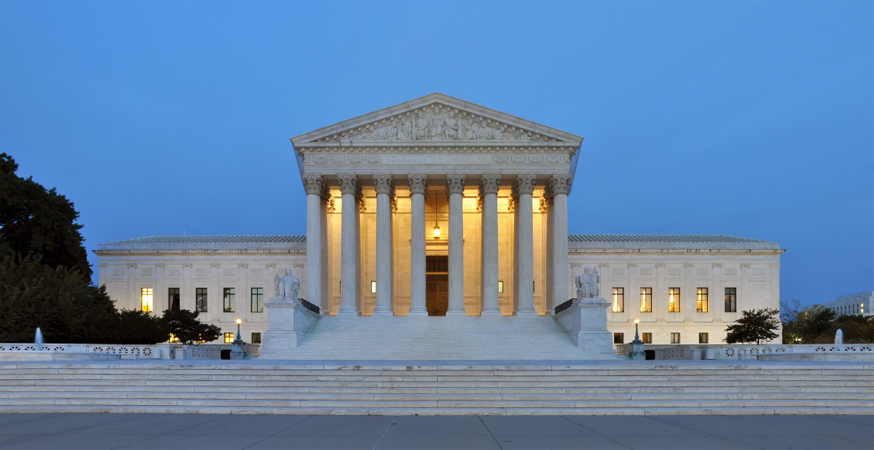
Chapter 18 CONCEPT: Federal Judiciary
Article III – Judicial Branch – interpret laws
Supreme Court – Congress decides how many justices
Federal Courts – Congress establishes
94 District Courts today
13 Courts of Appeals (divided into 12 judicial circuits, 13th national jurisdiction)
Legislative courts to deal with specific areas (Military, Tax, International trade, D.C., etc.)

Slide 4
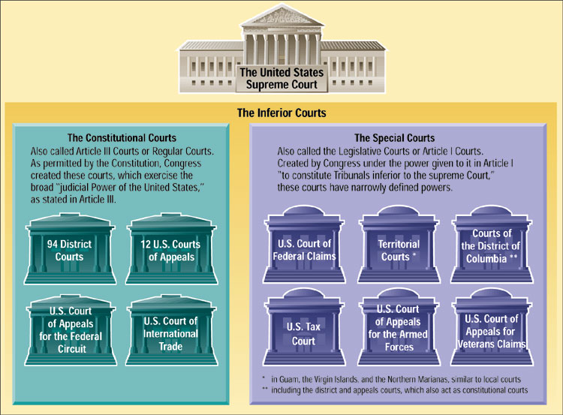
Types of Federal Courts
The Constitution created only the Supreme Court, giving Congress the power to create any lower, or “inferior,” courts as needed.

Slide 5
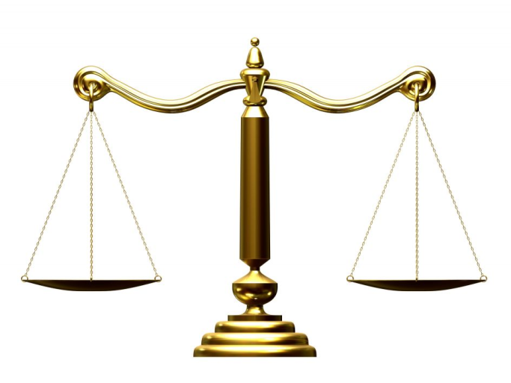
Chapter 18 CONCEPT: Federal Judiciary
Jurisdiction
State courts – state laws
Federal courts – federal laws, treaties, bankruptcy, ambassadors, two or more state govt, US govt, citizens who are residents of diff. state, interpretation of the Constitution
Concurrent – EX. Citizens of diff. states involving over $75,000, sue in either
Trial court = original jurisdiction; Federal district courts
Courts of Appeal = appellate jurisdiction only

Slide 6
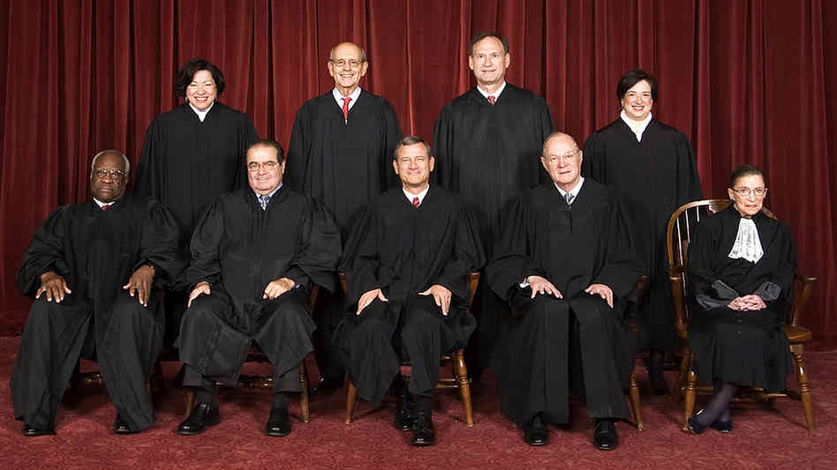
Chapter 18 CONCEPT: Federal Judiciary
Supreme Court
Carefully chooses cases, not required to hear
Decision are binding to all lower courts
Original Jur. – two states or state & federal govt. (very few cases heard)
Appellate Jur. – from federal courts, or highest court of a state
9 justices – since 1869
Life term – good behavior – can be impeached/removed (none removed, 1804 Samuel Chase impeached not convicted)
Chief Justice - $181,400 – Associate Justices - $173,600
FRONT:
Clarence Thomas
Antonin Scalia
Chief Justice
John Roberts
Anthony Kennedy
Ruth Ginsberg
BACK:
Sonia Sotomayer
Stephen Breyer
Samuel Alito
Elena Kagan

Slide 7
CLOSURE EXIT TICKET: JUDICIARY QUESTIONS
Explain the difference between original and appellate jurisdiction? What kind of jurisdiction does the Supreme Court have?
What qualifications do you think the President should consider in the appointment of a federal judge?
Explain why you would favor or oppose constitutional amendments providing for:
(a) the popular election of federal judges
(b) a fixed term of office for federal judges.

Slide 8
Creation of a National Judiciary
The Framers created the national judiciary in Article III of the Constitution.
There are two court systems in the United States: the national judiciary that spans the country, and the courts run by each of the 50 States.
The Constitution created the Supreme Court and left Congress to establish the inferior courts—the lower federal courts. There are two types of federal courts: (1) constitutional courts and (2) special courts.
2
3
4
Chapter 18, Section 1

Slide 9
Federal Court Jurisdiction
Jurisdiction is defined as the authority of a court to hear (to try and to decide) a case.
Article III, Section 2 of the Constitution provides that the federal courts may hear a case because either:
(1) the subject matter or
(2) the parties involved in the case.
2
3
4
Chapter 18, Section 1

Slide 10
Types of Jurisdiction
Exclusive and Concurrent Jurisdiction
Some cases can only be heard in federal courts. In that case, federal courts have exclusive jurisdiction.
Many cases may be tried in a federal court or a State court. In such an instance, the federal and State courts have concurrent jurisdiction.
Original and Appellate Jurisdiction
A court in which a case is first heard is said to have original jurisdiction over that case.
A court that hears a case on appeal from a lower court has appellate jurisdiction over that case.
The Supreme Court exercises both original and appellate jurisdiction.
2
3
4
Chapter 18, Section 1

Slide 11
Appointment of Judges
The power to appoint judges to federal courts falls on the President.
The President nominates Supreme Court justices, as well as federal court judges, who are then subject to the approval of the Senate.
Most federal judges are drawn from the ranks of leading attorneys, legal scholars and law school professors, former members of Congress, and State courts.
2
3
4
Chapter 18, Section 1

Slide 12
Terms and Pay of Judges
Judges appointed to the constitutional courts, including the Supreme Court, are appointed for life.
Judges of constitutional courts may only be removed by their own will or through impeachment. Only 13 federal judges have ever been impeached, and of them, seven were convicted.
Judges who sit in the special courts are appointed for terms varying from 4 to 15 years.
Congress determines salaries for federal judges.
2
3
4
Chapter 18, Section 1

Slide 13
Court Officers
Federal judges have many levels of support in order to fulfill their roles:
United States magistrates are appointed by each federal district court judge to handle duties ranging from issuing warrants to setting bail in federal criminal cases.
Each federal district judge appoints one bankruptcy judge for their district.
The President nominates, and the Senate approves, a United States attorney for each federal judicial district.
The President and the Senate also select a United States marshal to serve each of the district courts. Marshals act much like county sheriffs in regard to federal crimes.
2
3
4
Chapter 18, Section 1

