Slide 1
Tuesday April 21, 2015 Mr. Goblirsch – American Government
OBJECTIVE – Students Will Be Able To – SWBAT:
- Describe the selection process of federal judges
AGENDA:
WARM-UP: Jurisdiction Chart
DISCUSSION: Judiciary Questions
CONCEPT: Federal Judge Selection Process
READING: Choosing Federal Judges
***HW DUE NEXT TUESDAY – Jury Duty Interviews***
Jurisdiction Chart WARM-UP: (Follow the directions below)
***5 minutes***
Analyze the chart on P. 508. Answer the questions below.
Where are most cases heard? How come?
If you are suing a fellow citizen of California, will that be heard in a federal court? Why or why not?
Why are such cases (as described in the chart) heard in federal courts instead of State courts?

Slide 2
HW: Jury Duty Interviews
Conduct 3 interviews of people who have had jury duty. Ask them to recall their impressions of the experience.
(EX. – What was the case? How long did it last? How did the deliberations go? What’s the best excuse you heard to try and get out of jury duty? Etc.)
Try to find people who have actually served during the trial, not just people who were dismissed.
After conducting the interview, write a brief paragraph summary of each person’s responses.

Slide 3
DISCUSSION: JUDICIARY QUESTIONS
Explain the difference between original and appellate jurisdiction? What kind of jurisdiction does the Supreme Court have?
What qualifications do you think the President should consider in the appointment of a federal judge?
Explain why you would favor or oppose constitutional amendments providing for:
(a) the popular election of federal judges
(b) a fixed term of office for federal judges.

Slide 4
FEDERAL JUDGE SELECTION PROCESS
CHAPTER 18

Slide 5
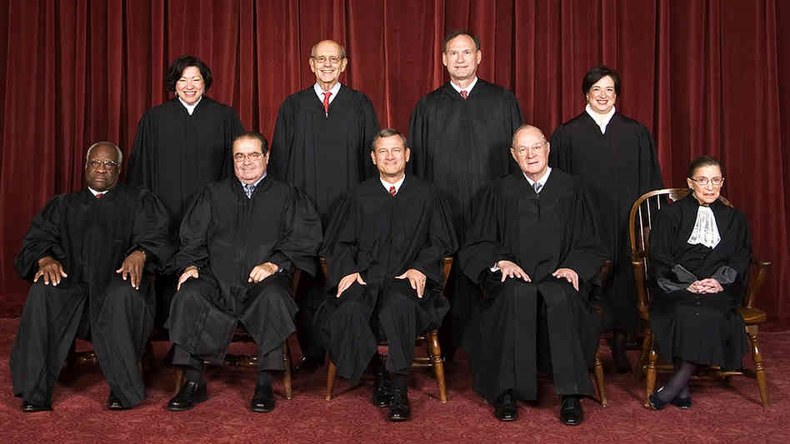
CONCEPT: Appointment of Judges
The power to appoint judges to federal courts falls on the President.
The President nominates Supreme Court justices, as well as federal court judges, who are then subject to the approval of the Senate.
Most federal judges are drawn from the ranks of leading attorneys, legal scholars and law school professors, former members of Congress, and State courts.
FRONT:
Clarence Thomas
Antonin Scalia
Chief Justice
John Roberts
Anthony Kennedy
Ruth Ginsberg
BACK:
Sonia Sotomayer
Stephen Breyer
Samuel Alito
Elena Kagan

Slide 6
Chapter 18 CONCEPT: Federal Judge Selection
Selecting Federal Judges – President appoints; Senate confirms
Life term grants freedom from public/political pressure
Nominate party members (80 – 95% of the time)
Congress + President (same party) = adding positions (1960 – Kennedy – added 71 justices)
Similar political ideology (conservative or liberal, lasting legacy for President)
Senatorial courtesy – asks state Senators for district court judges
LBJ – appointed Thurgood Marshall (1st African American- 1967)
Reagan – appointed Sandra Day O’Connor (1st female - 1985)
“Presidents come and go, but the Supreme Court goes on forever. (Its members) make decisions which will affect your lives and the lives of you children for generations to come.”
- President Nixon 1971, after appointment of William Rehnquist

Slide 7
Choosing Federal Judges
DIRECTIONS:
- Read the article on P. 516
- Answer the questions below
According to the author, how did the Founding Fathers feel about giving the President the power to appoint federal judges?
How does the nomination process reflect the principle of separation of powers?
How does the author feel about the appointment process as outlined in the Constitution?
Many people believe that a judicial nominee should not be pressured to give his/her opinions on Constitutional issues before the nominee takes a seat as a judge. What do you think?
Do you think the Constitution should have been more specific about the nomination and confirmation process of federal judges?

Slide 8
CONCEPT: Court Officers
Federal judges have many levels of support in order to fulfill their roles:
United States magistrates are appointed by each federal district court judge to handle duties ranging from issuing warrants to setting bail in federal criminal cases.
Each federal district judge appoints one bankruptcy judge for their district.
The President nominates, and the Senate approves, a United States attorney for each federal judicial district.
The President and the Senate also select a United States marshal to serve each of the district courts. Marshals act much like county sheriffs in regard to federal crimes.

