Slide 1
Friday April 24, 2015 Mr. Goblirsch – American Government
OBJECTIVE – Students Will Be Able To – SWBAT:
- Identify the 27 Amendments to the U.S. Constitution.
AGENDA: 3rd Period ONLY
WARM-UP: Tax Day
CONCEPT: Amending the Constitution
WORKSHEET: Amendments
PARTNERS: Amendment Flyer
***HW DUE TUESDAY – Jury Duty Interviews***
Tax Day WARM-UP: (Follow the directions below)
***5 minutes***
Calculate your weekly taxes and make your Weekly Deposit.
Ask your Section Leader if you received any restroom bonuses
If so, add it to your pay for that day on your Weekly Time Sheet
Add up your daily pay from the week to get your Gross Total
Calculate your taxes using the TAX BRACKETS below:
Gross Total Less than $45.00 ================→28% tax rate (X 0.28)
Gross Total $45 through $55.00 ==============→33% tax rate (X 0.33)
Gross Total More than $55.00 ================→38% tax rate (X 0.38)
Subtract your taxes from your gross to get your net pay
Your net pay for the week = your Weekly Deposit

Slide 2
Friday April 24, 2015 Mr. Goblirsch – American Government
OBJECTIVE – Students Will Be Able To – SWBAT:
- Identify the 27 Amendments to the U.S. Constitution.
AGENDA: 5th Period ONLY
WARM-UP: Tax Day
CONCEPT: Amending the Constitution
WORKSHEET: Amendments
PARTNERS: Amendment Flyer
***HW DUE TUESDAY – Jury Duty Interviews***
Tax Day WARM-UP: (Follow the directions below)
***5 minutes***
Calculate your weekly taxes and make your Weekly Deposit.
Ask your Section Leader if you received any restroom or attendance bonuses
If so, add it to your pay for that day on your Weekly Time Sheet
Add up your daily pay from the week to get your Gross Total
Calculate your taxes using the TAX BRACKET below:
Proportional Tax for ALL STUDENTS =============→37% tax rate (X 0.37)
Subtract your taxes from your gross to get your net pay
Your net pay for the week = your Weekly Deposit

Slide 3
Friday April 24, 2015 Mr. Goblirsch – American Government
OBJECTIVE – Students Will Be Able To – SWBAT:
- Identify the 27 Amendments to the U.S. Constitution.
AGENDA: 4th & 6th Periods ONLY
WARM-UP: Tax Day
CONCEPT: Amending the Constitution
WORKSHEET: Amendments
PARTNERS: Amendment Flyer
***HW DUE TUESDAY – Jury Duty Interviews***
Tax Day WARM-UP: (Follow the directions below)
***5 minutes***
Calculate your weekly taxes and make your Weekly Deposit.
Ask your Section Leader if you received any restroom bonuses
If so, add it to your pay for that day on your Weekly Time Sheet
Add up your daily pay from the week to get your Gross Total
Calculate your taxes using the TAX BRACKETS below:
Gross Total Less than $40.00 ================→10% tax rate (X 0.10)
Gross Total $40 through $60.00 ==============→20% tax rate (X 0.20)
Gross Total $60 through $70.00 ==============→30% tax rate (X 0.30)
Gross Total $70 through $80.00 ==============→40% tax rate (X 0.40)
Gross Total More than $80.00 ================→50% tax rate (X 0.50)
Subtract your taxes from your gross to get your net pay
Your net pay for the week = your Weekly Deposit

Slide 4
HW: Jury Duty Interviews
Conduct 3 interviews of people who have had jury duty. Ask them to recall their impressions of the experience.
(EX. – What was the case? How long did it last? How did the deliberations go? What’s the best excuse you heard to try and get out of jury duty? Etc.)
Try to find people who have actually served during the trial, not just people who were dismissed.
After conducting the interview, write a brief paragraph summary of each person’s responses.

Slide 5
AMENDMENTS & RIGHTS

Slide 6
Amending the Constitution
The Constitution provides for its own amendments—that is, for changes in its written words.
Article V sets out two methods for the proposal and two methods for the ratification of constitutional amendments, creating four possible methods of formal amendment.

Slide 7
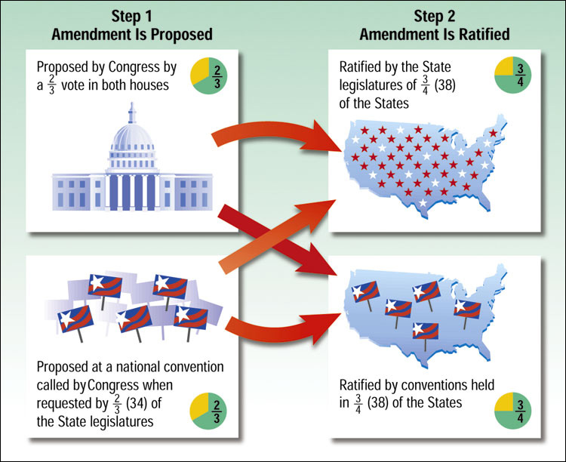
Formal Amendment Process
The four different ways by which amendments may be added to the Constitution are shown here:

Slide 8
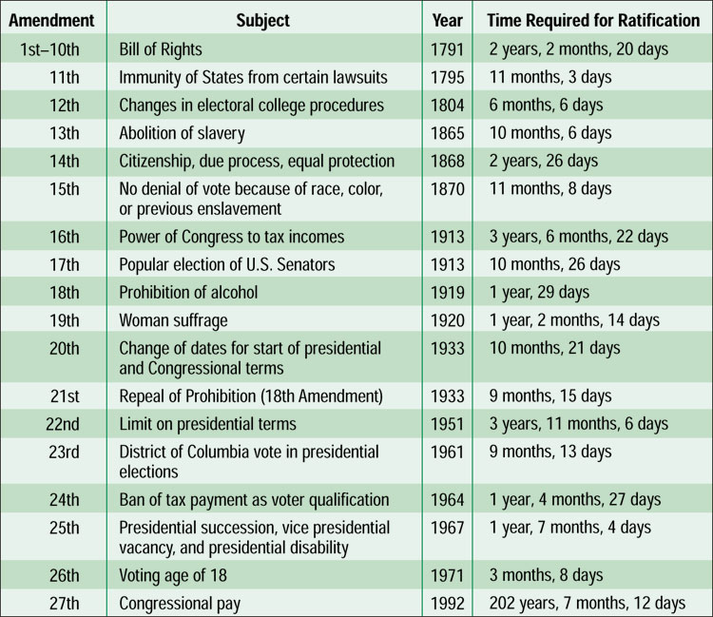
Amendments to the Constitution
Collectively, the first ten amendments are known as the Bill of Rights. They set out many of our basic freedoms.
TASK: Read the 27 Amendments on Pgs. 771 – 779 in your textbook. Complete The Amendments worksheet.

Slide 9
Amendment Flyer
Working with a partner
Create a flyer for an Amendment of your choice
THE FLYER MUST INCLUDE:
Title (ex. The 1st Amendment) at top of poster
Full description of right guaranteed within it
When it was created/ratified
Picture representative of the amendment

Slide 10
AMENDMENT CHART
Use the chart on P. 76 to answer the questions below.
How many amendments have been added to the Constitution?
What are the first 10 amendments called?
Which amendment was adopted in the shortest amount of time?
Which one took the longest amount of time to ratify?
Which amendment is the only one to have been repealed?

Slide 11
CLASS RANKINGS
CLASS AVERAGE
PURCHASED FINAL
5th – 71%
6th – 74%
4th – 77.52%
3rd – 77.85%
4) 5th – 74%
6th – 88%
3rd – 97%
1) 4th – 100%

Slide 12
LIST OF INDIVIDUALS WHO HAVE NOT PAID FOR THE FINAL
3RD PERIOD
Andrea C.
Total Have Not Paid
= 1 / 31

Slide 13
LIST OF INDIVIDUALS WHO HAVE NOT PAID FOR THE FINAL
4TH PERIOD
Total Have Not Paid
= 0 / 31

Slide 14
LIST OF INDIVIDUALS WHO HAVE NOT PAID FOR THE FINAL
5TH PERIOD
Rudi G.
Ernesto G.
Izaiah H.
Alex H.
Erasmo P.
Rafael R.
Oscar T.
Chris T.
Genesis V.
Total Have Not Paid
= 9 / 35

Slide 15
LIST OF INDIVIDUALS WHO HAVE NOT PAID FOR THE FINAL
6TH PERIOD
Rolando C.
Hannah G.
Abel M.
Julio O.
Total Have Not Paid
= 4 / 34

