Slide 1
Monday May 11, 2015 Mr. Goblirsch – American Government
OBJECTIVE – Students Will Be Able To – SWBAT:
- Analyze the 5th and 6th Amendments of the Constitution.
AGENDA:
WARM-UP: Accused Vocab
CONCEPT: 5th & 6th Amendment Rights
DOCUMENT: Miranda v. Arizona
QUICK WRITE: Rights of the Accused
*Workbook P. 92 from Friday DUE TOMORROW*
*****FINAL PROJECTS DUE MAY 22*****
Accused Vocab WARM-UP: (Follow the directions below)
***5 minutes***
Define the terms below.
Writ of habeas corpus 4. Grand jury
Bill of attainder 5. Indictment
Ex post facto law 6. Bench trial

Slide 2
RIGHTS & AMENDMENTS: 5th & 6th
CHAPTER 20

Slide 3
PRIOR KNOWLEDGE
4TH AMENDMENT
“right of the people to be secure in their persons, houses, papers, and effects, against unreasonable searches and seizures.”
Probable cause must be present
Sometimes difficult to define what this is
Warrant must be granted if no wrong doing is occurring at the time
No warrant is needed if a crime is occurring
Exclusionary Rule = evidence obtained illegally cannot be used in court

Slide 4
4th Amendment and High School
Limited protection inside of schools
School offices and officials (employees of the school) do not need warrants to conduct searches of persons or their property
All that is needed is reasonable grounds (suspicion alone has been ruled enough by the Supreme Court)

Slide 5
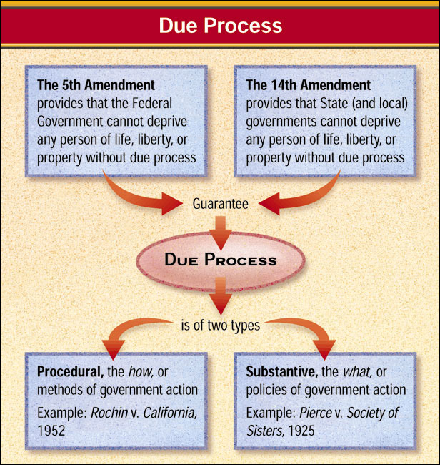
The Meaning of Due Process

Slide 6
5th Amendment – Self-incrimination
No person shall be compelled in any criminal case to be a witness against himself.”
Those charging a person with a crime bear the burden of proof (Presumption of Innocence)
Person must be read their rights or anything they say cannot be used against them in court

Slide 7
5th Amendment - Double Jeopardy
A person may not be charged twice for the same crime
Once found innocent no matter what evidence comes forward proving otherwise you cannot be tried again

Slide 8
6th AMENDMENT: Trial by Jury
Americans in criminal trials are guaranteed an impartial jury chosen from the district where the crime was committed.
If a defendant waives the right to a jury trial, a bench trial is held where the judge alone hears the case.
Most juries have to be unanimous to convict.

Slide 9
6th Amendment
Speedy & public jury trial
Guarantees the assistance of counsel for a persons defense
Paid for by the state where law was broken by the tax payers

Slide 10
Right to an Adequate Defense
Some rights of the accused:

Slide 11
QUICK WRITE
Do you agree or disagree with the following statement:
“Americans who are accused of crimes have too many legal rights/protections.”
Agree or Disagree? Support your opinion.

Slide 12
3rd Period FINAL PROJECT
PRESENATION SCHEDULE
WEDNESDAY May 27th | THURSDAY May 28th | FRIDAY May 29th
1st – Brett & Zach | 1st – Ashley & Angelina | 1st – Maria & Stephanie C.
2nd – Maria | 2nd – Toni & Sylvia | 2nd - Andrea
3rd – Lilly & Kim | 3rd – Stephanie W. & Ivan | 3rd – Christian H. & Lupe
4th – Raul & Jonathan | 4th – Juan & Brian | 4th - Caitlyn
5th - Justina | 5th - Ramon | 5th – Jose & Armando
6th - | 6th – Kristian W. | 6th – Juli
7th – Hector & Alicia | 7th - | 7th – Julian & Jasmien

Slide 13
4th Period FINAL PROJECT
PRESENATION SCHEDULE
WEDNESDAY May 27th | THURSDAY May 28th | FRIDAY May 29th
1st - Jonathan | 1st - | 1st – Ramon & Jesus
2nd – Jasmine A. & Illene | 2nd – Jennifer & Chris | 2nd – Lili & Casidy
3rd - Vanessa | 3rd – Tino & Ashley | 3rd – Savannah & Perla
4th – Lucy & Jennifer L. | 4th - Alicia | 4th - Maite
5th – Jasmine N. & Diana | 5th – Cristian & John | 5th – Elizabeth & Arvinder
6th – Ricky & Jaskaran | 6th – Brandon & Jose | 6th - Susana
7th - Lesley | 7th - Rafael | 7th -

Slide 14
5th Period FINAL PROJECT
PRESENATION SCHEDULE
WEDNESDAY May 27th | THURSDAY May 28th | FRIDAY May 29th
1st - | 1st – Andrew & Gabby | 1st – Leo & Tristan
2nd – Rafael R. | 2nd – Esai & Caleb | 2nd – Jose & Ernesto P.
3rd - | 3rd – Victor & Elizabeth | 3rd – Miranda & Hilsa
4th – David & Rudy | 4th - Alexis | 4th – Fatima & Genesis
5th - Hailey | 5th – Manuel & Maria | 5th – Erasmo & Ernesto G.
6th – Kyndall & Chris | 6th – Christian & Rafael A. | 6th – Alex & Jesus
7th – Cynthia & Kime | 7th – Izaiah & Oscar | 7th – Eduardo

Slide 15
6th Period FINAL PROJECT
PRESENATION SCHEDULE
WEDNESDAY May 27th | THURSDAY May 28th | FRIDAY May 29th
1st – Gabby & Stephanie | 1st – Julio P. & Jose | 1st - Sam
2nd – Josh & Leo | 2nd - | 2nd – Jennifer & Priscilla
3rd - Andrea | 3rd – Brayan & Fatima | 3rd – Ricardo & Efren
4th – Cecilia & Megan | 4th – Jonathan & Denice | 4th – Julio O. & Hannah
5th - | 5th - Kim | 5th - Carrie
6th - | 6th – Giovanna, Edgar & Mariela | 6th – Prez & VP
7th – Jorge & Alvaro | 7th - Marco | 7th – Rolando & Mario

