Slide 1
Tuesday August 25, 2015 Mr. Goblirsch – Economics
OBJECTIVE – Students Will Be Able To – SWBAT:
- Explain the concept of the invisible hand, and identify the factor and product markets of a capitalist system.
AGENDA:
WARM-UP: Free Market Vocab
CONCEPT: Free Market Part II
READING: Adam Smith on the Free Market (P. 33)
CLOSURE: Free Market Web
Free Market Vocab WARM-UP: (Follow the directions below)
***5 minutes***
Use the glossary of your textbook to define the terms.
Specialization 4) Factor Market
Household 5) Product Market
Firm 6) Consumer sovereignty

Slide 2
Chapter 2 Section 2
FREE MARKET PART II
Traditional Economies
Free Market Economies
Centrally Planned Economies
Mixed Economies

Slide 3
Factor and Product Markets
Factor Market
➢Buy & sell land, labor, and capital
➢ Households directly or indirectly own all economic resources and supply these to businesses
➢ Businesses demand resources and make payments to owner as rent, interest, wages, or profit income
Product Market
➢where people buy G & S from businesses
➢Income received from the selling of economic resources is used to purchase goods and services in the product market
➢ Interaction of supply and demand determines prices

Slide 4
PRODUCT MARKET
FACTOR MARKET
Resource Owners (Households)
Product Markets
Factor Markets
Business Organ. (Producers/Firms)
The Circular Flow Model
Green Arrows represent flow of money Black Arrows represent flow of goods/services

Slide 5
PRODUCT MARKET
FACTOR MARKET
Spend Income
Resource Owners (Households)
Earn Income
Buy Goods & Services
Sell Scarce Resources
Product Markets
Factor Markets
Sell Goods & Services
Buy Scarce Resources
Receive Revenue
Business Organ. (Producers/Firms)
Pay for Resources
Green Arrows represent flow of money Black Arrows represent flow of goods/services

Slide 6
STRUCTURED ACADEMIC DISCUSSION
The Factor Market is …
The Product Market is …

Slide 7
Section 3-13
Competition and Free Enterprise

Slide 8
STRUCTURED ACADEMIC DISCUSSION
The characteristic of Capitalism that drives people to improve their well being is …
The most important characteristic of a Capitalist system is …

Slide 9
CHAPTER 2 SECTION 2 Continued Self-Regulating Nature of the Marketplace
Self Interest
Buyers & Sellers only consider their personal gain
Competition
Drives prices down
People want to buy the highest quality at the cheapest price.
The invisible hand
Self-Interest and Competition drives the market

Slide 10
STRUCTURED ACADEMIC DISCUSSION
What are the components of the invisible hand?
One component of the invisible hand is …

Slide 11
READING: ADAM SMITH “Wealth of Nations”
Explain how specialization increases productivity.
How does Adam Smith feel about government in the economy?
Explain Adam Smith’s concept of the invisible hand.

Slide 12
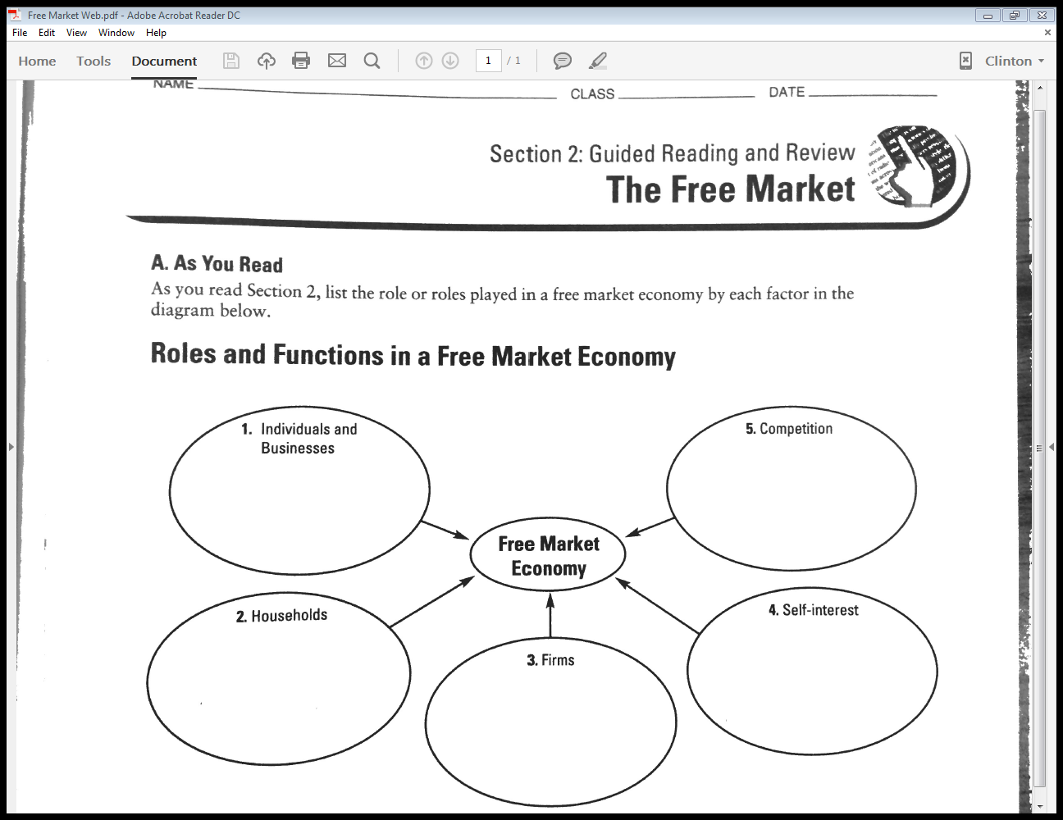
Free Market Web

Slide 13
Free Market Exit Ticket
The 4 types of economic systems are …
Profit is the main goal of a Capitalist/free market system because …
Competition is important to a Capitalist/free market system because …
The “invisible hand” is …
The difference between the Factor market and the Product market is …

