Slide 1
Monday August 31, 2015 Mr. Goblirsch – U.S. History
OBJECTIVE – Students Will Be Able To – SWBAT:
Analyze the division and conflicts that developed between the industrial North and plantation South.
AGENDA:
WARM-UP: Division Journal
CONCEPT: Sectionalism (NearPod)
MAP: States Choose Sides
VIDEO: America the Story of Us: Division
Division Journal WARM-UP: (Follow the directions below)
***5 Minutes***
Write a paragraph journal entry on the topic below.
Compromise means both sides working together and meeting “in the middle” to reach an agreement. What happens when one side, or both sides, refuse to compromise on an issue?

Slide 2
SECTIONALISM:
Loyalty to the interests of
A region rather than the
Country as a whole
Ch 3 Wrap Ch 4 Begins

Slide 3
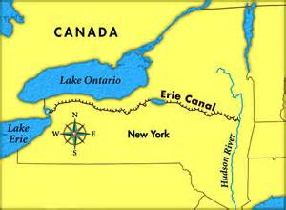
I. Industry Grows
Industrial Revolution spreads to the U.S.
Industrialization began in New England – farming was not profitable
Farmers began specializing, selling to urban markets, & using cash to purchase manufactured goods = Market economy
“American system” – transportation systems make travel easier

Slide 4
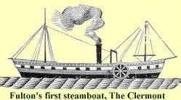
II. Market Revolution
1840s alone, national economy grew more than it had in first 40 years of the century
Growth of free enterprise & entrepreneurs invested in industries
Inventions fueled economic revolution
1807 – 1st steamboat, by 1830 – 200 = cut shipping rates
1840s – over 3,000 miles of canal
1850s – over 9,000 miles of track
1837 – Samuel Morse – telegraph – businesses & RR use to transmit orders relay info on prices/sales, safety hazards
Nation becomes more interdependent/connected
Goods become affordable and accessible
Northeast became the center of commerce

Slide 5
Structured Academic Discussion
What was the Market Revolution?
The Market Revolution was …
Identify one key invention of the early to mid 1800s.
One key invention of the early to mid 1800s was …

Slide 6
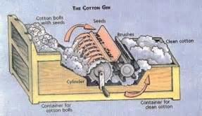
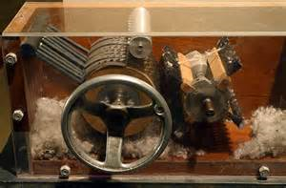
III. South remains Agricultural
Still reliant on plantation economy – cash crops = cotton, tobacco, and rice
1793 – Eli Whitney’s cotton gin leads to southern “Cotton Kingdom”
Slavery became an institution
1790 – 1820 – enslaved pop. grew from less than 700,000 to over 1.5 million

Slide 7
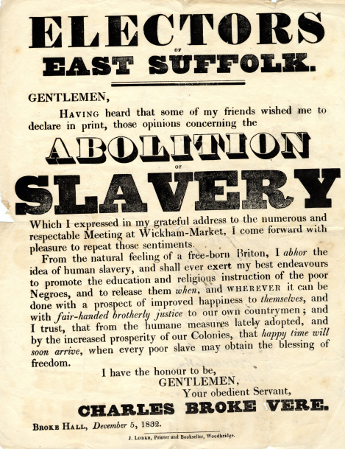
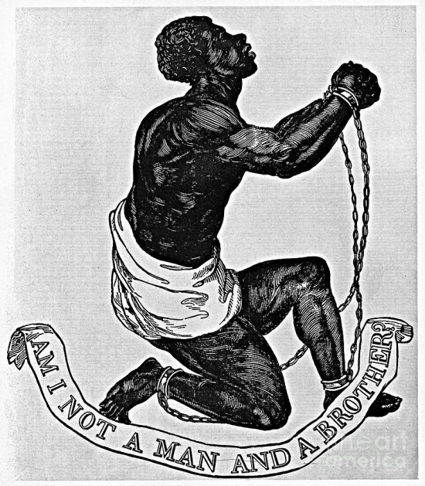
IV. Differences = Conflict
North — diversified industries not dependent on slavery
By 1804 – most northern states had abolished slavery
Abolition movement grows as North industrializes
1820s – over 100 anti-slavery societies
C. 1832 - Nullification crisis avoided
South dependent on cotton exports; tax on manufactured goods = Britain bought less cotton; South blamed taxes for economic decline
SC threatened nullification & secession; tax was gradually reduced

Slide 8
Structured Academic Discussion
How was the South different than the North?
The South was different than the North because …
What was the abolition movement?
The abolition movement …

Slide 9
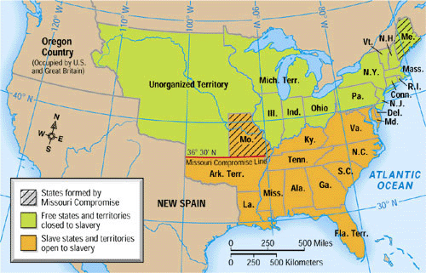
V. Issues over New Territories
Pro—more slave states
Con—stop spread of slavery
1. Missouri Compromise - 1820
Missouri Compromise
Maine admitted as a Free State
Missouri admitted as a Slave State
Above 36 Parallel No Slavery; Below Slavery OK

Slide 10
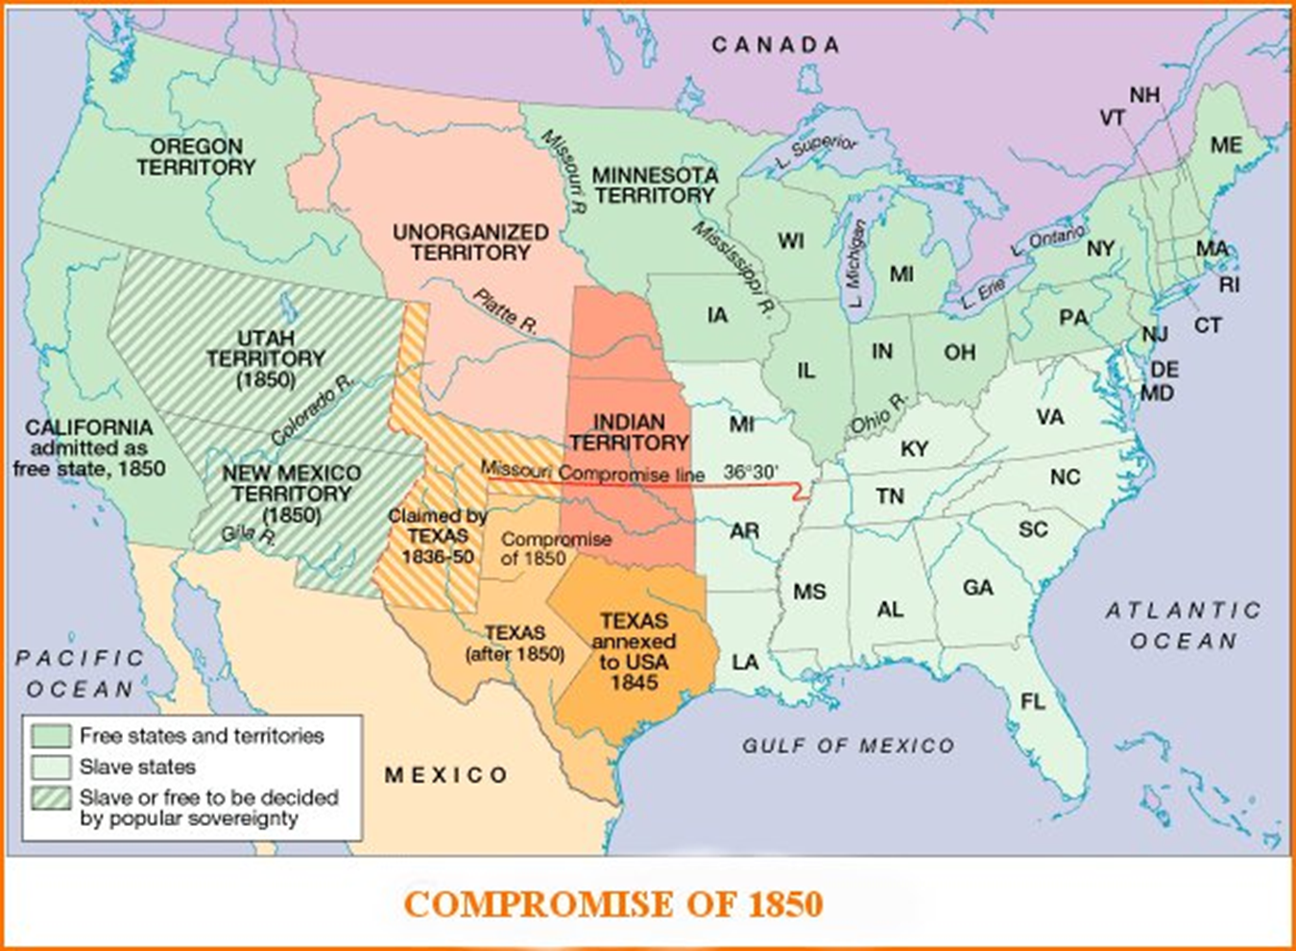
2. Compromise of 1850
North Pleased
California admitted as Free State
South Pleased
New & Harsh Fugitive Slave Laws Passed
N & S Pleased
Popular Sovereignty in New Mexico & Utah
(residents vote for or against slavery)

Slide 11
Structured Academic Discussion
What was the Missouri Compromise?
The Missouri Compromise was …
What was the Compromise of 1850?
The Compromise of 1850 was …

Slide 12
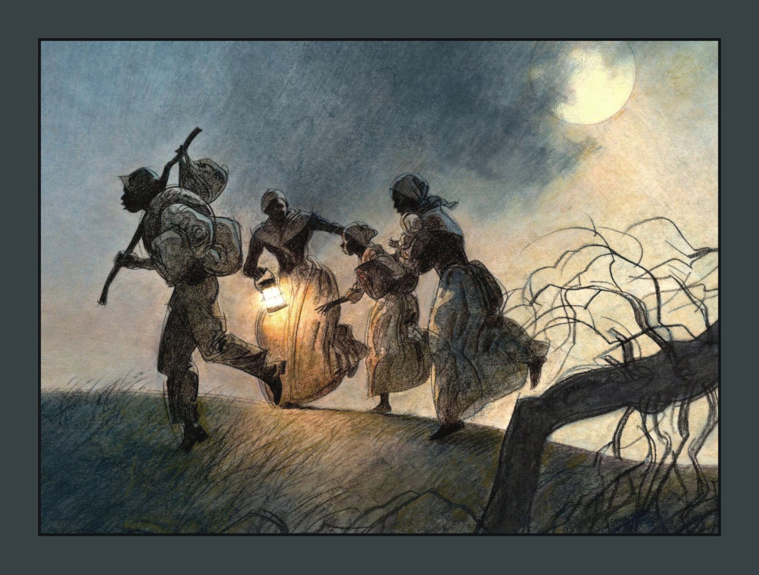
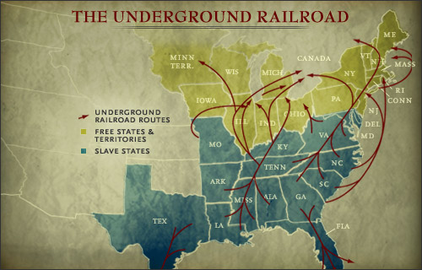
VI. Protest & Resistance
A. Fugitive Slave Laws infuriate North
Compromise of 1850
Some N used violence to rescue fugitives
Some helped slaves escape to the North
B. Underground Railroad
1. escape routes used by fugitive slaves
2. Harriet Tubman (conductor) helped slaves flee to freedom

Slide 13
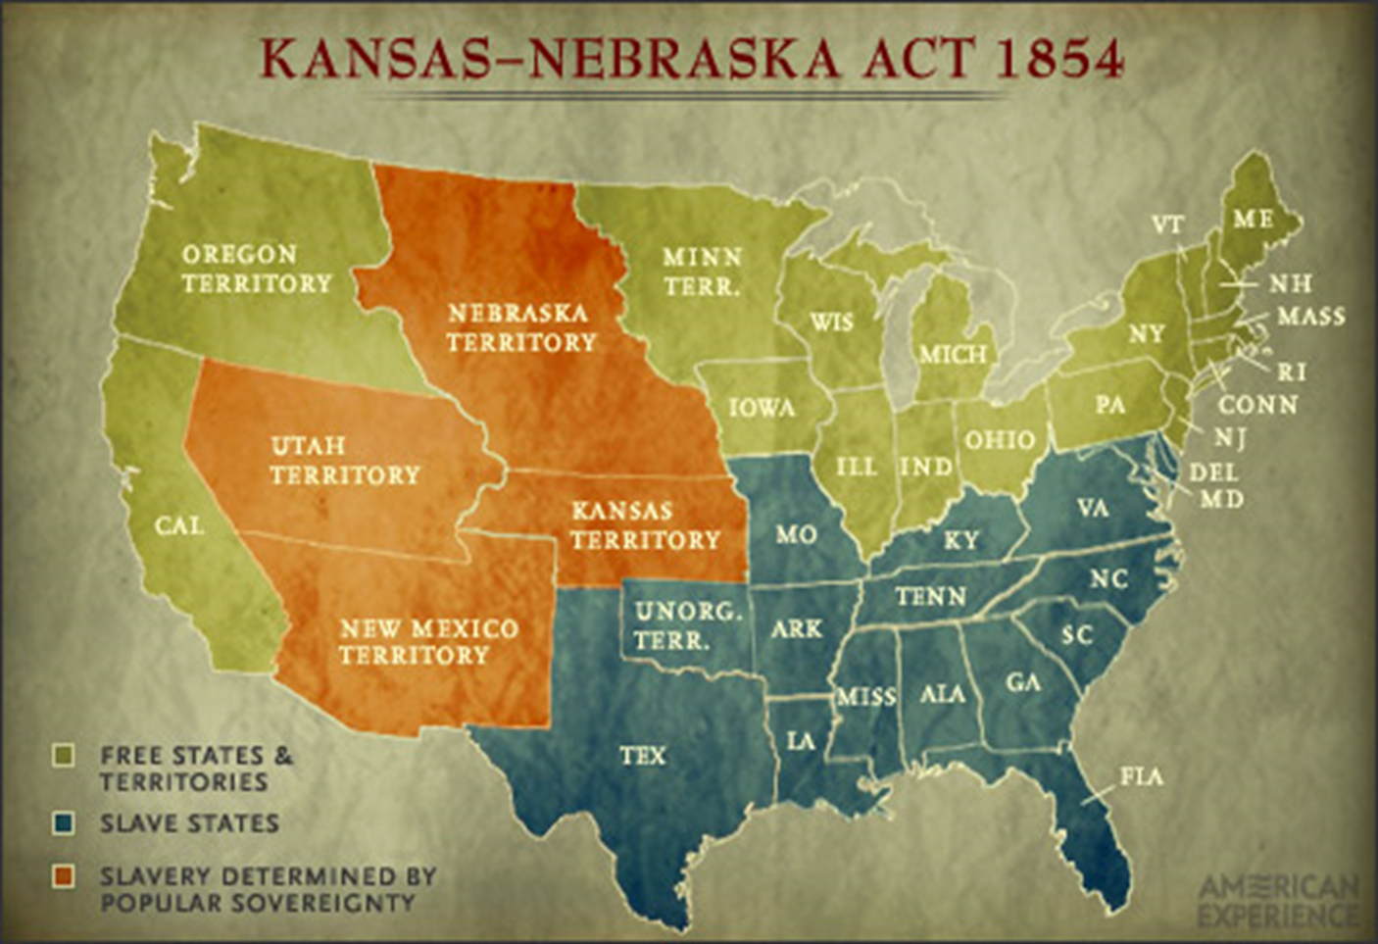
C. Kansas – Nebraska Act 1854
1. Divide the Territory into 2 Kan & Neb
a) Established Popular Sovereignty
(vote on slavery in each territory)
2. Bleeding Kansas – Abolitionists & slavery supporters fled to Kansas to vote
1855 – enough population to vote
“Border ruffians” from Missouri vote, establish pro-slavery government
Abolitionists establish separate govt
Violence breaks out over control of Kansas

Slide 14
Structured Academic Discussion
What was the Underground Railroad?
The Underground Railroad was …
What did the Kansas-Nebraska act do?
The Kansas-Nebraska act …

Slide 15
States Choose Sides Map
STEP 1
DIRECTIONS:
Label each of the 31 states with their 2 letter abbreviation.
Write an “S” in the states where slavery was still legal.

