Slide 1
Tuesday September 1, 2015 Mr. Goblirsch – U.S. History
OBJECTIVE – Students Will Be Able To – SWBAT:
Identify the significance of the Dred Scott decision and John Brown’s actions in leading to the outbreak of the Civil War.
AGENDA:
WARM-UP: Martyr Journal
CONCEPT: Rising National Tensions
ANALYZING DOCUMENTS: John Brown
Martyr Journal WARM-UP: (Follow the directions below)
***5 Minutes***
Write a paragraph journal entry on the topic below.
A martyr is a person who is put to death or endures great suffering on behalf of any belief, principle, or cause. If someone has such a strong belief in something, that they feel it is a worthy enough cause to murder for and they are then sentenced to death, would you consider them a martyr or a murderer? Explain.

Slide 2
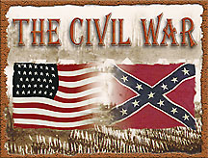
CH 4: THE UNION IN PERIL
RISING NATIONAL
TENSIONS

Slide 3
THE DRED SCOTT DECISION
A major Supreme Court decision occurred when slave Dred Scott was taken by his owner to free states Illinois & Wisconsin
Scott argued that made him a free man
Finally in 1857, the Court ruled against Dred Scott citing the Constitution’s protection of property
The decision increased tensions over slavery
Slavery would be able to spread to the western territories
DRED SCOTT LOST HIS CHANCE AT FREEDOM

Slide 4
John Brown
Abolitionist
Involved in the Underground Railroad
Moved to Kansas to support the anti-slavery cause
Responded to violence by pro-slavery men by organizing the murder of 5 proslavery settlers: Pottowatomie Creek Massacre

Slide 5
John Brown’s Raid on Harper’s Ferry
Brown planned a raid on a federal arsenal
He wanted to distribute weapons to slaves
Action failed. Brown and his men were mostly captured or killed within 36 hours
Brown was ultimately hanged

Slide 6
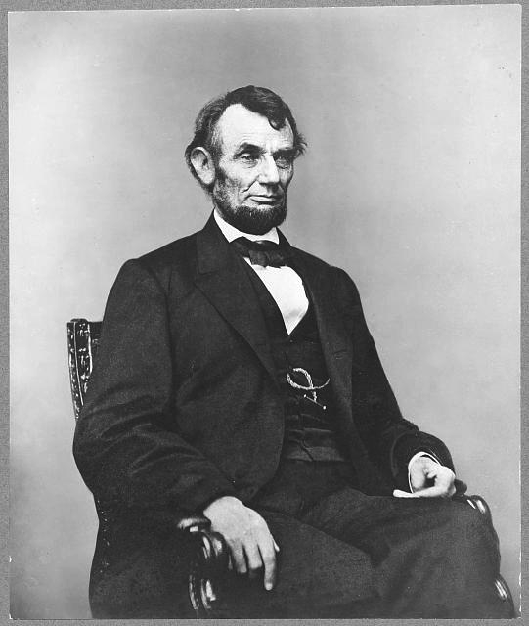
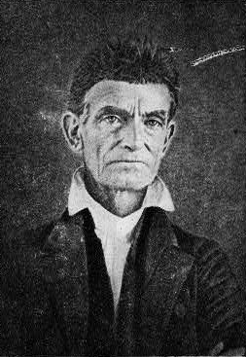
Abraham Lincoln called Brown a “misguided fanatic.”
Abraham Lincoln
John Brown

Slide 7
Central Historical Question:
Was John Brown a “misguided fanatic”?

