Slide 1
Thursday September 3, 2015 Mr. Goblirsch – U.S. History
OBJECTIVE – Students Will Be Able To – SWBAT:
Identify the advantages and strategy of each side, and analyze the impact of the Emancipation Proclamation.
AGENDA:
WARM-UP: Emancipation Proclamation Background
CONCEPT: The Civil War: Advantages & Strategy
VIDEO CLIP: Emancipation Proclamation (3 min)
PRIMARY SOURCES: Emancipation Proclamation Documents
CLOSURE: Did Lincoln Free the Slaves?
Emancipation Proclamation WARM-UP: (Follow the directions below)
***5 Minutes***
DIRECTIONS: Get out and log-in to your ChromeBook. Open up the “Emancipation Proclamation Reading Handout” in Google Classroom. Read the Emancipation Proclamation Background document (the 1st document in the file). Answer the questions below.
According to President Lincoln’s inaugural address, was the Civil War a war about slavery? If not, what was it a war about?
What were fugitive slaves declared to be?
How were slaves contributing to the Southern war effort?

Slide 2
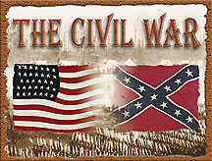
CHAPTER 4: THE UNION IN PERIL
The Civil War:
Advantages & Strategy

Slide 4
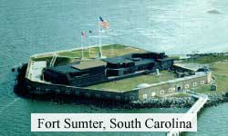
THE CIVIL WAR BEGINS: SECTION 2
The first battle of the Civil War (1861-1865) was fought at Fort Sumter, South Carolina on April 12, 1861
Soon after, Virginia, Arkansas, North Carolina and Tennessee seceded (Confederate states = 11)
Virginia split on whether to leave Union (West Virginia formed)

Slide 5
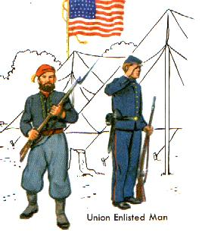
NORTH HAD ADVANTAGES
The North and South were not evenly matched
The North advantages:
More people, More factories
More food production
More railroads
Better communication
Established Central government, $$$
Called UNION

Slide 6
SOUTH HAD ADVANTAGES
The South advantages:
First rate military leadership
Highly motivated soldiers
Cotton Exports
Fighting for their way of life
Called CONFEDERACY

Slide 7
Structured Academic Discussion
In your opinion, who had the better advantages and why?

Slide 8
Strategy
1. Union
a) Blockade Southern Ports (Map on P. 171)
(no export of cotton---no import goods)
b) Split Confederacy in two
(Capture Mississippi River)
c) Capture Capital Richmond, VA
d) Goal: Reunite the Union
2. Confederacy
a) Defensive War (protect your state)
Attack the N only if the opportunity arises
b) Goal: be recognized as a separate nation

Slide 9
Structured Academic Discussion
In your opinion, who had the better strategy and why?

Slide 10
ANALYZING PRIMARY SOURCES
STEP 1 – INTROCUCTION: Watch the Emancipation Proclamation video clip
STEP 2 – READING: Read the Emancipation Proclamation document and Frederick Douglas document
STEP 3 – PARTNER WORK: Work with your partner to complete the Guided Questions worksheet
STEP 4 – EXIT TICKET: On the back of the worksheet, write a paragraph answering the question below:
Did President Lincoln free the slaves, or did the slaves free themselves? Use evidence from the documents to support your claim. Use at least 2 specific examples from the documents as your evidence.

