Slide 1
Wednesday September 9, 2015 Mr. Goblirsch – U.S. History
OBJECTIVE – Students Will Be Able To – SWBAT:
Describe the impact of the legislation passed during the Reconstruction era.
AGENDA:
WARM-UP: Reconstruction Vocab
CONCEPT: Reconstruction (NearPod)
VIDEO CLIP: Crash Course – Reconstruction (13 min)
EXIT TICKET: Reconstruction
*****Unit 1 Test FRIDAY*****
***Unit 1 Project DUE TUESDAY 9/15***
Reconstruction Vocab WARM-UP: (Follow the directions below)
***5 Minutes***
Define the following terms.
Thirteenth Amendment
Fourteenth Amendment
Fifteenth Amendment

Slide 2
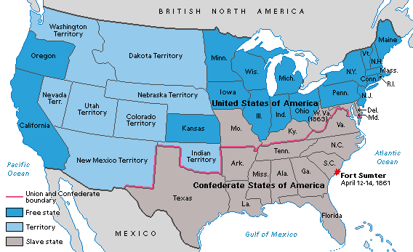
The Civil War, 1861-1865

Slide 3
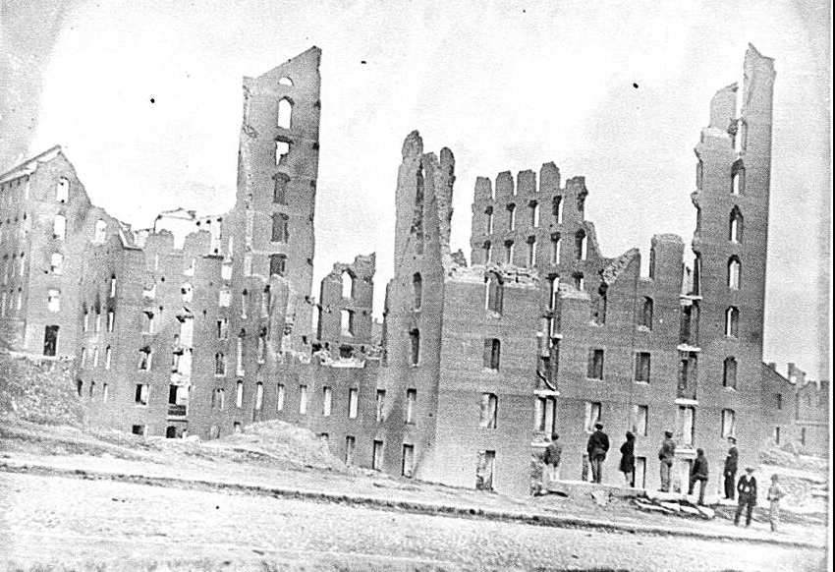
CONCEPT: Major questions following the Civil War
How to rebuild the South
How to bring Southern states back to the United States
How to bring former slaves into the United States as free people

Slide 4
CONCEPT: Consequences for Confederate States
Should people who fought against the United States be allowed to become citizens? Should they be punished?
What should be done to Southern state governments that fought against the U.S.?

Slide 5
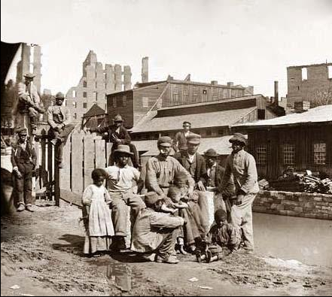
CONCEPT: Freedmen
How would freed men and women be treated in the Southern states?
What do you think were some of the major challenges faced by former slaves?
Notes:
At the end of the Civil War, there were hundreds of thousands former slaves living in the former Confederate States.

Slide 6
CONCEPT: VOCAB
Reconstruction
1865-1877
Period of rebuilding the nation following the Civil War
Radical Republicans
radical means “extreme”;
Disagreed with Lincoln and Johnson on Reconstruction

Slide 7
RECONSTRUCTION: SECTION 4
The Civil War had ended. Slavery and secession were no more. Now what?
How does the Union integrate the South back into American society?
How do 4 million newly freed African slaves integrate themselves into society?
1865-1877

Slide 8
CIVIL RIGHTS ACT
One of the important acts passed by Congress was the Civil Rights Act -1866
This law gave African Americans citizenship and forbade states from passing laws discriminating against former slaves (Black Codes)
FROM HARPER’S MAGAZINE 1866 – BLACKS CELEBRATE

Slide 9
FREEDMEN’S BUREAU
Congress also passed the Freemen’s Bureau Act which provided much needed aid to African Americans
Included in the Act was money for education, hospitals, social services, churches, and help with labor contracts and discrimination cases
STRUCTURED ACADEMIC DISCUSSION
What was the Freedman’s Bureau?
The Freedman’s Bureau was ______________
EDUCATION WAS AN IMPORTANT PART OF THE BUREAU

Slide 10
14TH AMENDMENT
In 1866, Congress passed the 14th Amendment which provided legal backing to the Civil Rights Act
It prevented states from denying rights to people based on race
This nullified the Dred Scott decision
STRUCTURED ACADEMIC DISCUSSION
What did the 14th Amendment do?
The 14th Amendment …

Slide 11
RECONSTRUCTION ACT OF 1867
Congressional Republicans again joined forces to pass the Reconstruction Act
This act voided the state governments formed in the South under the Presidential plans and instead divided the south into 5 military districts
The states were required to grant black men the right to vote and to ratify the 14th Amendment
“First Vote”
This image depicts an artisan, a businessman and a soldier standing in line to cast their first ballot.

Slide 12
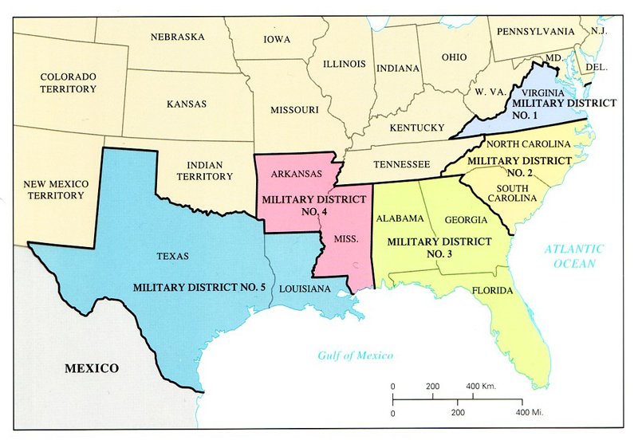
Federal Troops Govern Districts
STRUCTURED ACADEMIC DISCUSSION
What did the Reconstruction Act of 1867 do?
The Reconstruction Act of 1867 …

Slide 13
JOHNSON IMPEACHED
Radical Republicans felt Johnson was blocking Reconstruction efforts
Thus, they looked for grounds to impeach him
They found grounds when he fired a cabinet member in violation of the “Tenure of Office Act”
He was impeached, but not convicted and served out his term
GALLERY TICKET FOR JOHNSON IMPEACHMENT HEARING

Slide 14
15th AMENDMENT
1868 - Ulysses Grant elected, Congress passed the 15th Amendment
This amendment stated that no one could be kept from voting because of “race, color, or previous servitude”
The 15th Amendment was ratified in 1870
STRUCTURED ACADEMIC DISCUSSION
What did the 15th Amendment do?
The 15th Amendment …

Slide 15
RECONSTRUCTING SOCIETY
The South went through significant changes after the war
The economy was in ruins and they lost hundreds of thousands of young men
Republicans now dominated politically, but often with conflicting goals
MANY SOUTHERN CITIES SUFFERED EXTENSIVE DAMAGE

Slide 16
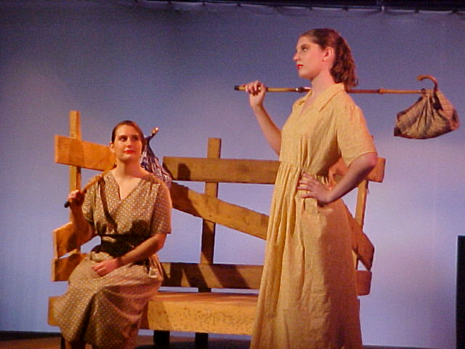
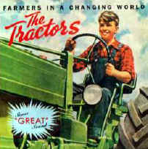
SOUTHERN REPUBLICANS
3 groups made up the bulk of Southern Republicans
1) Scalawags: These were white farmers (Small farms)
2) Carpetbaggers: These were Northerners who came South in search of opportunity after the war
3) African Americans: Former slaves- 90% of whom were Republican
CARPETBAGGERS
STRUCTURED ACADEMIC DISCUSSION
What groups made up the Southern Republicans?
The Southern Republicans were ______________
SCALAWAGS

Slide 17
SHARECROPPING AND TENANT FARMING
Without land of their own, Southern African Americans could not grow their own crops
Thus, many became sharecroppers– a system be which families were given a small plot of land to work in exchange for some of the crops
ARKANSAS SHARECROPPERS

Slide 18
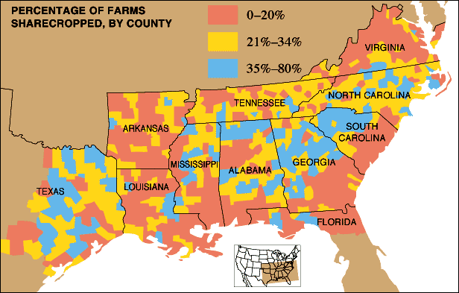
SHARECROPPING IN THE SOUTH - 1880

Slide 19
THE COLLAPSE OF RECONSTRUCTION
While some Southern whites participated in the new governments, voted in elections, and reluctantly accepted African Americans---others were very resentful and formed hate groups
Most famous vigilante group was the Ku Klux Klan – only acceptable religion was protestant

Slide 20
KU KLUX KLAN
The Klan was formed by disgruntled Confederate soldiers whose goals included destroying the Republican Party, aiding the planter class, and preventing blacks from integrating into society
Estimates range as high as 20,000 murders attributed to the Klan whose membership peaked at almost 4 million in the 1920s

Slide 21
Structured Academic Discussion
The Ku Klux Klan rose to power after the Civil War and _________________

Slide 22
CONGRESS SUPPORT FADES
When Congress passed the Amnesty Act returning voting rights to 150,000 Confederates and allowed the Freedmen’s Bureau to expire—it became clear that Southern Democrats were back in political control

Slide 23
DEMOCRATS “REDEEM SOUTH”
Lack of Republican unity in the South and an economic downturn that diverted attention from Southern issues, caused Democrats to regain control of the South
Called “Redeemers” these politicians were out to reclaim Southern Culture and tradition
The Reconstruction Era was over

Slide 24
EXIT TICKET
Use the Google Form link in Google Classroom to complete the Reconstruction Exit Ticket

