Slide 1
Tuesday September 15, 2015 Mr. Goblirsch – Economics
OBJECTIVE – Students Will Be Able To – SWBAT:
- Explain the role of the government in the American free enterprise system.
AGENDA:
WARM-UP: Decision Making Journal
CONCEPT: Providing Public Goods & a Safety Net
GROUPS: Externalities
ASSIGNMENT: Chapter 3 Vocab Boxes
***Unit 1 Test THURSDAY 9/17 (Chapters 1, 2, 3, & 8)***
Decision Making Journal WARM-UP: (Follow the directions below)
***5 minutes***
Write a paragraph journal entry answering the question below.
The City of Ceres has a shortage of parking spaces near it’s downtown businesses. Should the city build a new parking garage or leave it the businesses and residences as it currently is?

Slide 2
Chapter 3: American Free Enterprise
◆ Benefits of Free Enterprise
❖ Promoting Growth & Stability
⬥ Providing Public Goods
 Providing a Safety Net

Slide 3
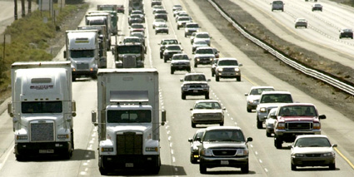
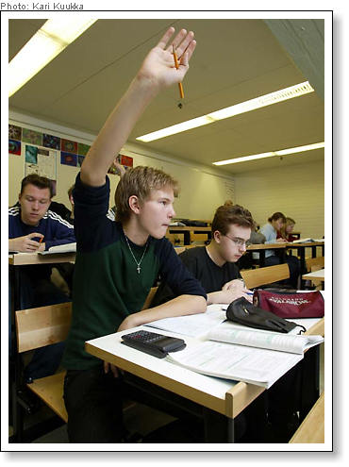
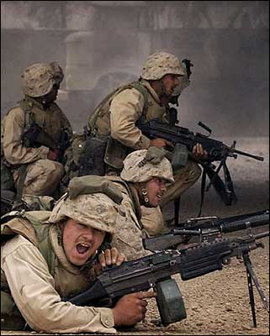
Section 3: Providing Public Goods
When Free Market doesn’t provide the government will
Market Failure when the market doesn’t provide.
Free Riders are a problem.

Slide 4
PUBLIC GOODS
Draw a Picture of A Public Good
Government will analyze cost/benefit:
COST: Is the cost too high for individuals or businesses?
BENEFIT: Does the benefit outweigh the cost?
YES so government provides it

Slide 5
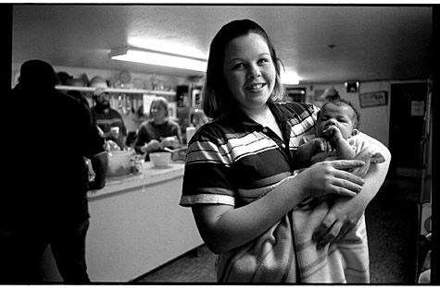
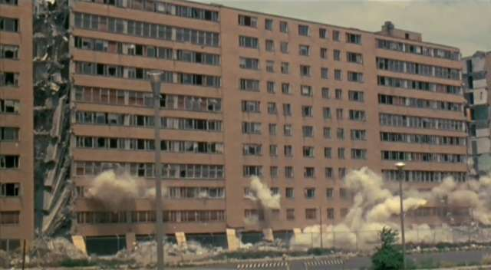
Section 4: Providing a Safety Net
The Poverty Problem
2012
➢ 46.5 Million people
15% of Population
Poverty Threshold
➢1 Parent—1 Child
 $14,000
➢ 2 parents—2 children
 $ 22,000

Slide 6
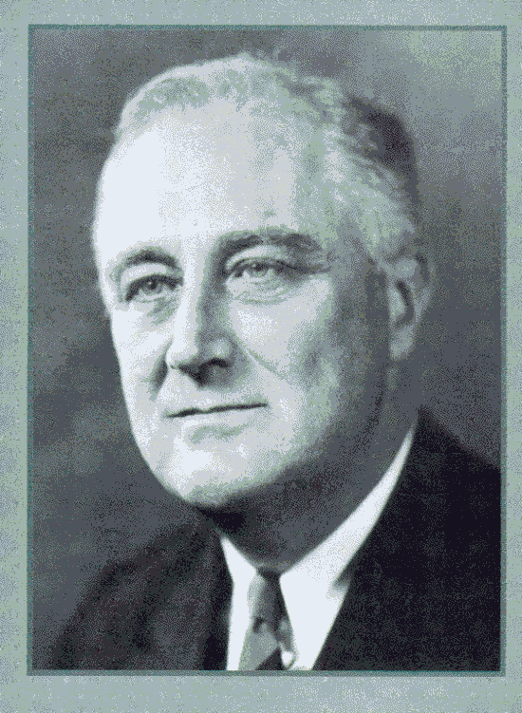
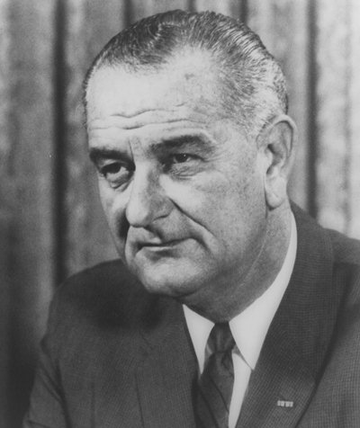
The Welfare System: Where it Started
The Great Depression
Johnson’s War on Poverty

Slide 7
Redistribution Programs
Cash transfers
Social Security Ins.
Temp. Ass. For Needy Families (TANF)
Unemployment Insurance
Workers’ Compensation

Slide 8
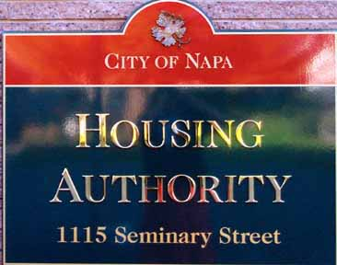
Redistribution Programs —Cont.
In-Kind Benefits
Food Giveaways
Food Stamps
Subsidized Housing
Legal Aid

Slide 9
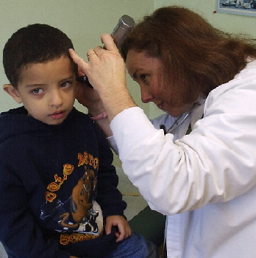
Redistribution Programs—Cont.
Medical Benefits
Medicare
Medicaid
Healthy Families
Etc.

Slide 10
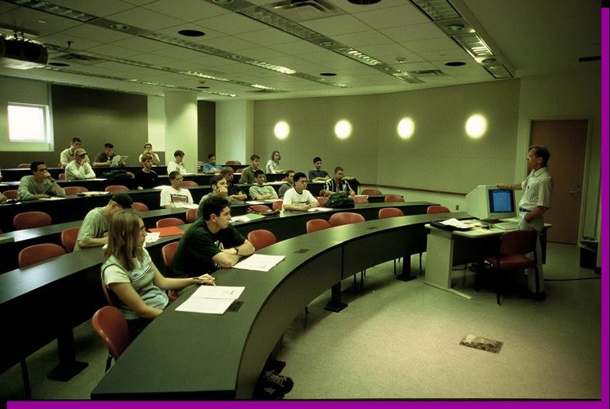
Redistribution Programs—Cont.
Education
➢Public Schools
Public Universities
Grants
Scholarships

Slide 11
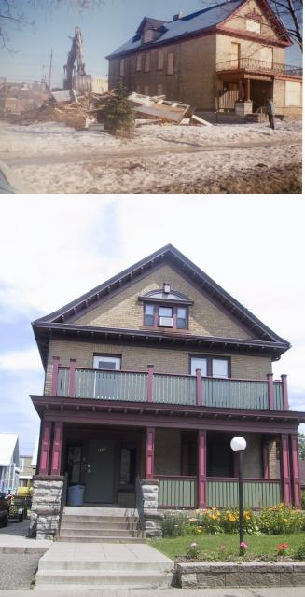
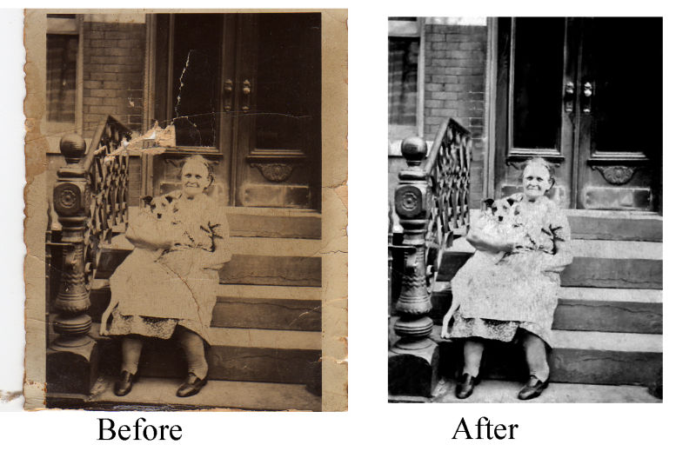
Positive Externalities a beneficial side effect of economic activity

Slide 12
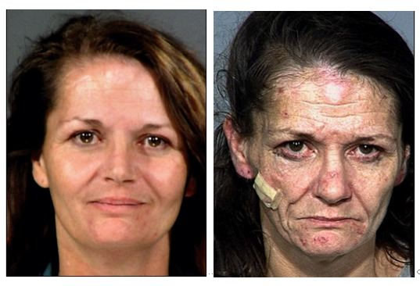
Negative Externality: _____________________________________________
Drug Use – Environmental Issues (Radiation)

Slide 13
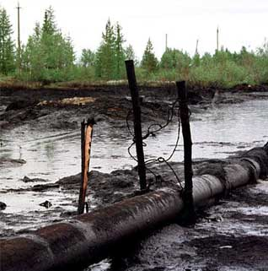
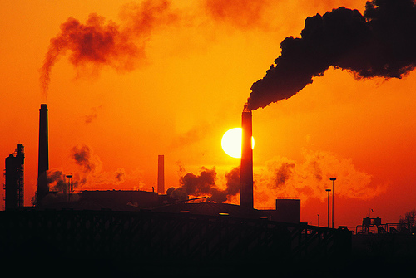
Negative Externality: a harmful side effect of economic activity
Pollution

Slide 14
EXTERNALITIES
DIRECTIONS: Create a list of the positive and negative externalities of the scenario below.
SCENARIO: The city of Ceres is deciding to purchase an abandoned business complex and the surrounding homes. The city wants to destroy the structures and turn the land into a recreational park for city dwellers, complete with baseball fields, basketball courts, tennis courts, a swimming pool, and a bicycle path. Some of the city leaders support the plan and others condemn it. Work with your pod to speculate on both sides of why some feel it is a good idea, and others feel it is not a good idea.
POSITIVE
NEGATIVE

Slide 15
CLOSURE: Chapter 3 Vocab Boxes
For each of the terms below, complete a Vocab box like seen to the right:
Profit Motive
Competition
Private Sector
Public Sector
Free Rider
VOCAB TERM
Definition in your own words | Picture, Logo, Cartoon to demonstrate definition
***Complete the Vocab Boxes on a separate
piece of paper in order to turn it in
DUE WEDNESDAY - 9/16

Slide 16
UNIT 1 TEST – Chapters 1-3 & 8
CHAPTER 1
Scarcity
Opportunity cost
Incentives
Entrepreneur
Factors of Production
Production Possibilities Curve
CHAPTER 3
Competition
Public goods
Role of government
Public safety & health
Safety Net
Externality
Free Rider
CHAPTER 2
Impact of Technology
Specialization
Free Market advantages
Centrally Planned characteristics
Factor & Product market
3 Economic Questions
Why is the “customer always right”?
CHAPTER 8
Sole proprietorship
Partnership
Corporation
Franchise
ESSAY QUESTION: Describe the economic system of the United States.
- Free Market characteristics
- Role of the entrepreneurs
- Role the American Government plays

