Slide 1
Wednesday September 16, 2015 Mr. Goblirsch – Economics
OBJECTIVE – Students Will Be Able To – SWBAT:
- Explain the role of the government in the American free enterprise system.
AGENDA:
WARM-UP: Case Study Questions
CONCEPT: Externalities
GROUPS: Externalities
ASSIGNMENT: Chapter 3 Vocab Boxes – DUE TODAY
***Unit 1 Test TOMORROW 9/17 (Chapters 1, 2, 3, & 8)***
Case Study Questions WARM-UP: (Follow the directions below)
***5 minutes***
Read the Real Life Case Study “Government & the Interstate Highway System” on P. 71. Answer the questions.
Answer Applying Economic Ideas Question #1
Answer Applying Economic Ideas Question #2

Slide 2
Chapter 3: American Free Enterprise
◆ Benefits of Free Enterprise
❖ Promoting Growth & Stability
⬥ Providing Public Goods
 Providing a Safety Net

Slide 3
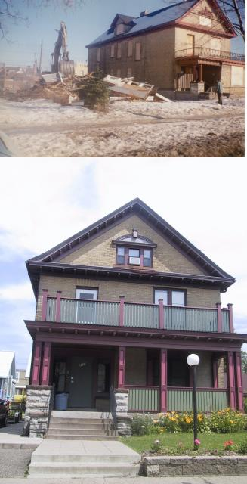
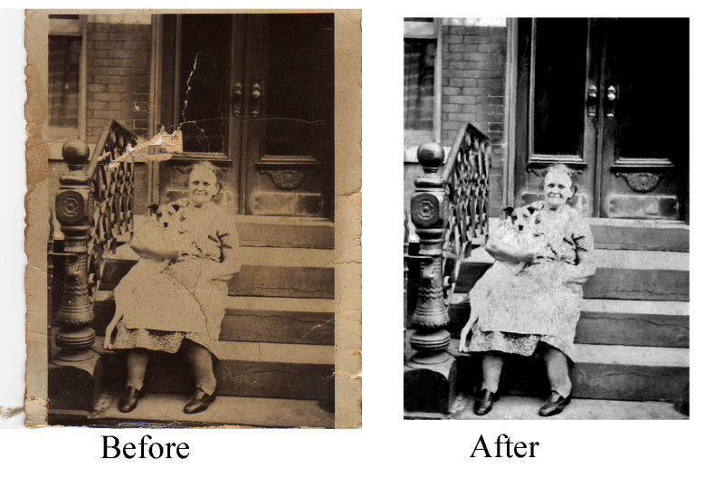
Positive Externalities a beneficial side effect of economic activity

Slide 4
STRUCTURED ACADEMIC DISUSSION
Think about the Highway System case study we read about for the Warm-Up.
What are some positive externalities of the government providing the public good of a highway system?
A positive externality of the highway system is …

Slide 5
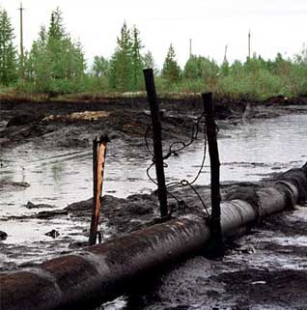
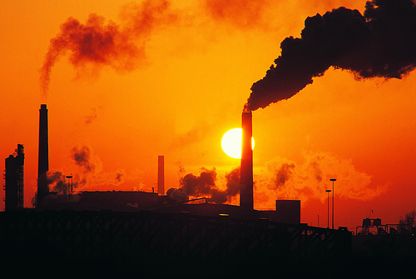
Negative Externality: a harmful side effect of economic activity
Pollution

Slide 6
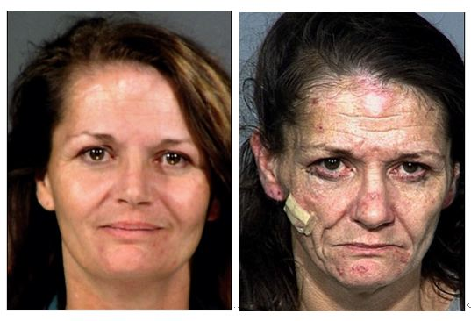
Negative Externality: _____________________________________________
Drug Use – Environmental Issues (Radiation)

Slide 7
STRUCTURED ACADEMIC DISUSSION
Think about the Highway System case study we read about for the Warm-Up.
What are some negative externalities of the government providing the public good of a highway system?
A negative externality of the highway system is …

Slide 8
EXTERNALITIES
DIRECTIONS: Create a list of the positive and negative externalities of the scenario below. Cast your vote based on the chart.
SCENARIO: The city of Ceres is deciding to purchase an abandoned business complex and the surrounding homes. The city wants to destroy the structures and turn the land into a recreational park for city dwellers, complete with baseball fields, basketball courts, tennis courts, a swimming pool, and a bicycle path. Some of the city leaders support the plan and others condemn it. Work with your pod to speculate on both sides of why some feel it is a good idea, and others feel it is not a good idea.
POSITIVE
NEGATIVE

Slide 9
EXTERNALITIES
POSITIVE EXTERNALITIES
NEGATIVE EXTERNALITIES

Slide 10
CLOSURE: Chapter 3 Vocab Boxes
For each of the terms below, complete a Vocab box like seen to the right:
Profit Motive
Competition
Private Sector
Public Sector
Free Rider
VOCAB TERM
Definition in your own words | Picture, Logo, Cartoon to demonstrate definition
***Complete the Vocab Boxes on a separate
piece of paper in order to turn it in
DUE WEDNESDAY - 9/16

Slide 11
UNIT 1 TEST – Chapters 1-3 & 8
CHAPTER 1
Scarcity
Opportunity cost
Incentives
Entrepreneur
Factors of Production
Production Possibilities Curve
CHAPTER 3
Competition
Public goods
Role of government
Public safety & health
Safety Net
Externality
Free Rider
CHAPTER 2
Impact of Technology
Specialization
Free Market advantages
Centrally Planned characteristics
Factor & Product market
3 Economic Questions
Why is the “customer always right”?
CHAPTER 8
Sole proprietorship
Partnership
Corporation
Franchise
ESSAY QUESTION: Describe the economic system of the United States.
- Free Market characteristics
- Role of the entrepreneurs
- Role the American Government plays

