Slide 1
Monday September 21, 2015 Mr. Goblirsch – Economics
OBJECTIVE – Students Will Be Able To – SWBAT:
- Explain the law of demand and interpret a demand graph using demand schedules.
AGENDA:
WARM-UP: Demand Journal
CONCEPT: Demand
POLITICAL CARTOON: “I Demand!” (Google Classroom)
INDEPENDENT PRACTICE: Ch 4-1: Demand Vocab Boxes
INTRO: Business Project – DUE WEDNESDAY 10/7
***Business Project DUE WEDNESDAY Oct 7***
– Make sure you complete Part 1 & Part 2 of the Business Project
Demand Journal WARM-UP: (Follow the directions below)
***5 minutes***
Write a paragraph journal entry on the topic below.
When you go shopping for new clothes, what is the most important thing when you consider buying something new? Is it price, style, brand, fit, or something else? Explain your answer.

Slide 2
Chapter 4: Demand
Section 1: Understanding Demand
Section 2: Shifts of the Demand Curve
Section 3: Elasticity of Demand

Slide 3
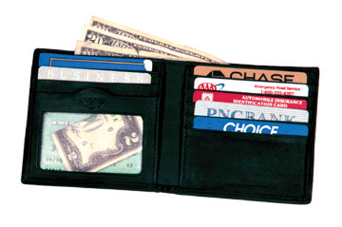
Section 1: Understanding Demand
Demand
Two Parts:
The desire to own something.
❖ The Ability to pay for it.

Slide 4
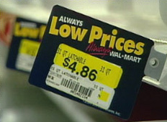
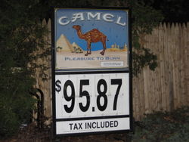
Section 1: Understanding Demand
The Law of Demand
When a good’s price is lower, consumers will buy more of it.
I like low prices!!
It costs too much! I’m going to quit!!!
When a good’s price is higher, consumers will buy less of it.
P$ = QD
P$ = QD

Slide 5
Demand Schedules & Graphs
Demand Schedule
Price of of a slice of pizza | Quantity Demanded
Demand Graph
Price
$3.00
$2.50
$2.00
$1.50
$1.00
$0.50
$0.50
5
$1.00
4
$1.50
3
$2.00
2
$2.50
1
D
$3.00
0
0 1 2 3 4 5 Q

Slide 6
“I DEMAND” Cartoon
Read through the cartoon
Highlight economic terms/concepts that you see in the cartoon
DISCUSS THIS QUESTION:
How did Calvin misinterpret the economic concept of Demand?

Slide 7
INDEPENDENT PRACTICE: Chapter 4-1: DemandVocab Boxes
For each of the terms below, complete a Vocab box like seen to the right:
Demand
Law of Demand
Substitution effect
Income effect
VOCAB TERM
Definition in your own words | Picture, Logo, Cartoon to demonstrate definition
***Complete the Vocab Boxes on a separate
piece of paper in order to turn it in
DUE WEDNESDAY - 9/23

