Slide 1
Wednesday September 23, 2015 Mr. Goblirsch – Economics
OBJECTIVE – Students Will Be Able To – SWBAT:
- Describe the substitution and income effects on demand and graph a market demand curve.
AGENDA:
WARM-UP: Price Changes Journal
READING: Chapter 4-1 Summary (Google Classroom)
CONCEPT: Changes in Demand
GUIDED PRACTICE: Analyzing & Graphing Demand
INDEPENDENT PRACTICE: Ch 4-1: Demand Vocab Boxes
*Business Project DUE WEDNESDAY Oct 7*
– Make sure you complete Part 1 & Part 2 of the Business Project
Price Changes Journal WARM-UP: (Follow the directions below)
***5 minutes***
Critical Thinking: Answer the question below.
Why does the price of a good or service change sometimes when the good or service does not change, only the price? How does this make sense? Explain

Slide 2
DEMAND SUMMARY READING
READING QUESTIONS
GRAPH QUESTIONS
According to the law of demand, a fall in the price of milk has what effect on the amount of milk people will buy?
What does a demand curve show?
At $0.50 per slice, what is the quantity demanded for pizza per day?
Assume the price of pizza rose from $0.50 per slice to $2.00 per slice. Would the quantity demanded increase or decrease? How much?

Slide 3
Chapter 4: Demand
Section 1: Understanding Demand
Section 2: Shifts of the Demand Curve
Section 3: Elasticity of Demand

Slide 4
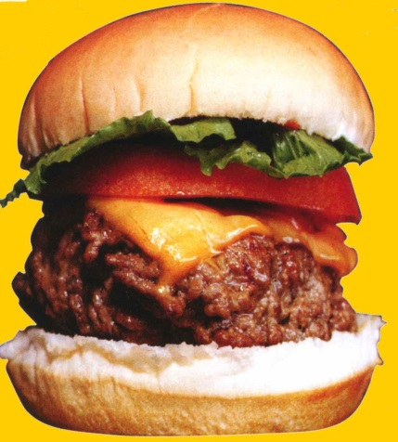
Changes in Demand: Substitutes can be used in the place of another good when prices change.
or
or

Slide 5
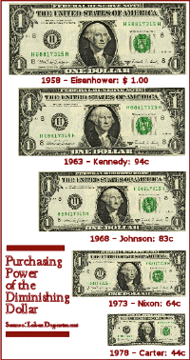
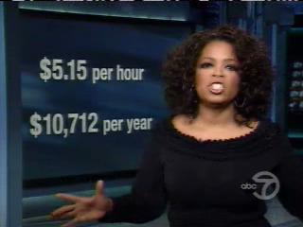
Changes in Demand: A person’s demand for an item can be effected by their income.
Income can drop due to inflation or their actual income can increase or decrease.

Slide 6
Demand Schedules & Graphs
Demand Schedule
Price of of a slice of pizza | Quantity Demanded
Demand Graph
Price
$3.00
$2.50
$2.00
$1.50
$1.00
$0.50
$0.50
5
$1.00
4
$1.50
3
$2.00
2
$2.50
1
D
$3.00
0
0 1 2 3 4 5 Q

Slide 7
Change in the Quantity Demanded Movement along the Demand Curve
$10
$9
$8
$7
$6
$5
$4
$3
$2
$1
$0
D1
0 1 2 3 4 5 6 7 8 9 10

Slide 8
Section 1-15
Demand and Marginal Utility
Marginal utility is the extra usefulness or satisfaction a person receives from getting or using one more unit of a product. 
The principle of diminishing marginal utility states that the satisfaction we gain from buying a product lessens as we buy more of the same product.

Slide 9
Analyzing Demand: Substitution & Income Effects
DIRECTIONS: Analyze the Chart on P. 80 & 81
(P. 80) Describe how a rise in the price of A affects the consumption of other goods based on the income effect.
(P. 80) Describe how a decrease in the price of A affects the consumption of other goods based on the substitution effect.
(P. 80) Explain the difference between the income effect and the substitution effect.
(P. 81) What is the difference between an individual demand schedule & a market demand schedule?
(P. 81) How does the market demand for pizza change when the price falls from $2.50 to $1.00 per slide?

Slide 10
INDEPENDENT PRACTICE: Chapter 4-1: Demand Vocab Boxes
For each of the terms below, complete a Vocab box like seen to the right:
Demand
Law of Demand
Substitution effect
Income effect
VOCAB TERM
Definition in your own words | Picture, Logo, Cartoon to demonstrate definition
***Complete the Vocab Boxes on a separate
piece of paper in order to turn it in
DUE TODAY

