Slide 1
Friday September 24, 2015 Mr. Goblirsch – Economics
OBJECTIVE – Students Will Be Able To – SWBAT:
- Analyze the Dow to determine if stock values increased or decreased.
- Identify the law of demand and graph changes in quantity demanded.
AGENDA:
WARM-UP: Pay Day
COMPETITION: The DOW Stock Simulation Week 6
VIDEO CLIP: Crash Course Economics: Supply & Demand
GRAPHING: Demand Curve
Pay Day WARM-UP: (Follow the directions below)
***5 minutes***
Take out and sign-in to your ChromeBook.
Go to Google Classroom and open the Weekly Time Sheet.
Complete the Time Sheet form for this week’s pay check. REMEMBER: Our current Tax Rate is 28%, so put 0.28 in the TAX RATE column (The Sheriff will be coming around to make sure it’s accurate)
Make your weekly deposit in your Account. (The Clerk will be coming around to stamp your account forms)

Slide 2
COMPETITION: Tracking The DOW
Use one of the following websites to track the current price for your 5 DOW stocks:
finance.yahoo.com
money.cnn.com
marketwatch.com
google.com/finance
Get a “live” current price for your 5 DOW stocks
Go to your Stock Simulation sheet in Google Classroom, “UNSUBMIT” from last week
Fill out your Stock sheet for Week 6 by typing the price into the column “Price Per Share Week 6”
Each week, the 3 students who have the highest “CHANGE from LAST WEEK” will receive an individual bonus

Slide 3
Figure 4.3
Change in Quantity Demanded

Slide 4
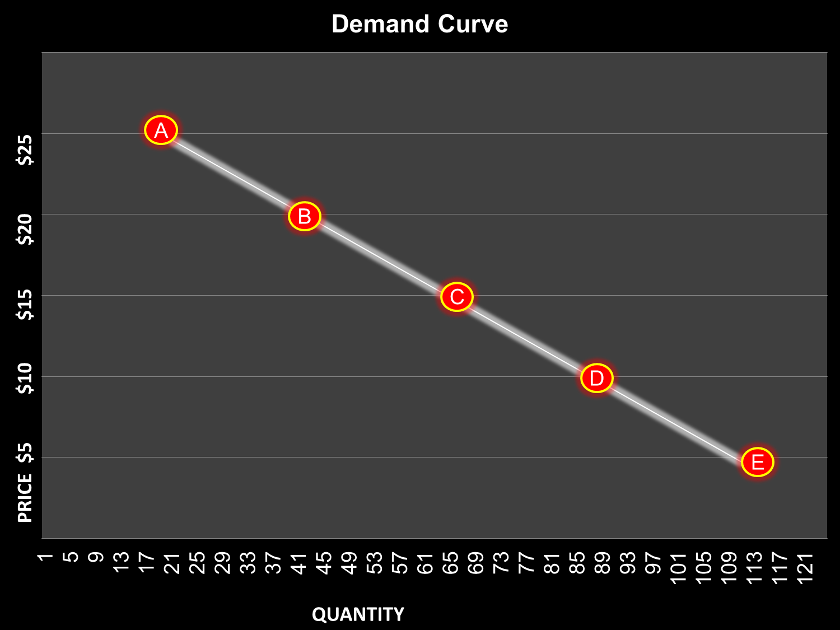
Demand Curve
DEMAND SCHEDULE
PRICE ($) | Quantity Demanded
$5 | 500
$10 | 395
$15 | 275
$20 | 125
$25 | 50
Draw the Demand Curve to the right on your graph paper 2 separate times. Draw the curve and the points A - E
50
125
275
395
500

Slide 5
Increase in Quantity Demanded
Draw an arrow from one point to another representing an increase in the quantity demanded.
DEMAND SCHEDULE
PRICE ($) | Quantity Demanded
$5 | 500
$10 | 395
$15 | 275
$20 | 125
$25 | 50
50
125
275
395
500

Slide 6
Decrease in Quantity Demanded
Draw an arrow from one point to another representing a decrease in the quantity demanded.
DEMAND SCHEDULE
PRICE ($) | Quantity Demanded
$5 | 500
$10 | 395
$15 | 275
$20 | 125
$25 | 50
50
125
275
395
500

Slide 7
Analyzing Demand: Substitution & Income Effects
DIRECTIONS: Analyze the Chart on P. 80 & 81
(P. 80) Describe how a rise in the price of A affects the consumption of other goods based on the income effect.
(P. 80) Describe how a decrease in the price of A affects the consumption of other goods based on the substitution effect.
(P. 80) Explain the difference between the income effect and the substitution effect.
(P. 81) What is the difference between an individual demand schedule & a market demand schedule?
(P. 81) How does the market demand for pizza change when the price falls from $2.50 to $1.00 per slide?

