Slide 1
Monday September 28, 2015 Mr. Goblirsch – Economics
OBJECTIVE – Students Will Be Able To – SWBAT:
- Identify the factors of a change in demand, and the difference between a change in quantity demanded vs a change in demand.
AGENDA:
WARM-UP: Creating Demand Journal
PRIOR KNOWLEDGE: Change in Quantity Demanded
CONCEPT: Changes in Demand
GROUPS: “Blast from the Past” Activity
*Business Project DUE WEDNESDAY Oct 7*
– Make sure you complete Part 1 & Part 2 of the Business Project
Creating Demand Journal WARM-UP: (Follow the directions below)
***5 minutes***
Write a paragraph journal entry answering the questions below.
What is demand?
How do companies try to create demand for their products?
How do sales/clearance at a store affect consumers? Do you tend to make more purchases during sales/clearance? How come or why not?

Slide 2
Factors Affecting Demand
Chapter 4 Section 2

Slide 3
PRIOR KNOWLEDGE Change in the Quantity Demanded
Movement along the demand curve
Income changes and potential alternative goods and services can cause this
The Income/Substitution Effect
Income Effect
Change in price alters a persons real income
Substitution Effect
Quantity demanded changes as price of substitutes or trade-offs incr./decr.
EX) Rise in the ticket prices for an NFL team = change in quantity demanded (possibly because of the availability of NFL Sunday Ticket = Substitute)

Slide 4
Change in Demand
A change in demand is when people buy different amounts of the product at the same prices.
The willingness to buy a certain product changes even though there is no price change

Slide 5
Factors Affecting Demand
Two factors that affect demand of a good or service
Change in the quantity demanded (Price changes)
Change in the demand (Price stays the same)
What is the difference between these?

Slide 6
STRUCTURED ACADEMIC DISCUSSION
A change in demand and change in quantity demanded are different because …

Slide 7
Section 2-10
Change in Demand (cont.)

Slide 8
Shift in Demand—Increase
$10
$9
$8
$7
$6
$5
$4
$3
$2
$1
$0
D₂
D₁
0 1 2 3 4 5 6 7 8 9 10

Slide 9
Shift in Demand—Decrease
$10
$9
$8
$7
$6
$5
$4
$3
$2
$1
$0
D₂
D₁
0 1 2 3 4 5 6 7 8 9 10

Slide 10
STRUCTURED ACADEMIC DISCUSSION
With an increase in demand, the demand curve will shift to the ________
With a decrease in demand, the demand curve will shift to the ________

Slide 11
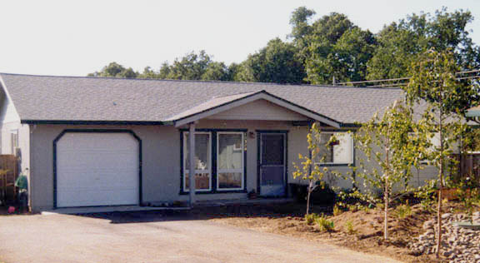
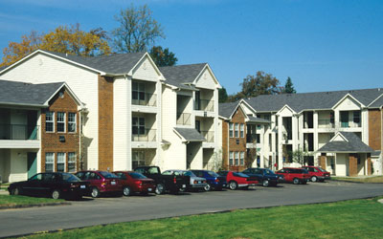
What Causes a Shift?  Income
or
or

Slide 12
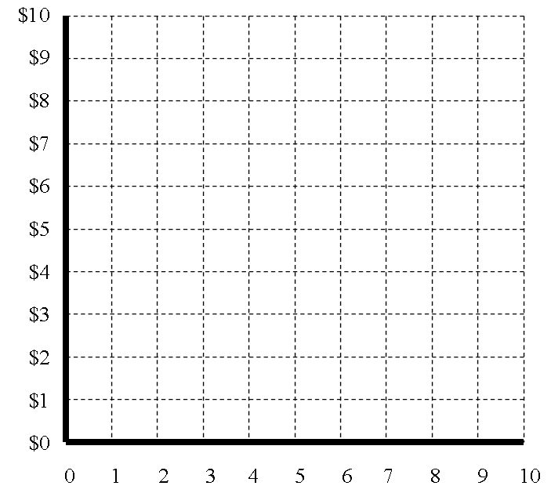
Demand for Homes
Income Increases
In $10,000 increments
D₂
D₁

Slide 13
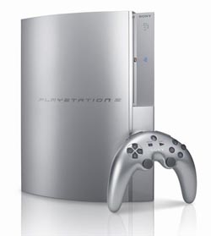
What Causes a Shift?  Consumer Expectations
Should I wait or should I buy now?

Slide 14
Demand for Cell Phones (iPhone 4, 5, 6), because of the Expectations for iPhone 6s
In $100 increments
D₁
D₂

Slide 15
STRUCTURED ACADEMIC DISCUSSION
Why might demand for the iPhone 5 & 6 have dropped before the new iPhone 6s comes out?

Slide 16
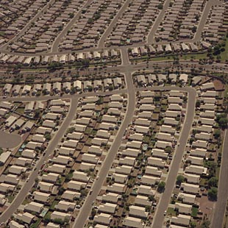
⬥ Population
1968—200 Million
2006—300 Million
2020-2030—400 Million
➢As Population grows so does demand.
➢more people to feed, clothe, and shelter

Slide 17
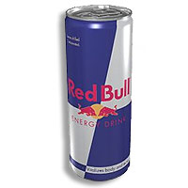
 Consumer Tastes & Advertising
What is cool?
What is the new thing?
It is always changing.

Slide 18
Demand for “Red Bull”
Consumer Taste & Advertising
Which way will Red Bull fly?
In $10 increments
D₂
D₁

Slide 19
STRUCTURED ACADEMIC DISCUSSION
Companies will spend millions of dollars on advertising because …

Slide 20
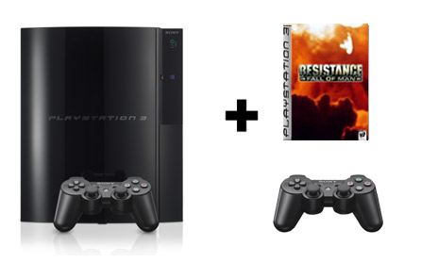
Price of Related Goods
◆ Complements—Two goods that are bought & sold together.
❖ Substitutes—Goods that are used in place of one another.
&

Slide 21
STRUCTURED ACADEMIC DISCUSSION
A complement good is …

Slide 22
“Blast From The Past” Assignment
Create a list of 8 items (2 per each member of the pod) from the past decade or two that were once the most demanded product in its genre that are no longer at the top…
Product choices can be anything from clothing to food to cars…anything goes
Once a list is created give a brief explanation of why the product is no longer number one in its particular market…
Was it a marketing flaw?
Is there a better alternative choice?
Did peoples income changes cause it?
Maybe it’s a combination of several factors…be specific
SUMMARY OF DIRECTIONS: 2 Parts
Part 1 – List Product
Part 2 – Description of why product is no longer in demand

