Slide 1
Wednesday September 30, 2015 Mr. Goblirsch – Economics
OBJECTIVE – Students Will Be Able To – SWBAT:
- Describe the concept of demand elasticity and determine if a good is elastic, inelastic, or unitary elastic.
AGENDA:
WARM-UP: Demand Elasticity Vocab
VIDEO CLIP: Demand: The Economic Lowdown (6 min)
CONCEPT: Elasticity of Demand
VIDEO CLIP: Micro 2.9 Elasticity & Total Revenue Test (7 min)
ASSIGNMENT: Ch 4-3 Worksheet (Google Classroom)
***Chapter 4 – Demand Quiz NEXT TUESDAY***
Demand Elasticity Vocab WARM-UP: (Follow the directions below)
***5 minutes***
Define the terms below using the glossary of your textbook.
Ceteris paribus 4) Elastic
Inferior good 5) Inelastic
Elasticity of demand

Slide 2
Chapter 4: Demand
Section 1: Understanding Demand
Section 2: Shifts of the Demand Curve
Section 3: Elasticity of Demand

Slide 3
Section 3: Elasticity of Demand
How consumers respond to a change in Price.
Elastic
Demand is very responsive to change in price.
Inelastic
Demand is not very responsive to a change in price.
Unitary Elastic
A change in price is equal to the change in quantity demanded

Slide 4
Determinants of Elasticity
Three Questions that can help determine if a product is Elastic or Inelastic
Can the purchase be delayed?
Are adequate substitutes available?
Does the purchase use a large portion of the income?

Slide 5
Factors Affecting Elasticity
Needs (Inelastic) vs. Wants (Elastic)
Necessity Versus Luxuries
➢Necessities are always bought
➢ Luxuries can be cut back on/delayed
VS.

Slide 6
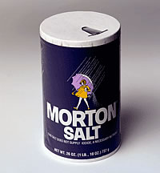
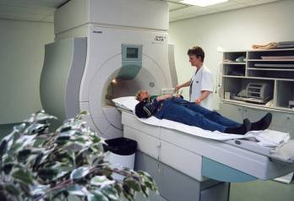
Factors Affecting Elasticity
Availability of Substitutes
➢ Few choices
 Gasoline
 Medical care
 Salt

Slide 7
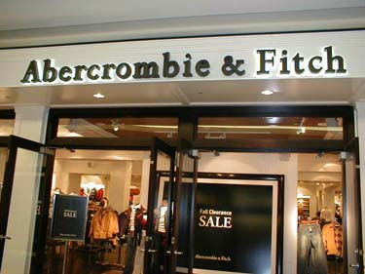
Factors Affecting Elasticity
Relative Importance
➢ Thinking at the margin
➢ Will a price increase change how much you buy?

Slide 8
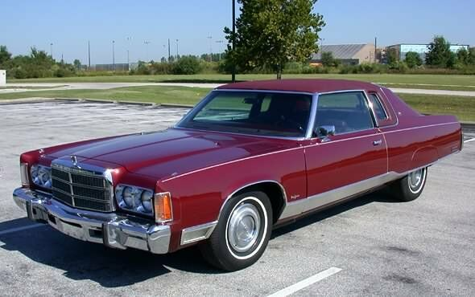
Factors Affecting Elasticity
Change Over Time
➢ High Prices will cause people to look for alternatives or efficiency.
8-12 MPG

Slide 9
Focus Activity 3.1
Elasticity = % change QD
% change P$
>1 = Elastic Demand
<1 = Inelastic Demand
=1 = Unit Elastic Demand

Slide 10
II. Total Expenditures Test
P$ X QD = total expenditures.
if the price changes and expenditures move in opposite directions on the demand curve, demand is elastic
same direction, demand is inelastic
no change, demand is unit elastic

Slide 11
Section 3-9
The Total Expenditures Test (cont.)

Slide 12
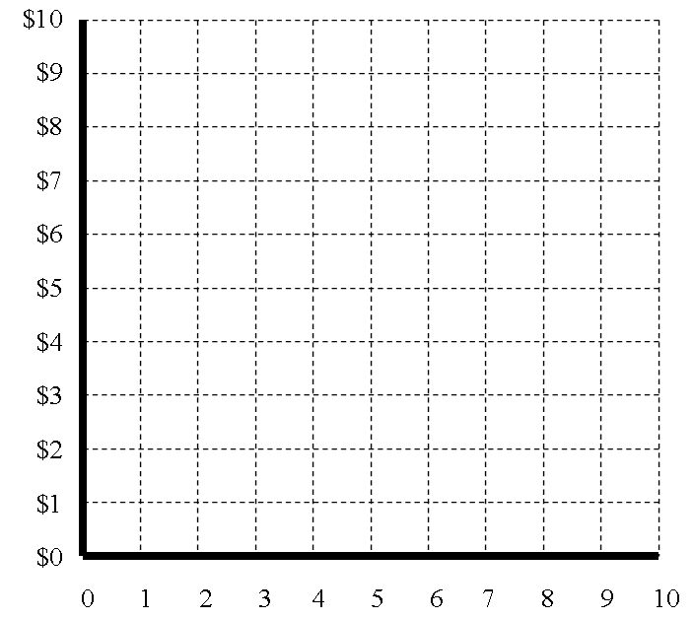
Elastic
Inelastic
$6 X 5= $30
$5 X 8.5= $42.50
$6 X 3.5= $21
$4 X 4= $16

