Slide 1
Tuesday October 13, 2015 Mr. Goblirsch – Economics
OBJECTIVE – Students Will Be Able To – SWBAT:
- Graph a change in quantity supplied and a change in supply.
AGENDA:
WARM-UP: Supply in Capitalism
CONCEPT: Changes in Supply & Elasticity (PearDeck)
GUIDED PRACTICE: Graphing Supply
INDEPENDENT PRACTICE: Workbook P. 31
CLOSURE: Supply Changes Review
Supply in Capitalism WARM-UP: (Follow the directions below)
***5 minutes***
Write a paragraph journal entry addressing the topic below.
In the U.S. we have a free enterprise Capitalist economic system. Some of the characteristics of Capitalism are economic freedom, self-interest, and profit motive. Explain how these characteristics are involved in the law of supply.

Slide 2
CHANGES IN Supply & ELASTICITY
Chapter 5 Section 1

Slide 3
Supply Changes
Change in Quantity Supplied = change in the amount offered for sale in response to a change in price
Change in Supply = situation where suppliers offer different amount of products for sale at the same prices

Slide 4
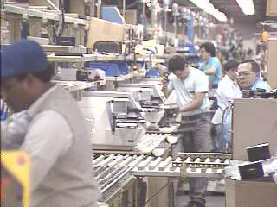
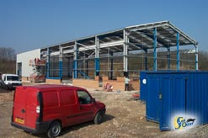
Elasticity of Supply & Time
Short Run
➢ Fairly inelastic
➢ Hire more workers
Overtime pay
Long Run
More elastic
Expand Production

Slide 5
Pizza Supply Schedule
INDIVIDUAL
SUPPLY CURVE
Price per Slice
Slices Supplied
Price ($P) DECREASE =
DECREASE In
Quantity Supplied (QS)
Movement along the Supply
Curve to the Left
$3.00
$2.50
$2.00
$1.50
$1.00
$0.50
$0.50
100
Change in Quantity Supplied (QS) is shown by movement along the Supply Curve
$1.00
150
$1.50
200
Price ($P) INCREASE =
INCREASE In
Quantity Supplied (QS)
Movement along the Supply
Curve to the Right
$2.00
250
S₁
$2.50
300
$3.00
350
50 100 150 200 250 300 350

Slide 8
Pizza Supply Schedule
MARKET
SUPPLY CURVE
Price per Slice
Slices Supplied
Change in Supply creates a shift of the Supply curve
$3.00
$2.50
$2.00
$1.50
$1.00
$0.50
DECREASE in Supply creates a Shift of the Supply Curve to the LEFT
$0.50
1,000
$1.00
1,500
$1.50
2,000
$2.00
2,500
INCREASE in Supply creates a Shift of the Supply Curve to the RIGHT
S₁
$2.50
3,000
$3.00
3,500
500 1000 1500 2000 2500 3000 3500

Slide 11
SUPPLY CHANGES REVIEW
A change in quantity supplied occurs when …
A change in supply occurs when …
An _______ in supply occurs when the curve shifts to the ______

