Slide 1
Wednesday October 14, 2015 Mr. Goblirsch – Economics
OBJECTIVE – Students Will Be Able To – SWBAT:
- Describe the factors that impact supply.
AGENDA:
WARM-UP: Demand vs. Supply
REVIEW: Demand & Supply Graphs (Google Form)
CONCEPT: Changes in Supply
ASSIGNMENT: Workbook P. 31
***Workbook P. 31 DUE TOMORROW***
Demand vs. Supply WARM-UP: (Follow the directions below)
***5 minutes***
Write a paragraph journal entry answering the following question.
Compare the concept of Demand to the concept of Supply.
How are they different?

Slide 2
_________ Schedules & Graphs
Schedule
Price of of a slice of pizza | Quantity
Graph
Price
$3.00
$2.50
$2.00
$1.50
$1.00
$0.50
$0.50
5
$1.00
4
$1.50
3
$2.00
2
$2.50
1
$3.00
0
0 1 2 3 4 5 Q

Slide 3
Pizza Schedule
Price per Slice
Quantity
$3.00
$2.50
$2.00
$1.50
$1.00
$0.50
$0.50
100
$1.00
150
$1.50
200
$2.00
250
$2.50
300
$3.00
350
50 100 150 200 250 300 350

Slide 4
Change Movement along the Curve
$10
$9
$8
$7
$6
$5
$4
$3
$2
$1
$0
0 1 2 3 4 5 6 7 8 9 10

Slide 5
Pizza Schedule
Price per Slice
Quantity
$3.00
$2.50
$2.00
$1.50
$1.00
$0.50
$0.50
100
$1.00
150
$1.50
200
$2.00
250
$2.50
300
$3.00
350
50 100 150 200 250 300 350

Slide 6
$10
$9
$8
$7
$6
$5
$4
$3
$2
$1
$0
0 1 2 3 4 5 6 7 8 9 10

Slide 7
$10
$9
$8
$7
$6
$5
$4
$3
$2
$1
$0
0 1 2 3 4 5 6 7 8 9 10

Slide 8
Pizza Schedule
Price per Slice
Quantity
$3.00
$2.50
$2.00
$1.50
$1.00
$0.50
$0.50
1,000
$1.00
1,500
$1.50
2,000
$2.00
2,500
$2.50
3,000
$3.00
3,500
500 1000 1500 2000 2500 3000 3500

Slide 9
Supply change factors
Chapter 5 Section 3

Slide 10
Change in Supply
Change in Supply = situation where suppliers offer different amount of products for sale
Causes
Cost of Inputs
Productivity
Technology
Taxes and Subsidies
Subsidy = government payment to an individual or business to encourage economic activity

Slide 11
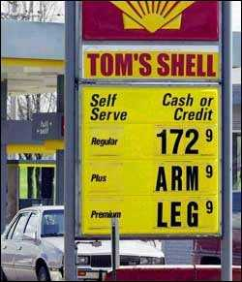
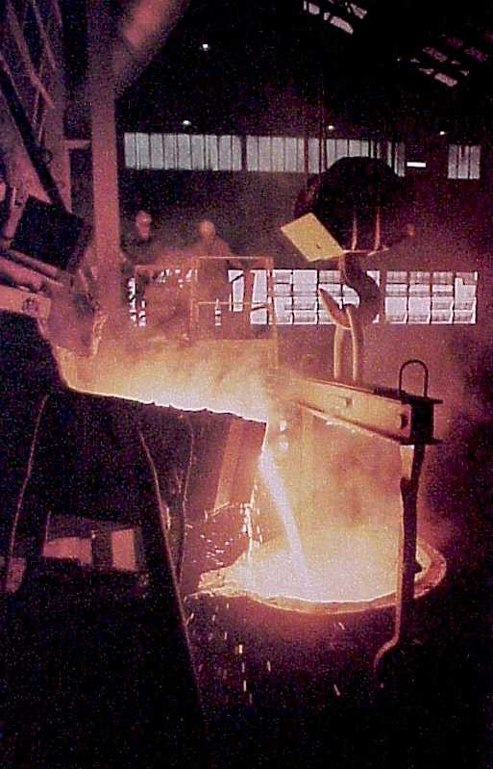
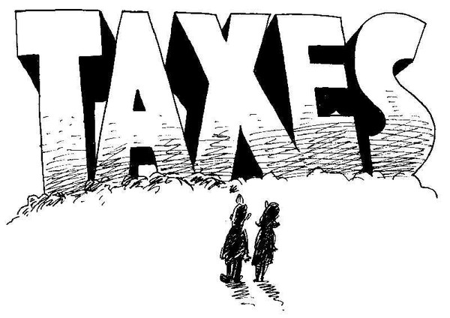
Input Costs
Effects of Rising Costs
➢ If costs go up, then it costs more to produce G & S
CA minimum wage increase and price increase.

Slide 12
Effects of Rising Costs
$10
$9
$8
$7
$6
$5
$4
$3
$2
$1
$0
S₂
S₁
D₁
0 1 2 3 4 5 6 7 8 9 10

Slide 13
STRUCTURED ACADEMIC DISCUSSION
An example of an input cost that might cause a decrease in supply is …

Slide 14
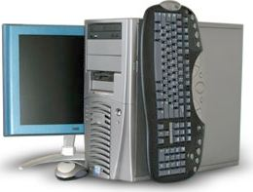
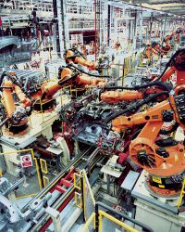
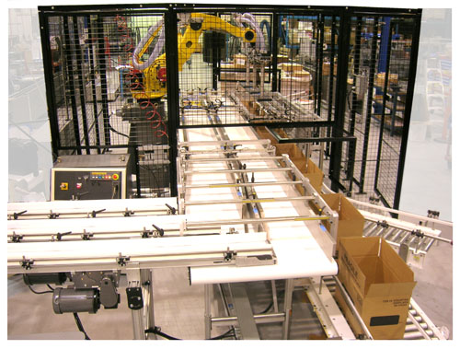
Input Costs
Technology
Lowers costs
Increases Supply

Slide 15
Technology How does an increase in technology effect supply?
$10
$9
$8
$7
$6
$5
$4
$3
$2
$1
$0
S₁
D₁
S₂
0 1 2 3 4 5 6 7 8 9 10

Slide 16
STRUCTURED ACADEMIC DISCUSSION
An example of an input cost that might cause an increase in supply is …

Slide 17
Government’s Influence on Supply
Subsidies: Gov. payment to support a business
➢ Farms
➢ Infant industries
Taxes: Gov.uses to discourage some industries
➢ Tobacco
➢ Gasoline
Regulation: Gov intervention in the market that affects the price, quantity, or quality of a good.
➢ Fight Pollution
➢ Benefit Health

Slide 18
STRUCTURED ACADEMIC DISCUSSION
The government can influence supply by …

Slide 19
Other Influences on Supply
Future Expectations of Price
 Price to rise in the future—hold product & sell later.
 Price to fall in the future—sell now
Number of Suppliers
☞ If the number of suppliers increases so does supply
☞ If the number of suppliers decreases so does supply.

