Slide 1
Thursday August 20, 2015 Mr. Goblirsch – Economics
OBJECTIVE – Students Will Be Able To – SWBAT:
- Describe the economic goals & societal values that a country strives for.
AGENDA:
WARM-UP: Opp. Cost Review
CONCEPT: Economic Goals
ASSIGNMENT: Ch 1 Workbook Pages
CLOSURE: What I need to Know for Tomorrow’s Quiz
***HW Week 2 – DUE TOMORROW – Ch 1 Workbook Pages
*****Chapter 1 Quiz TOMORROW*****
***Select stocks for DOW Stock Simulation - TOMORROW
Opp. Cost Review WARM-UP: (Follow the directions below)
***5 minutes***
Answer the following in a paragraph.
If your best friend asked you to borrow $100, would you loan it to them? Why or Why not?
Regardless of your answer to Part 1, if you DID loan your friend a $100 and he/she paid you back one year later, what was the opportunity cost of lending your friend the money?

Slide 2
Economic Goals & Societal Values
 Economic Efficiency
 Economic Freedom
● Economic Security & Predictability
❍ Economic Equity
■ Economic Growth & Innovation
□ Additional Goals

Slide 3
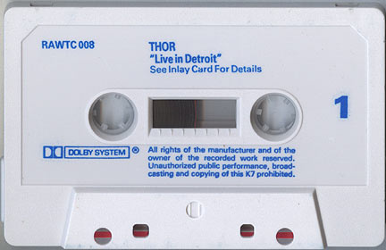
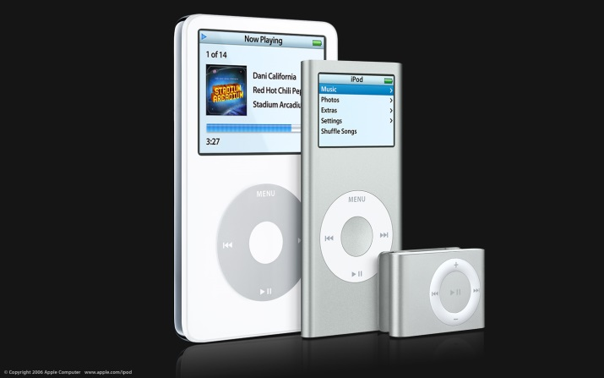
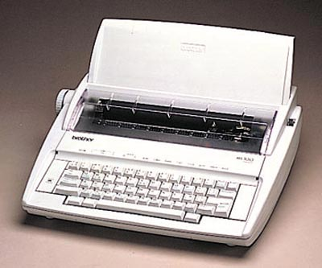
 Economic Efficiency
Society must maximize its scarce resources by accurately assessing:
“What to Produce?”
➢CDs or cassette tape
➢typewriters or computers

Slide 4
STRUCTURED ACADEMIC DISCUSSION
What does the goal of economic efficiency mean?
Economic efficiency means …

Slide 5
HIGHER LEVEL THINKING
How can governments sometimes interfere with the economic goal of economic efficiency?

Slide 6
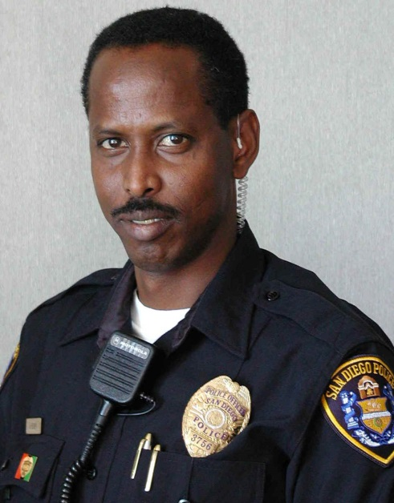
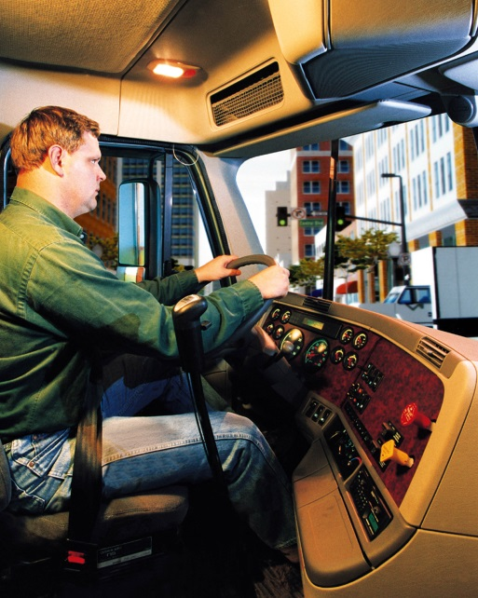
 Economic Freedom
You can be whatever you want to be

Slide 7
STRUCTURED ACADEMIC DISCUSSION
What does the goal of economic freedom mean?
Economic freedom means …

Slide 8
HIGHER LEVEL THINKING
How can governments sometimes interfere with the economic goal of economic freedom?

Slide 9
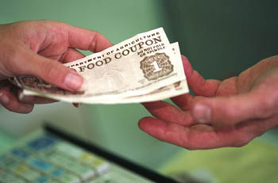
● Economic Security & Predictability
Economic Systems are there to ensure that people get what they want.
Government is there to ensure that we have safety nets to protect people in hard times.

Slide 10
STRUCTURED ACADEMIC DISCUSSION
What does the goal of economic security mean?
Economic security means …

Slide 11
HIGHER LEVEL THINKING
The goal of Economic Security often clashes with the goals of Economic Freedom and Economic Efficiency.
Explain why this statement is true.

Slide 12
❍ Economic Equity
Who gets paid what?
Discrimination?
Disabled?

Slide 13
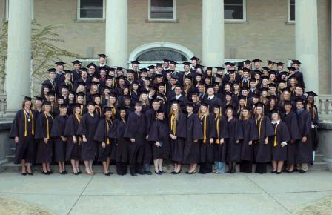
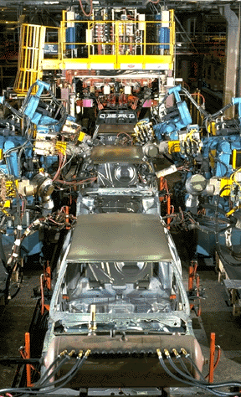
■ Economic Growth & Innovation
The economy must grow to create new jobs
innovations bring about efficiency and lowers prices

Slide 14
□ Additional Goals
Environmental Protections
Full Employment
Universal healthcare

Slide 15
CLOSURE: What Do I Need To Know For Tomorrow’s Quiz?
3 Basic Econ Questions
Factors of Production
Good vs. Service
Want vs. Need
Reading a Production Possibilities Curve
What’s the fundamental economic problem?
Opportunity cost
Relationship of Trade-Offs and Opportunity Costs

