Slide 1
Friday January 30, 2015 Mr. Goblirsch – U.S. History
OBJECTIVE – Students Will Be Able To – SWBAT:
Describe the cause & effects of the Great Depression.
AGENDA:
WARM-UP: Cause & Effect
VIDEO: America the Story of Us: Bust
INDEPENDENT: Finish Depression Review ?s
***Depression Review Questions DUE TODAY
Cause & Effect WARM-UP: (Follow the directions below)
***5 Minutes***
Use your notes and what we’ve covered this week to fill in the chart.
-
-
-
-
-
CAUSES:
1.
2.
EFFECTS:
1.
2.
GREAT
DEPRESSION

Slide 2
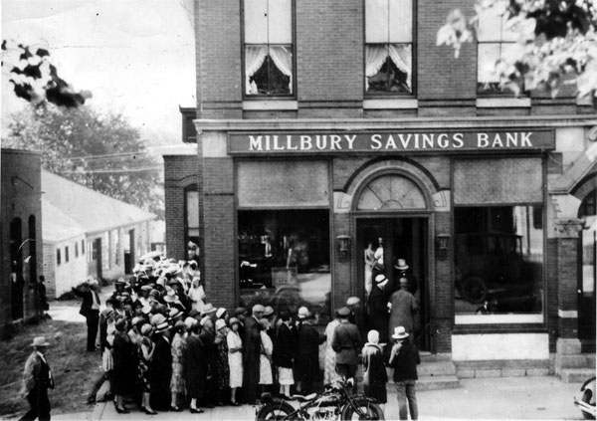
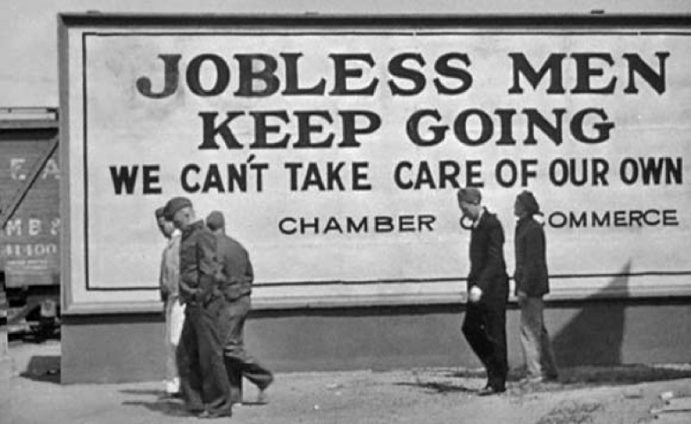
America Video: The Crash of 1929 and the Panic of 1930
Crash of 1929 (Oct. 1929)
Panic of 1930 (Dec. 1930)
Banks close
Mass home foreclosure
Mass unemployment

Slide 3
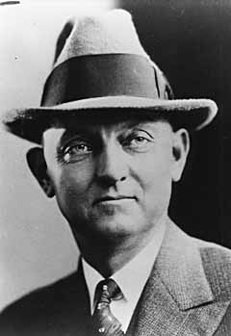
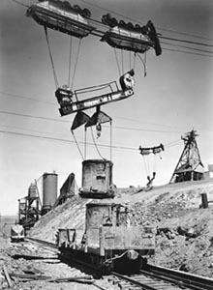
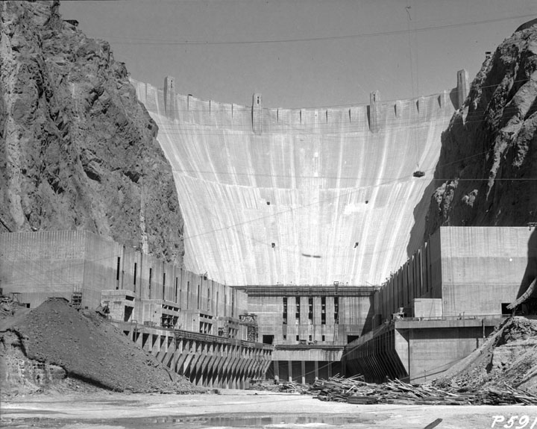
America Video: The Hoover Dam
Frank Crowe
Hoover Dam employment
Hoover Dam construction
Carbon monoxide poison
Las Vegas

Slide 4
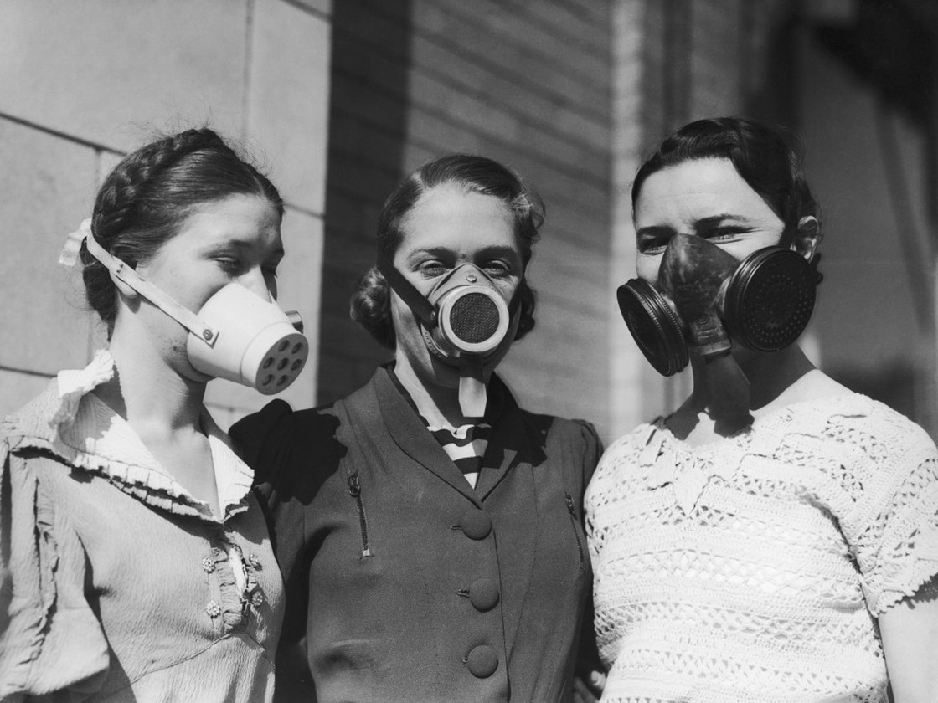
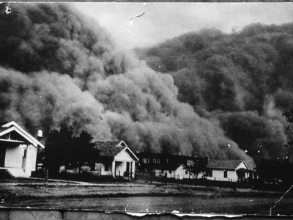
America Video: The Dust Bowl
Massive dust storm
Top soil from Great Plains
Respiratory problems
Darkness
Radio

Slide 5
Depression Review Questions
DIRECTIONS: After reading Ch. 14, answer the following questions.
***DUE FRIDAY***
“Economic Troubles on the Horizon”
Why did businesses fail after housing fell off?
Why did the farming industry grow weak?
Why did more Americans start living on credit?
Why did the uneven distribution of income affect producers of goods?
“The Crash”
Describe what happened on Black Tuesday.
Explain what a bank run is and the impact bank failures had on the American economy.
“Depression Impact”
Why were conditions for African Americans and Latinos especially difficult during the Depression?
What was the Dust Bowl and it’s impact?
Why were working women met with such resentment during the Depression?
How did the Depression affect the country’s children?
What social and psychological impact did the Depression have on Americans?

